Slide 1
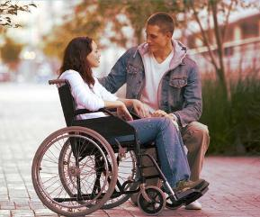
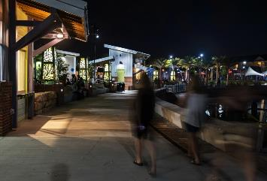
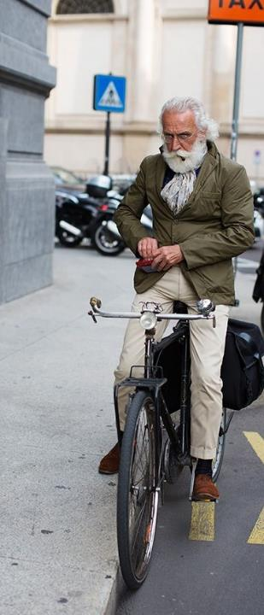
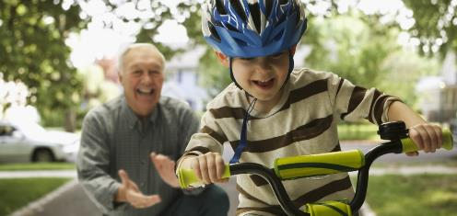
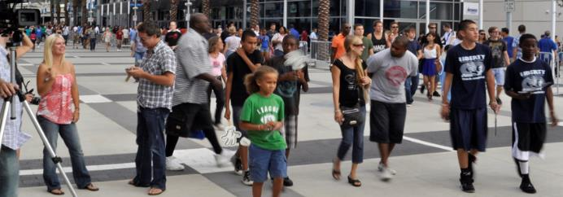
Community Engagement for Livable Communities
Pinellas County Economic Development Symposium
April 21, 2017
Kelly Morphy
Communications Director, Dix.Hite + Partners
Vice President of the Board, Walkable and Livable Communities Institute

Slide 2
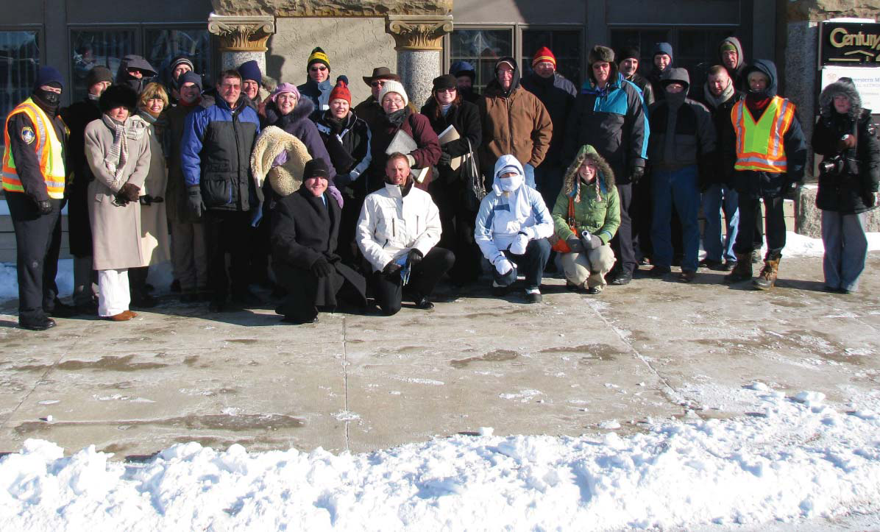
Notes:
Spent past ten years advancing walkability, bikeability, livability, healthy community design, vibrant downtowns and overall better built environments.
Brought to this effort experience and a background in outreach, communications and marketing from previous work done in the public and private sector.
Since then, built not just best practices, but “better practices,” and today is a time to share the highlights of lessons I’ve learned, observed, and downright stolen from others in the field who have been doing this work a long, long time.

Slide 3
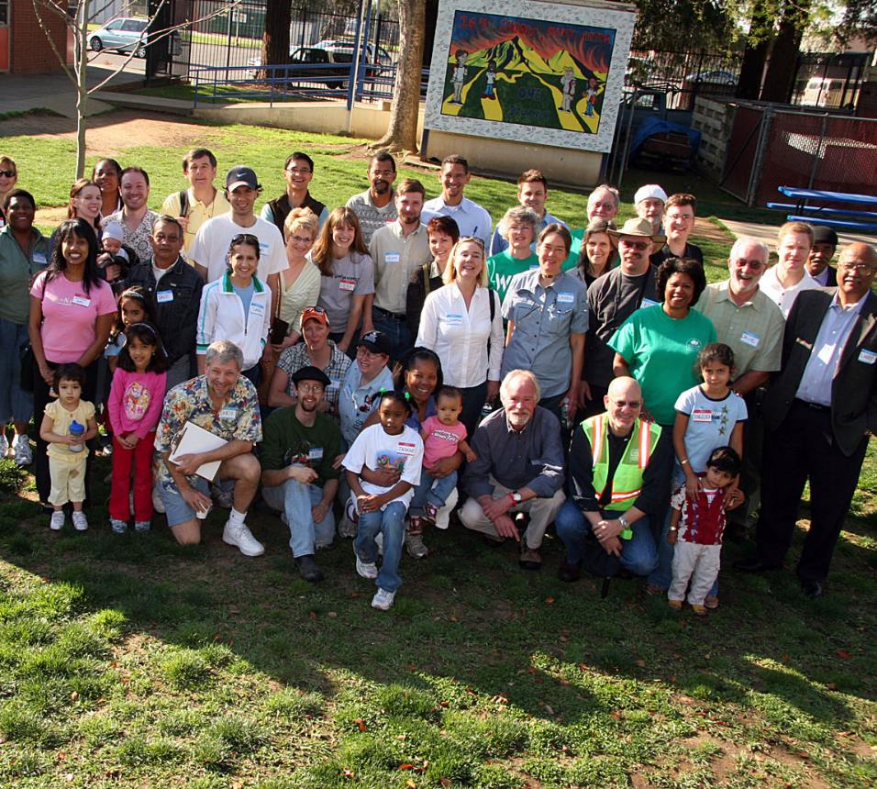

Slide 4
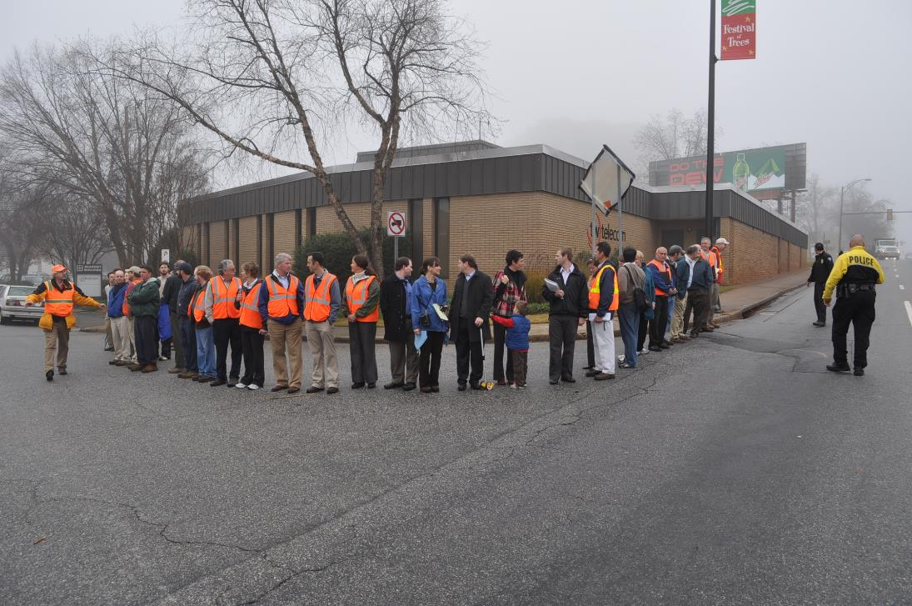

Slide 5
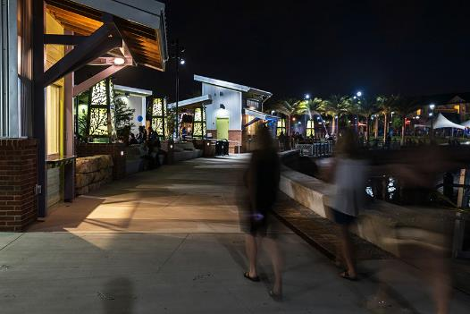

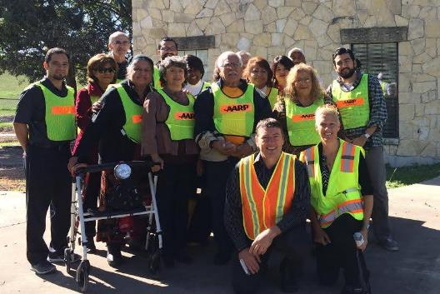
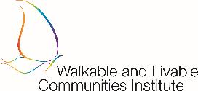
Longwood, Birmingham, Atlanta
www.DixHite.org
National 501c3 non-profit www.WalkLive.org

Slide 6
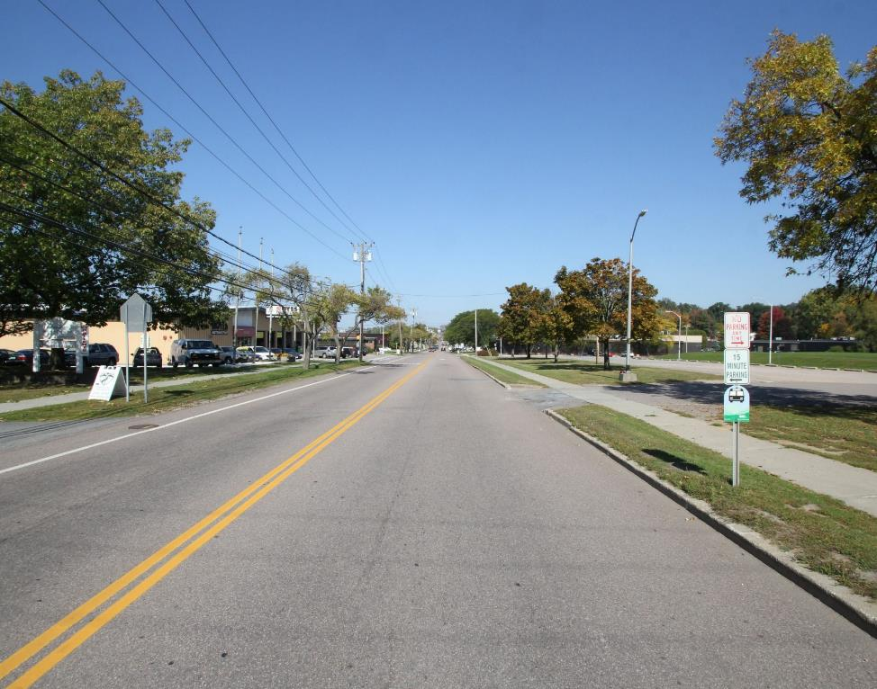
THE WORLD IS CHANGING
Notes:
Based on presentations yesterday and today, you don’t need to be persuaded that better connected, more dense, more livable, more sustainable also the most profitable and most beneficial, for municipalities and downtown distrits, as well as for human beings – residents – the stakeholders and constituents who live, work, play, worship, visit, do business in and pay taxes here.

Slide 7
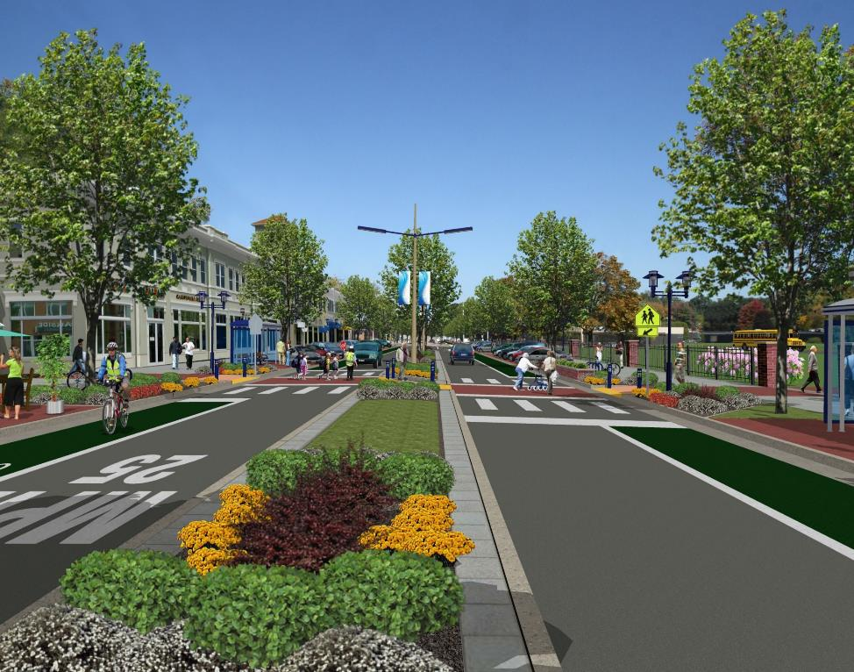
THE WORLD IS CHANGING

Slide 8
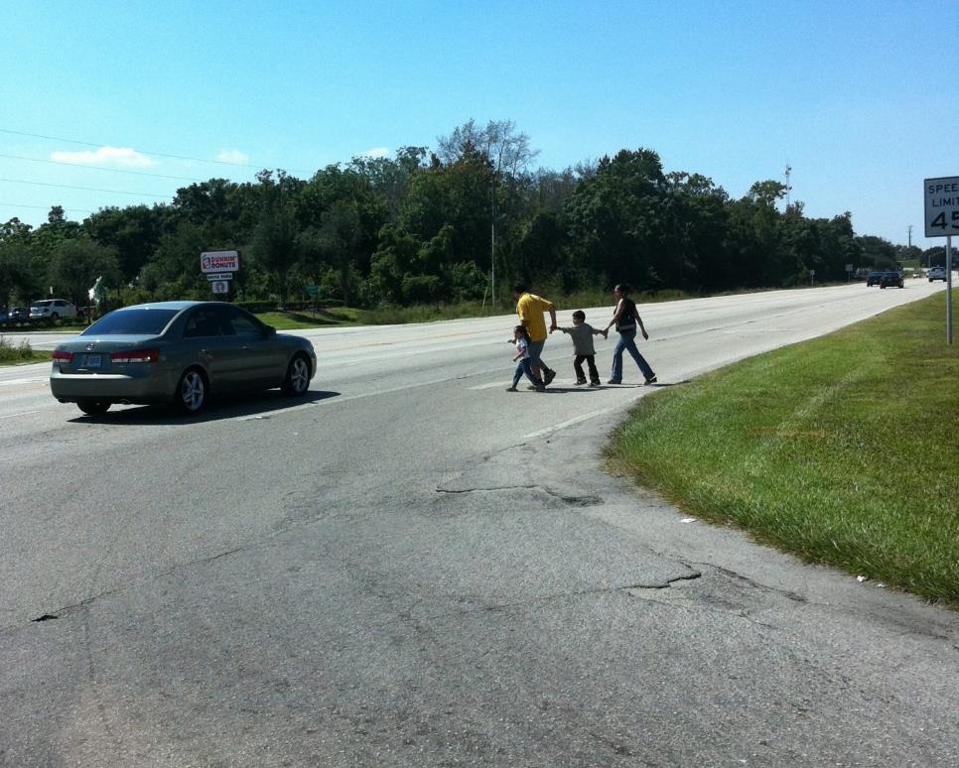

Slide 9
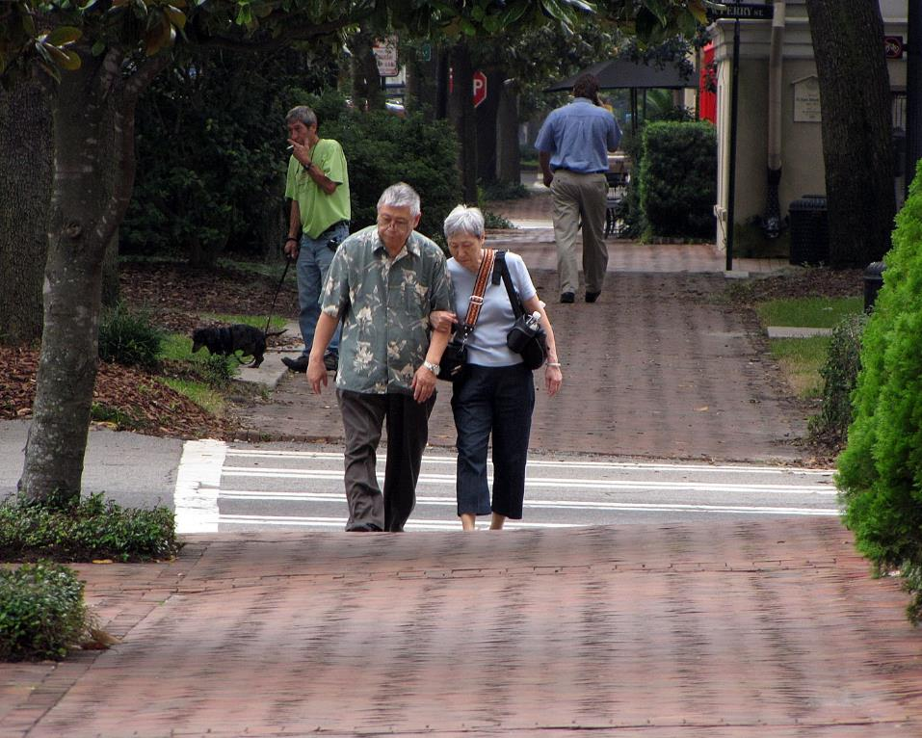

Slide 10

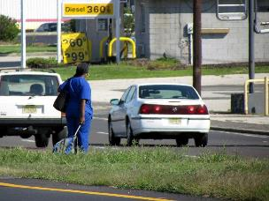
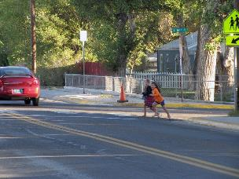
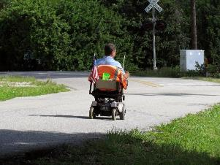
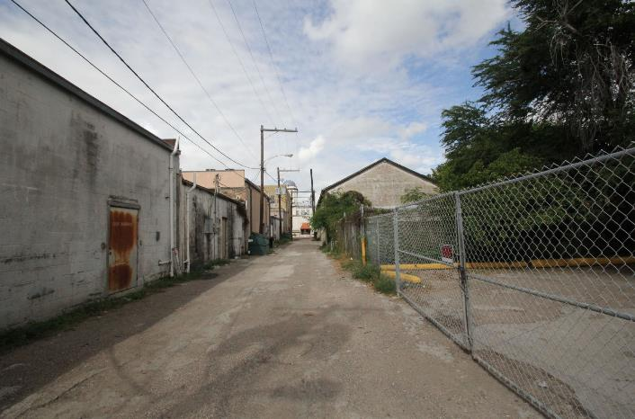
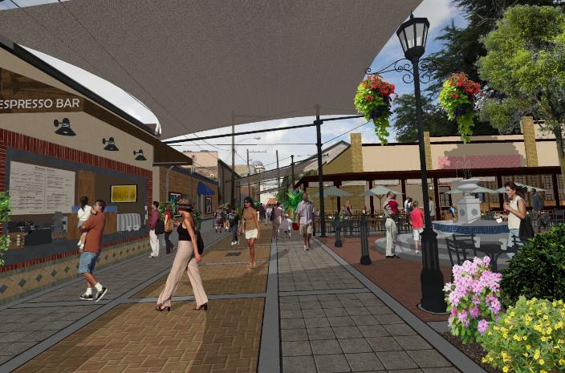

Slide 11
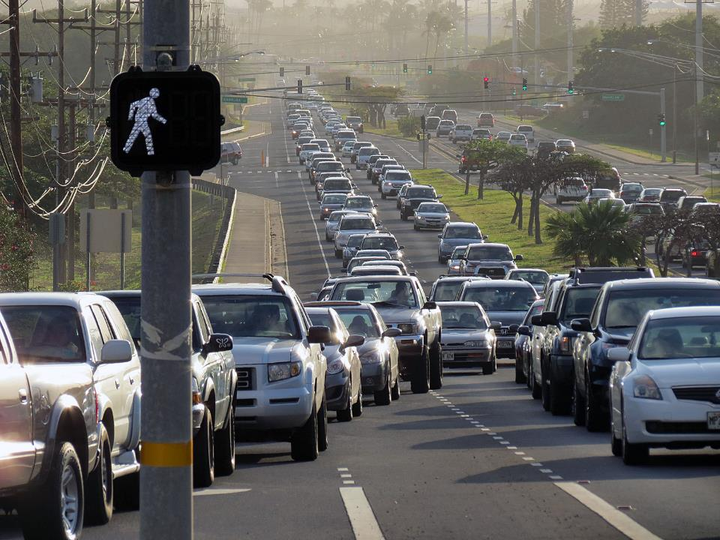

Slide 12
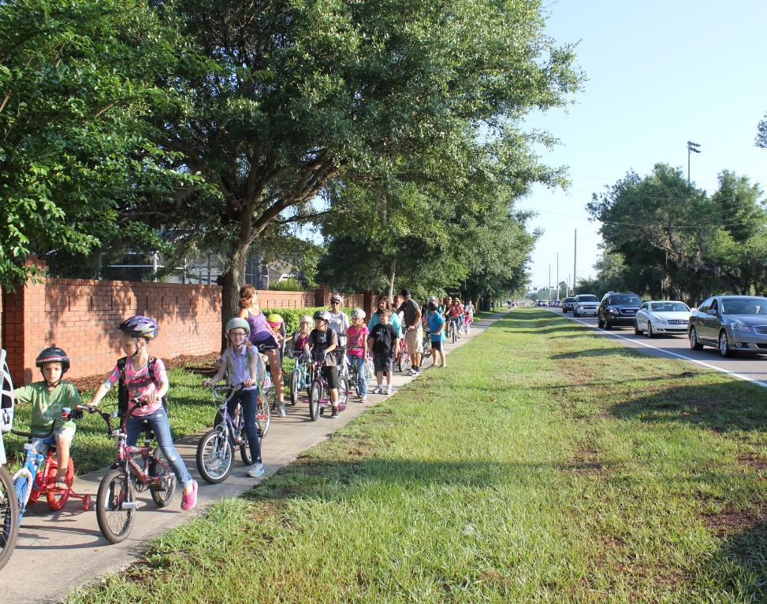

Slide 13
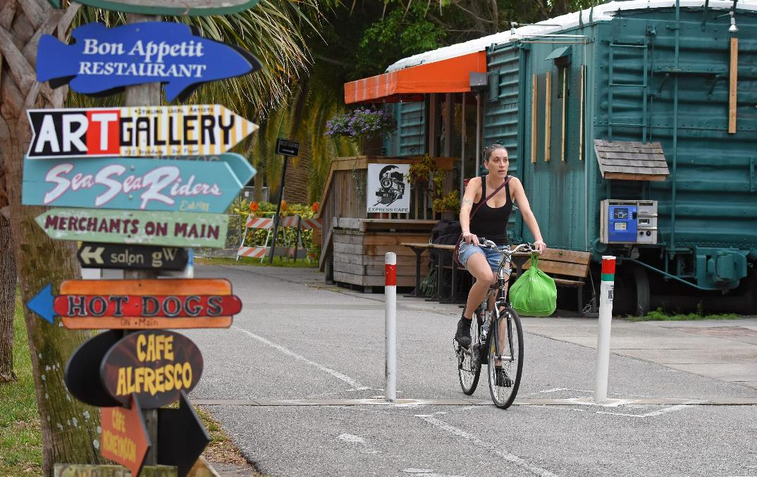
Photo: Tampa Bay Times, via tbo.com

Slide 14
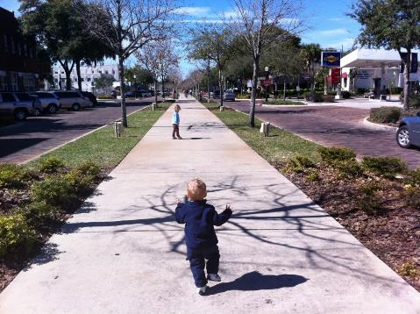
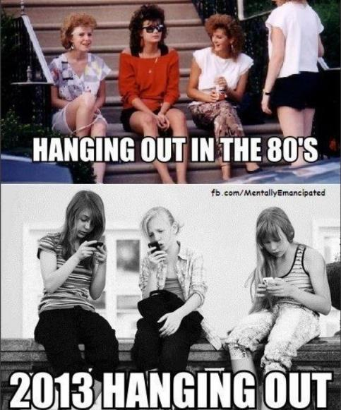
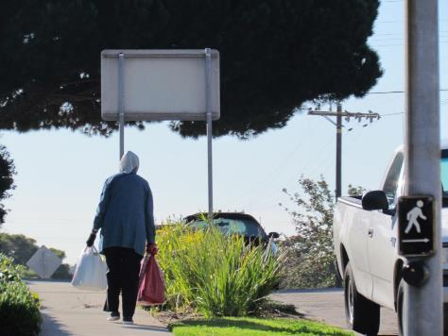
Notes:
Transportation independence is one of the first things that a human being wants, and one of the last things a human being wants to give up. For those reasons, and more,
Risks of senior seclusion
Many of us will outlive our ability to drive by 7 to 11 years
Four million seniors stay home daily because they lack transportation
Seniors are over-represented in intersection fatalities by a factor of more than two-to-one.
Older Americans are at great risk for rapidly declining health and social isolation once they lose the ability to travel on their own
Need transportation independence!
Millennials: Game-Changers
About half of Millennials would choose Internet access over a car
Drivers license rates among young adults are the lowest they’ve been in decades
Millennials choose where to live before finding a job.
64% looked for a job after they chose the city where to live.

Slide 15
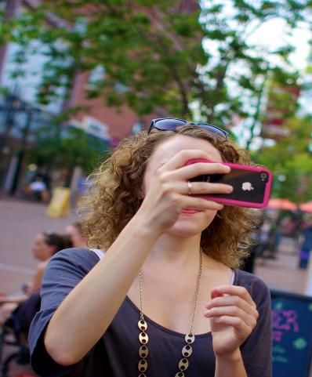
LOCATION AND FORM MATTER: WHO MOVES THERE
Attracting new residents
Young professionals
64% of college-educated 25- to 34-year-olds looked for a job after they chose the city where they wanted to live.
- U.S. Census
Slide Compiled by Christopher Coes, Smart Growth America
Notes:
A region’s most important source of competitive advantage is its workforce. In the past, employers attracted workers, but now, according to a study by CEOs for Cities, it’s the pool of talent that attract firms, particularly in the knowledge economy. The vast majority of college educated young people chose where to live based on factors other than employment opportunities. Creating attractive, mixed use communities attracts the talent, and that business.
Source: Ania Ania Wieckowski, Harvard Business Review, The Magazine, May 2010; Cities of Opportunity, Price Waterhouse-Coopers and the Partnership for New York City (2010).
Photo credit: “BJMAP touches down in Burlington, VT,” by Flickr user missmeng (Meng He). Retrieved at: http://www.flickr.com/photos/missmeng/5881124444. August 4, 2011. Creative Commons license.

Slide 16
Walkable, bike-able, “complete streets”
Destinations
Mix of land uses: homes, schools, office space, retail shops, parks
Routes
Walkways, trails, bike lanes, sidewalks, crosswalks
Safety and Security
“Eyes on the street,” buffers, crossing islands, transparency
A Pleasant Journey
Trees, shade, benches, landscaping, other people

Slide 17
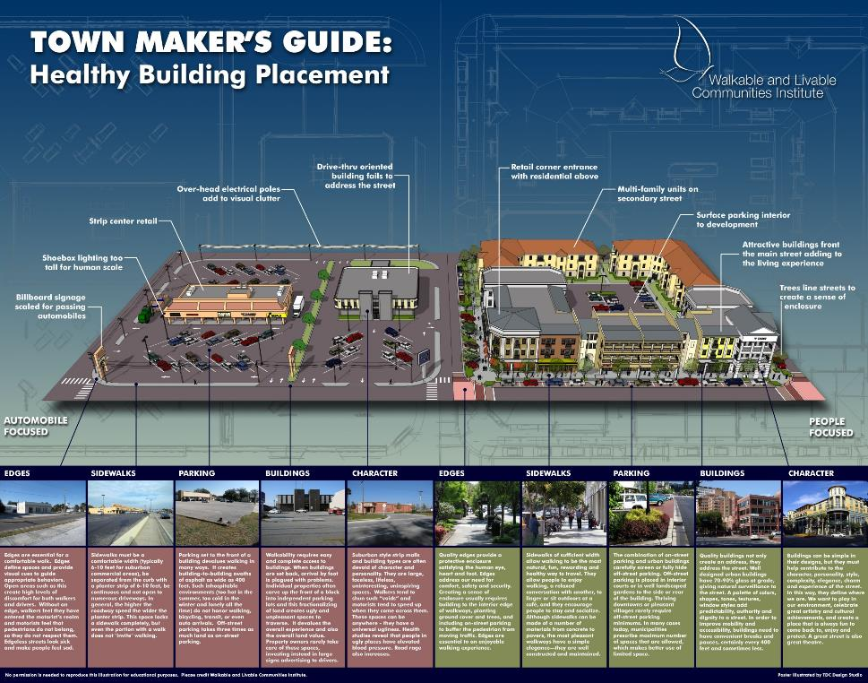

Slide 18
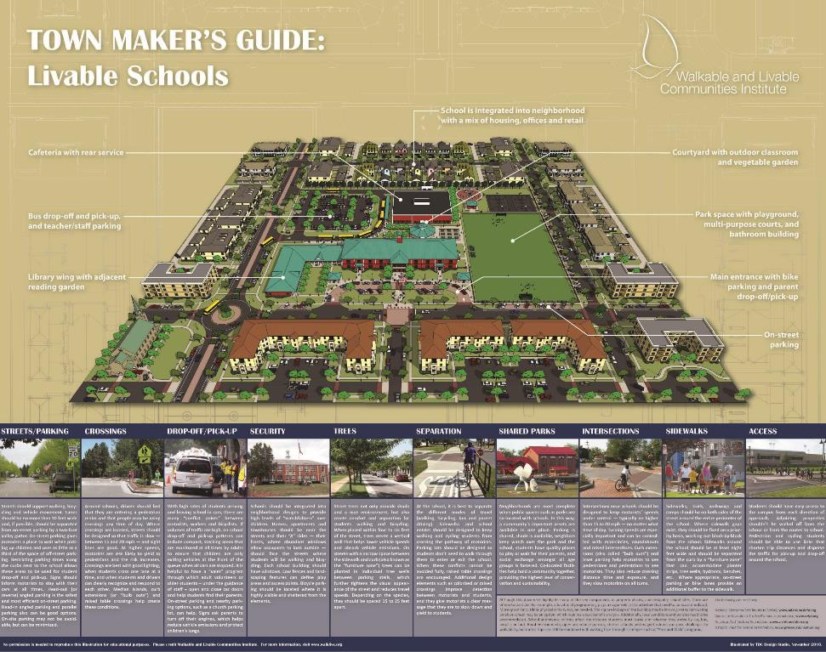

Slide 19
If you plan cities for cars and traffic, you get cars and traffic.
If you plan for people and places, you get people and places.
- Fred Kent, Project for Public Spaces

Slide 20
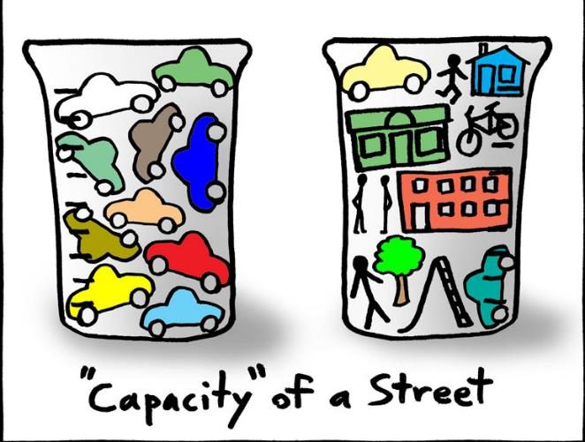
By Ian Lockwood, P.E., Toole Design Group

Slide 21
SIMPLE, RIGHT?

Slide 22
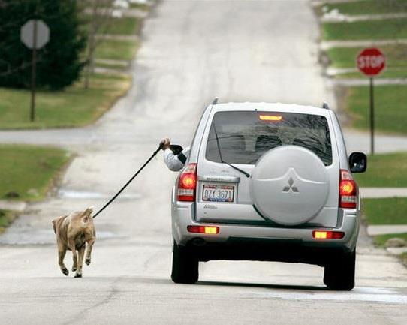

Slide 23
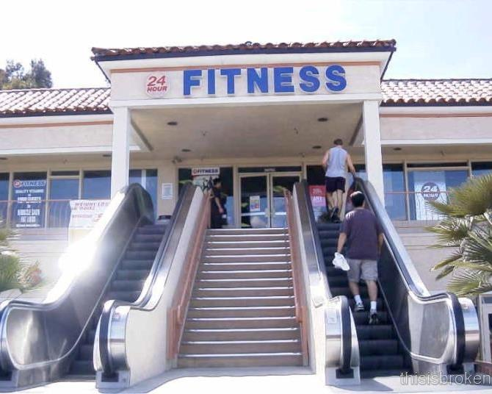

Slide 24
WHY PUBLIC ENGAGEMENT?
  Improve health
  By simply becoming involved in their community, people become healthier.
  * Source: Hanson, P. Citizen involvement in community health promotion: a role of CDC’s PATCH model. International Quarterly of Community Health Education 1988-89-9(3) 177-186
  Build social capital
  Community engagement can build a culture in which neighbors know each other, volunteerism is high, social connections are strong and diverse and residents take interest in local events. In these communities, residents are more likely to support financial investments in community-building efforts.
  * Source: Connected Communities: Local Government as a Partner in Citizen Engagement and Community Building. Alliance for Innovation. Oct 2010
  Increase project success rates
  Agencies that successfully engage the public processes are more successful at adapting to the socio-economic changes that influence development or implementation of the resulting projects.*
  Reduce pressure on staff and elected leaders
  Locals know!
  * Source: Cogan, E. and Faust, S. Innovative civic engagement tools and practices in land-use decision-making. Prepared by Cogan Owens Cogan, LLC for the Intermountain West Funder Network. April 2010.
Notes:
Let’s talk a little bit about why it’s important to truly ENGAGE the public in our projects, and not just INFORM them by meeting minimum public noticing requirements and such. And
Research is showing us that a community can achieve long-term health improvements when people become involved and work together to affect change. So even before policies and projects are fully developed, just having community engagement in the process already is providing a health benefit.
By bringing people together to work toward a shared vision, community outreach also has the power to build social capital. Those social networks we have matter; they inspire trust and a sense of community. But they do more. They improve our ability to solve problems together in an innovative manner and – here’s something very relevant to our projects – high levels of social capital “increase the likelihood that citizens will support financial investments in community projects.”
And along those lines, we see that effective community outreach and civic engagement do, in fact, improve the success rates of projects. This is partly because agencies that engage the public in projects that are much more able to adapt to the changes in society that affect the projects.
Engaging the public successfully will reduce pressure on the staff members and local leaders.
Also, locals have unique knowledge of their neighborhoods. They know the local culture, the geography, the politics, the intangibles that affect projects. So of course they should have input on the project, but they also can help shape the views and perspective of us as project developers. With the added insight we gain from our local stakeholders, we can ensure the project is tailored to meet the community’s needs.
There we have several compelling reasons to truly engage the public, and not just inform.
we’ll go through these briefly.

Slide 25
ASSUMPTIONS
  Accept responsibility
  It is our responsibility as practitioners and leaders of the process to engage the public.
  If engagement fails, why?
  Remember: successful engagement increases project success, reduces pressure on staff, improves health and builds social capital.
  Start with a plan
  Work with communications team
  Detail and define goals and desired outcomes, success, known issues, target audiences, key messages, distribution channels, messengers or speakers, resources, tools and materials, timelines and methods of evaluation and adjustment.
Notes:
Let’s talk a little bit about why it’s important to truly ENGAGE the public in our projects, and not just INFORM them by meeting minimum public noticing requirements and such. And
Research is showing us that a community can achieve long-term health improvements when people become involved and work together to affect change. So even before policies and projects are fully developed, just having community engagement in the process already is providing a health benefit.
By bringing people together to work toward a shared vision, community outreach also has the power to build social capital. Those social networks we have matter; they inspire trust and a sense of community. But they do more. They improve our ability to solve problems together in an innovative manner and – here’s something very relevant to our projects – high levels of social capital “increase the likelihood that citizens will support financial investments in community projects.”
And along those lines, we see that effective community outreach and civic engagement do, in fact, improve the success rates of projects. This is partly because agencies that engage the public in projects that are much more able to adapt to the changes in society that affect the projects.
Engaging the public successfully will reduce pressure on the staff members and local leaders.
Also, locals have unique knowledge of their neighborhoods. They know the local culture, the geography, the politics, the intangibles that affect projects. So of course they should have input on the project, but they also can help shape the views and perspective of us as project developers. With the added insight we gain from our local stakeholders, we can ensure the project is tailored to meet the community’s needs.
There we have several compelling reasons to truly engage the public, and not just inform.
we’ll go through these briefly.

Slide 26
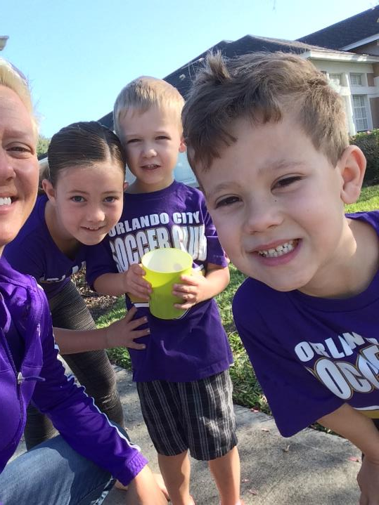
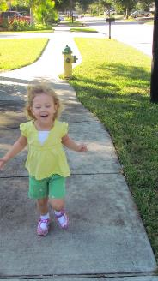
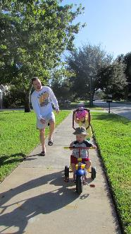
  Expect emotional connections – and reactions - to the built environment
  “Place attachment”
  Example Lake House
Notes:
Every person has an emotional connection to their built environment, and we as project developers need to respect that.
This is my family. This is a major part of our world – the sidewalk in front of our house. It’s where my kids learned to ride bikes. It’s important to us for many reasons, and whether or not we acknowledge it, we have an emotional connection to it. Other people have other reasons for being emotionally connected to their built environments, whether it be a sidewalk in front of their house, a bridge they pass every time they go to grandma’s house, a greenway where they walk their dog, whatever it is, as project developers, we need to ensure that people are engaged in any changes to their built environments. In fact, we’d BETTER engage people because when they come home to changes in their built environment, hell hath no fury ….. The WALC Institute has been called upon to help two communities – one in North Carolina and one in Arkansas – that implemented road diets – narrowing of roadways to calm traffic – without an effective public process. The road diets themselves may be a great solution, but when people woke up one morning and the 5-lane commute to work was suddenly two travel lanes plus a turning lane, they were upset. So we’ve got to get them involved and engaged. And we also need to understand that people’s reactions and responses may not always be rational or logical; in fact, they often aren’t. But even if a reaction is based only in emotion, it’s real and need to not be dismissive, but address it just as we would a reaction that seems perfectly logical.

Slide 27
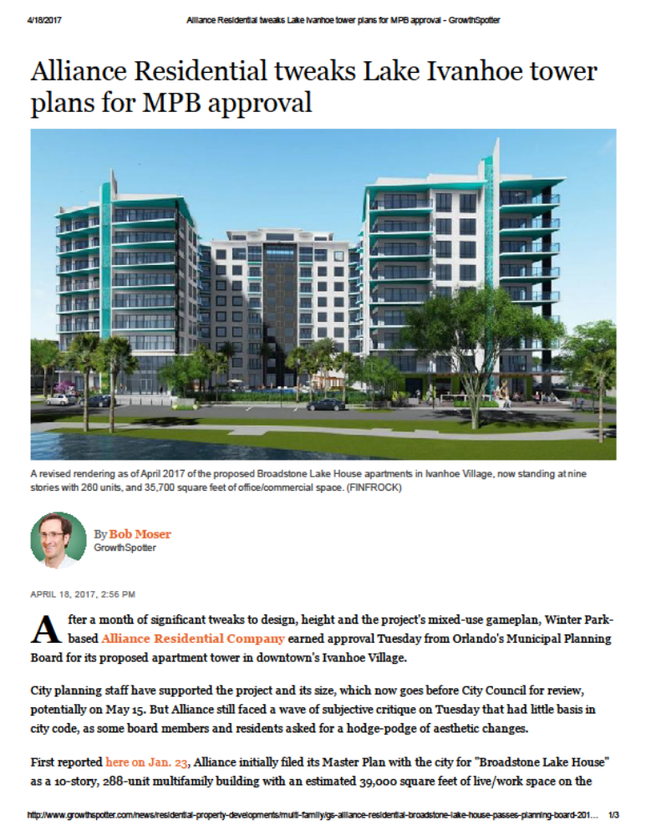
“…the project was delayed a month amidst vocal opposition by a group of area stakeholders, who challenged the building's potential traffic impact, the developer's need for height and density waivers, and what they deemed an unattractive ‘boxey’ design.”

Slide 28
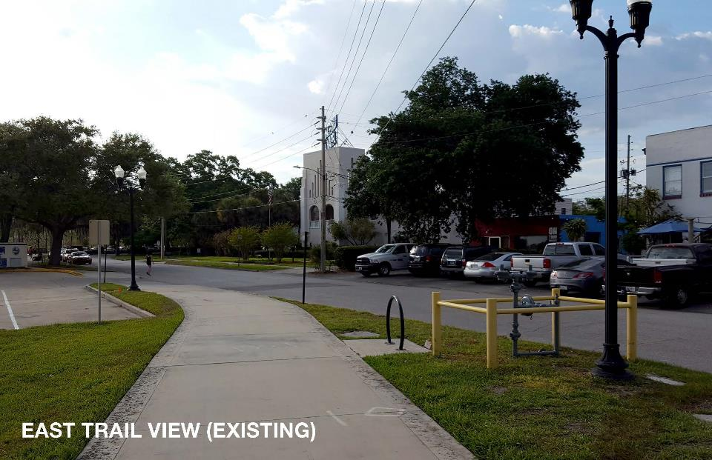

Slide 29
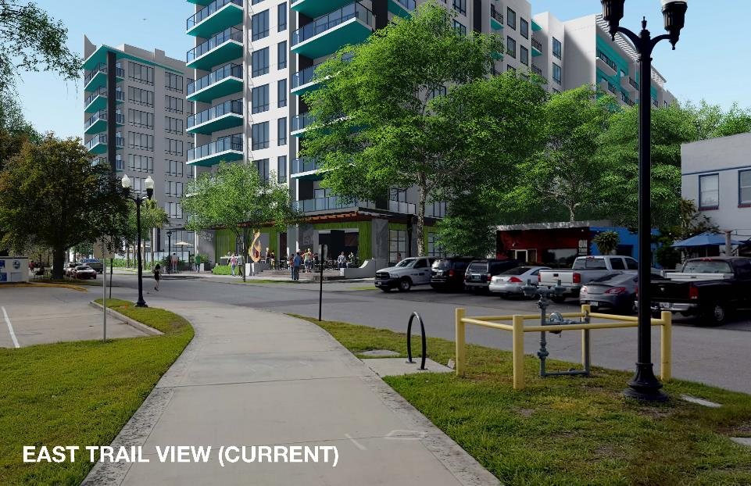

Slide 30
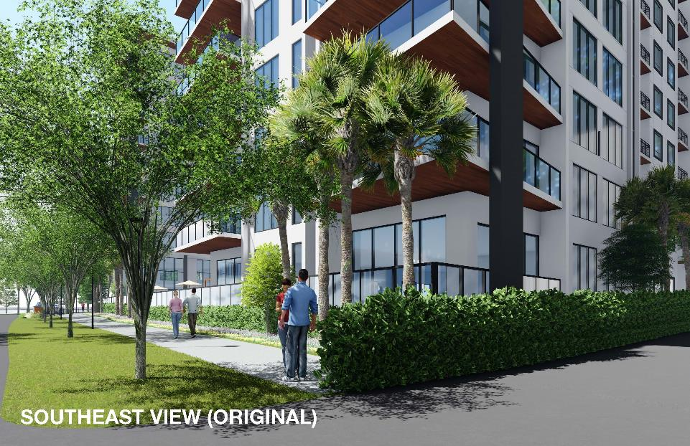

Slide 31
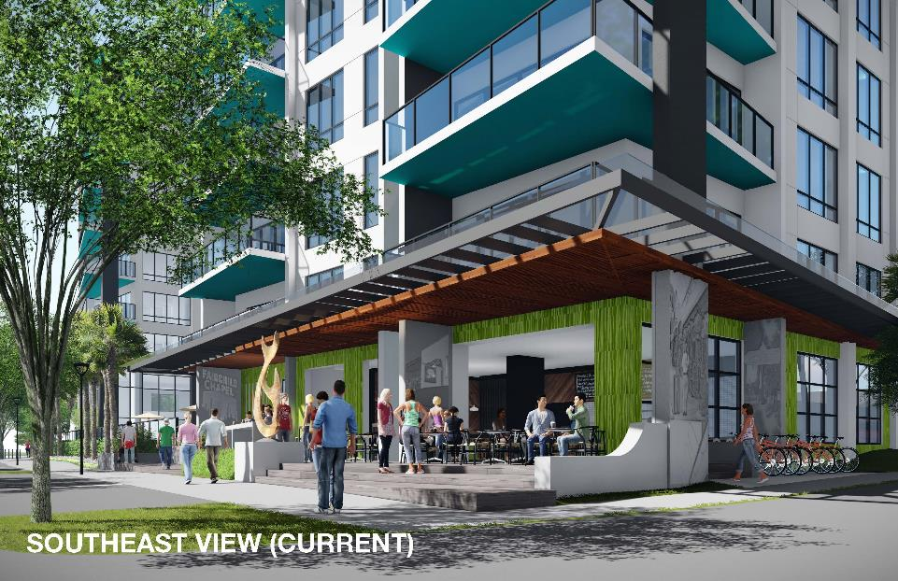

Slide 32
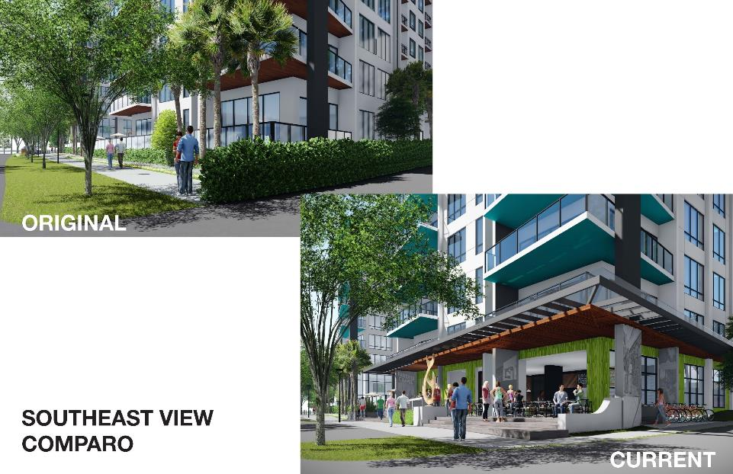

Slide 33
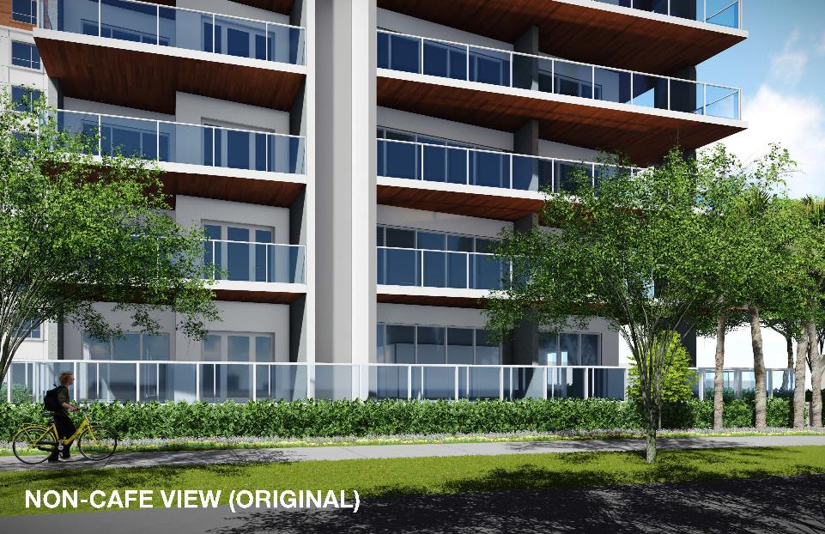

Slide 34
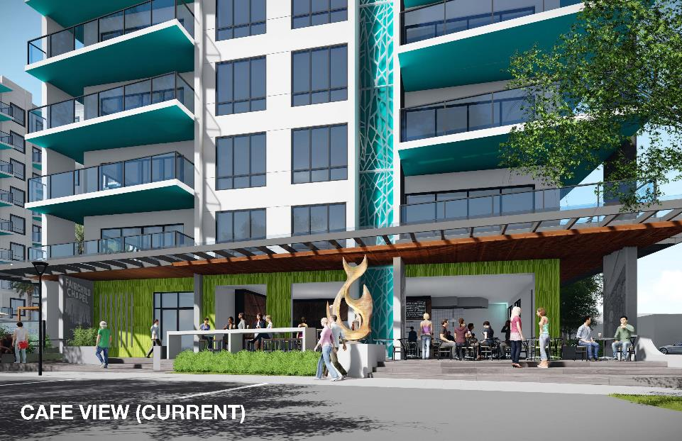

Slide 35
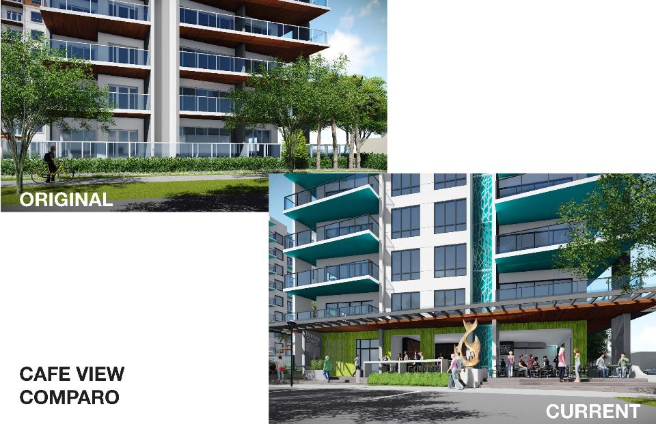

Slide 36
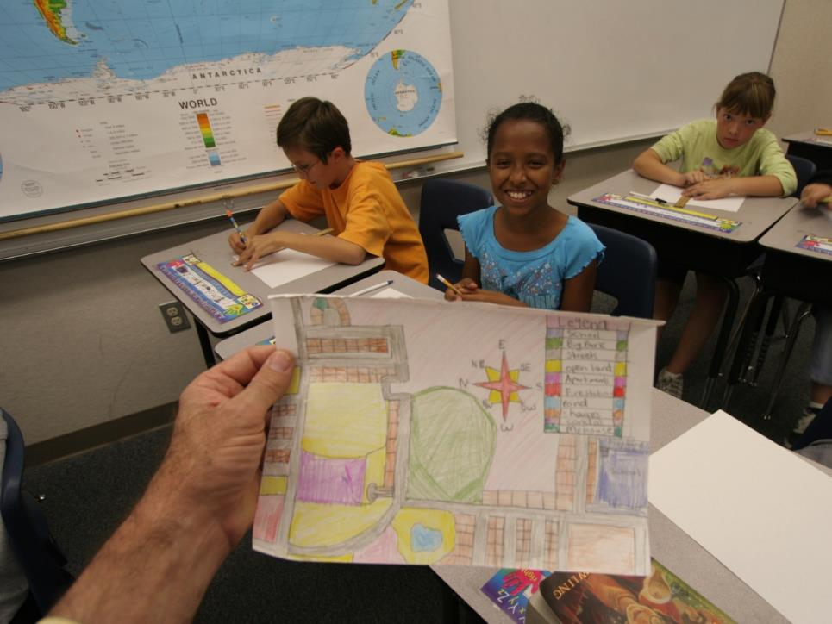
  Broaden the list of stakeholders
  Opposition
  Faith-based organizations
  Seasonal residents
  Children
  Media
Notes:
The overarching goal should be to achieve diversity by involving a demographically and geographically balanced group of people representing various interests and backgrounds.
Stakeholders and partners commonly include city and county staff, advocacy groups, residents, business operators, property owners, elected officials, community leaders, neighborhood safety groups, school representatives, health agencies, “Main Street” or downtown groups, charitable non-profit organizations and regional employers. To be more effective, project leaders also should seek the early involvement of faith-based organizations, news outlets, potential opposition groups and seasonal residents.
Potential opposition groups. Special efforts should be made to identify and reach out to people and organizations that may be expected to oppose the project. It is important to build their trust and involvement. Try to identify and address their concerns both as part of the public process and during special stakeholder interviews or meetings. Note that this may include internal groups or professionals who initially may be inclined to provide technical “brush-offs.” For example, they may at the outset be worried that sanitation trucks won’t be able to maneuver on narrow roads, that trees may disrupt drainage, or that a crosswalk isn’t needed where people don’t already try to cross the road. Whether internal or external, these concerns need to be addressed early in the public process to give the potential opposition time to understand the project, become comfortable with proposed solutions, ask many questions and decide whether or not to support the effort. Support is much more likely when they have been invited into the process early and have been included as key stakeholders.
Faith-based organizations. Across the country, churches “build and sustain more social capital – and social capital of more varied forms – that any other type of institution.” In small towns or areas of sprawl, faith-based organizations often serve an ever greater role than in urban settings to build community and build capacity for change. Thus, project leaders should seek innovative ways to work with church leaders to engage their membership in public projects.
Seasonal residents, including migrant workers, resort residents, members of the military and merchant marines. It is important to reach out to groups that represent seasonal residents. Although their members may not be able to attend public events in-person, representatives of seasonal residents - including organizations such as migrant worker education, healthcare providers, homeowners’ associations, property managers, military officials, and operators of ports, marinas and resorts - can become important liaisons between their constituents and the project leaders, and are well positioned to share timely and important information both ways.
Children. Children have much to offer in the community planning and design process, yet they remain mostly untapped throughout community transformation processes. A child’s imagination is a powerful tool; they can dream up the perfect community in which to live, play and go to school. Beyond the power of their imaginations, they also can bring very practical solutions to the table. For example, children often are aware of shortcuts to the places they go that could be formalized into trails and added to the community’s pedestrian network map. They often speak volumes about important values and their honesty helps raise the discussion to the level of guiding principles. Perhaps most importantly, the involvement of children in public processes can change the whole tenor of the events. Engage them through children’s charrettes, art or urban design contests, school field trips, holding special activities for them at community charrettes or workshops, inviting them on walking audits near their schools, or at the very least providing schools with flyers announcing the project or public process that can be send home with children in their bags.
Media. Conventional community outreach plans have treated the media as a means of simply disseminating information. A more effective approach is to engage members of traditional and non-traditional news outlets alike (newspaper, television, radio, online news services, bloggers, etc.) as stakeholders and seek their involvement early in the process. Just as project leaders should build capacity amongst residents and within the community, so too should they seek to build capacity with journalists and news outlets.

Slide 37
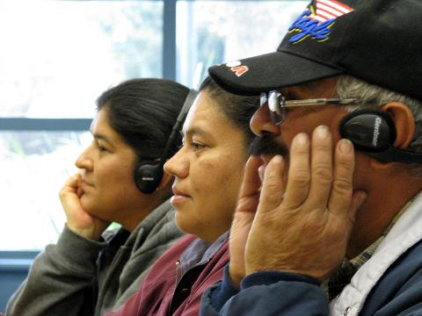
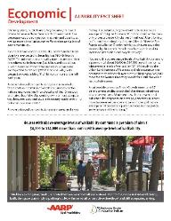
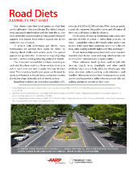
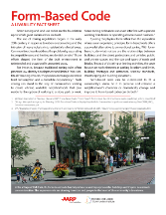
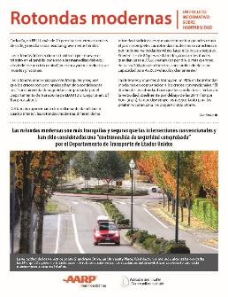




About the WALC Institute
Our Shoulders are Big
Why Engage?
Improve Health
Social Capital
Don’t Sound Smart
Overarching Principles
Education is Engagement
Media isn’t for Disseminating
Nuggets to Take Away
Successful Rates of Projects
Access inequities
Responsibility for engagement
Educate to Engage; Show Them
Streets for Kids? Ask the Kids!
Make Parents Proud
Media: More than a Mouthpiece
Once Engaged, Keep Them: Working Group
Accepted premise: we are responsible for successful engagement
Announce what Matters
  Build cultural competence
Notes:
In places where multi-lingual outreach is important - most places in the country – making it matter can be tricky. Translating messages and materials into all appropriate languages is good, but it’s even better to culturally adapt messages for target audiences.
The 11 livability fact sheets produced by the WALC Institute and AARP are available in English and Spanish to download for free at www.walklive.org.

Slide 38

  Start with a base of shared values and then build understanding
Notes:
The conventional model for public involvement in projects that affect the built environment often engages the public too late in the process, and in a manner that pits interests against each other. For example, holding a standard public hearing on a proposed project sets up stakeholders to take a position either for or against the project, without any discussion about community values and whether the project supports those values.
A better model is to start the public process with visioning sessions or educational workshops that identify or clarify shared values. In some communities, a vision plan already exists and in those cases, the vision plan should help guide the project development. In other communities, a simple values-clarification exercise during an initial public workshop can go a long way toward helping stakeholders see that they generally want the same things for their community – safety and security, economic development, places for recreation, health, and so on – and that their goal should be to collaborate on ways to achieve those ideals through the project being developed. Values clarification also can provide useful guidance to policy makers when trade-offs are concerned—for example, when the potential long-term effects of a decision are measured against short-term gains or losses. And starting with a base of shared values helps ensure outcomes aren’t predetermined, but in fact that the local vision is driving the process.
From this base of shared values, strive to build understanding and knowledge. Think like an educator, use language that is familiar and clear to the audience, and encourage reciprocal learning (learning from each other) and experiential learning (learning by doing or experiencing.) Frame issues neutrally to maintain credibility and to ensure participants can make informed decisions. Facilitate well-informed and well-rounded discussions that ensure all voices are heard.

Slide 39

  Approach engagement as a two-way conversation
    Reciprocal learning.
    Show, don’t just tell.
    Be shown, don’t just listen.

Slide 40


Slide 41


  Active workshops and design workshops, or “charrettes”
  Diversity of participants, representing multiple stakeholders, government staff, public
  Include walking audits
Notes:
One way to do that is through ACTIVE workshops. If you’re talking about streets in your meeting or workshop, take people out to the streets to show them specifically what you’re talking about. Of course, I’m not suggesting you do this on a whim, but instead plan for a portion of the meeting to be a walkability audit, or a vehicle speed assessment, or an evaluation of access to healthy food. Whatever your trying to get out of your transportation projects, take a workshop group into the field and explore together what the existing conditions are, and where opportunities exist.

Slide 42

Start with some basic principles.
Lack of security
Car-centric
Lack of activity and destinations
People aren’t out
No marked crossings
No sense of place
Lack of investment
Notes:
Click to reveal morph.

Slide 43

Begin by investing in the public realm -- adding sidewalks and marked crossings, for example.
Notes:
Click to reveal morph.

Slide 44

Add street trees and benches, for example.
Notes:
Click to reveal morph.

Slide 45

New buildings should front the street -- watch over and honor the neighborhood. “EYES ON THE STREET”
Notes:
Click to reveal morph.

Slide 46

  Walkability Workbook

Slide 47

  Tell the Story of the Place

Slide 48


Slide 49


Slide 50


Slide 51



Slide 52

All 30 of the largest U.S. metros have rent per square foot premiums for walkable urban office, retail and rental multi-family housing
Walkable urban development is expanding market share in all 30 metros, drivable sub-urban losing market share; 1st time 60 years
Walkable urbanism correlates with a highly educated workforce and higher GDP per capita
High walkable urbanism metros have the highest social equity, in spite of rent premiums
These trends suggest FUTURE DEMAND for tens of millions square feet of WALKABLE URBAN DEVELOPMENT…Likely the end of sprawl.
The economic story. Source: Smart Growth America

Slide 53


Slide 54


Slide 55


Existing condition: Oct. 2013

Slide 56


Existing condition: Oct. 2013

Slide 57



Slide 58

Existing condition: Oct. 2013

Slide 59


Slide 60


Existing condition: Oct. 2013

Slide 61

Existing condition: Oct. 2013

Slide 62


Slide 63


Slide 64

Use those stories to show people how it will feel and look.
Notes:
In fact, it’s very helpful to show people what the new place can look like.
Difficult for most of us to read plans and understand what the experience will be like when it’s built.

Slide 65



Vision for a Better Street and Place

Slide 66


Slide 67


Slide 68


Slide 69


Slide 70


Slide 71


Slide 72


Slide 73


Slide 74


  Build on Momentum
  Model projects
  Celebrate early wins

Slide 75


Slide 76

“TACTICAL URBANISM”
Tactical Urbanist’s Guide to
Materials and Design
Version 1.0

Slide 77


IMPROVE Crossings
The project team identified during the workshop that a midblock crossing is needed to facilitate people getting from the west side of 5th to the elementary school. Within 30 days of the workshop, the crosswalk had been marked (image not available). See the following slide for another treatment to consider at this midblock crossing.

Slide 78

Remove Signs that Send the Wrong Message
This combination of signs can be confusing to drivers. Moreover, right turns on red shouldn’t be allowed near schools at any time of day. Less than 30 days after the walking audit, the bottom sign had been removed.
Before

Slide 79

The Dallas Morning News
April 12, 2017

Slide 80
Town Makers Guides: Healthy Building Placement and Livable Schools
The Livability Fact Sheets (English and Spanish)
The Imagining Livability Design Collection
The Walkability 101 Workbook
Pop-Up Demonstration Toolkit
: walklive.org navigate to Resource Library
What If?
: dix.hite.com navigate to DesignTHOUGHT
The Better Block Project
: betterblock.org
Tactical Urbanist’s Guide to Materials and Design, Version 1.0
: tacticalurbanismguide.com

Slide 81

WE ARE CHANGING THE WORLD

Slide 82

WE ARE CHANGING THE WORLD

Slide 83

WE ARE CHANGING THE WORLD

Slide 84

WE ARE CHANGING THE WORLD

Slide 85


Slide 86
Kelly Morphy
kmorphy@dixhite.com
(407) 667-1777
www.dixhite.com
www.walklive.org

Slide 87
  Talk and write to build understanding.
  Evaluate the terms you use, the language of the industry and how they may affect communication with the public.
  Think like a teacher. Use words familiar to your audiences.
  Common Meanings
  Corridor = Hallway
    Replacements: streets, roadways
  Facilities = Buildings
    Replacements: amenities, lanes, lockers
  Acronyms
  ROW, AADT, ADT, TMP, CSS, VMT, ITS, EIS, and 1,000s more
  Don’t use them. Don’t define them and continue to use them when speaking. Avoid them in writing, as well, unless they are critically necessary.
Notes:
First, in the pieces of your civic engagement strategy where you are communicating with the public, don’t write or talk to sound smart. Communicate to broaden understanding and to share important information. Think like a teacher. Use words that are familiar to your audiences. If a word that means one thing in transportation speak means something else to the general public, try to avoid it. For example, to most of us, a corridor is a hallway. During community events, it’s okay to use the word street, or roadway, or whatever fits the situation, instead of corridor. Also, I hear bike facilities talked about a lot at public meetings. Most of us use the word facility to refer to a building. So if you can, use something like amenities or lanes or lockers depending on what you’re talking about.
Acronyms. Oh, acronyms, how we love our acronyms. ROW, ADT, TMP, CSS, VMT… I Googled transportation engineering acronyms and one of the documents returned was 27 pages long, more than a thousand acronyms. Don’t expect the public to easily digest the acronyms. In fact, it’s not even fair to a listener who isn’t from our field to define an acronym, and then use it as a part of speech and expect them to be able to keep up. Each time that acronym slips into your conversation, the listener who isn’t very familiar with it has to stop – has to unplug from the discussion for a moment – to remember what it means, and they lose those precious seconds of comprehension because you continued talking while they were checked out. There isn’t any need for acronyms in conversation, and likely not even in writing. It’s not that hard to say Right-of-Way or spell it out in writing. It’s not that hard to say Annual Daily Traffic. Saying the full words will help your audience immensely as they try to understand you. Now, again, this is all as it relates to community outreach and engagement, I’m not saying not to use ROW in your technical documents.

Slide 88

Notes:
Winter Garden, FL

Slide 89

People and Place
Notes:
This intersection is a people place. We made it a people place by the way we’re using the land. We put a county baseball park right on the corner. And right next to that, we have an elementary school. On the other three corners are parcels of land just waiting to be developed. And within walking distance are thoudands of homes, located in great neighborhoods that we love.

Slide 90

Within Walking and Biking Distance

Slide 91



Within Walking and Biking Distance
Image from www.childrenslighthousepof.com

Slide 92




Within Walking and Biking Distance
Swimmers cross-train on land
Image from www.giftofswimming.org

Slide 93



Slide 94


Slide 95


Slide 96


Slide 97


Slide 98


Slide 99


Slide 100



Safety is Paramount in People Places
Concerns about plans to four-lane the intersection
  Street width and crossing distances
  Vehicle speeds
Notes:
Where we should expect people to be, where we have created people-rich environments, safety for all roadway users should be paramount. This is especially true near schools.
Two areas that affect safety greatly that we still have the opportunity to decide are vehicle speeds and crossing distances.

Slide 101

Street Width/Crossing Distances

Slide 102


Slide 103

  “Drivers read the road, not the design plans.”
  - Federal Highway Administration, Speed Concepts Informational Guide, 2009

Slide 104


Slide 105

Source: Swift-Painter-Goldstein study of traffic accidents in Longmont, CO

Slide 106

A child was hit by a car in this crosswalk as she headed to Lake Whitney Elementary School on May 30, 2012. Her mom was right behind her. She was crossing with the green “walk” light. Her dad was called and arrived within minutes.

Slide 107


Slide 108


Slide 109




Slide 110


Slide 111


Why a Roundabout
Conflicts at intersection with signal
  Why safer?
  Reduced conflict points
  Reduced vehicle speeds
  While still moving traffic
  “When operating within their capacity, roundabouts typically operate with lower vehicle delays than other intersection forms and control types.”
  – National Cooperative Highway Research Program, Transportation Research Board of the National Academies, Report 672, “Roundabouts: An Informational Guide,” 2010.
Conflicts at roundabout

Slide 112


Economic Development

Slide 113
Economic Development
“The sad trajectory for many corner properties as traffic volume grows at conventional intersections is a slow and inexorable decline….” - Ken Sides, P.E., PTOE, AICP, in the ITE Journal, Sept. 2011, “Roundabouts as Context Sensitive Solutions”
“…. The last viable use is usually a gas station until, finally, that too goes out of business and the surrounding community is saddled with four vacant, useless, eyesore lots.”

Slide 114




Slide 115
Vision for a Better Street and Place

