Slide 1
Redeveloping
Properties with Environmental Issues
Frank L. Hearne, Esq.
Mechanik Nuccio Hearne & Wester, P.A.
305 South Boulevard
Tampa, Florida 33606
(813) 909-7400
frank@floridalandlaw.com
The
Development Perspective
2017 Pinellas Economic Leadership Symposium

Slide 2

The Key Question: What makes a deal work for a developer?
Reasonable financial rewards
Considering ordinary risks
and acceptable environmental risks
Including predictability of schedule and costs.

Slide 3
Legal and Practical Risks of Contamination
Statutory Cleanup Costs
Financing Fears
Pre-closing or Pre-construction delays
Delays during construction
Business interruption during later operation
On-site Lawsuits: workers and others
Off-site Lawsuits: Neighbors
Issues in later sales or re-financing
These all represent financial and schedule risks to the Developer.

Slide 4
Why go to sites with Issues at All?
Advantages of Contaminated Sites:
“Infill Sites” are often Good Business Locations
Infrastructure is in Place
Neighborhood Project Support
Local Government Support
Special Financial Incentives
Better Price!
Availability – Most areas are already “built out”.

Slide 5
What are some types of sites?
Landfills – Permitted & Historic: Solid Wastes
Golf Courses – arsenic from herbicides
“Legacy” Sites from Manufacturers/Industrial – various issues: metals, organics, etc.
Gas Stations – tanks/waste oil/solvents
Dry Cleaners - solvents
Small Industry Sites – various issues: platers, boat builders, auto repair, machine shops

Slide 6
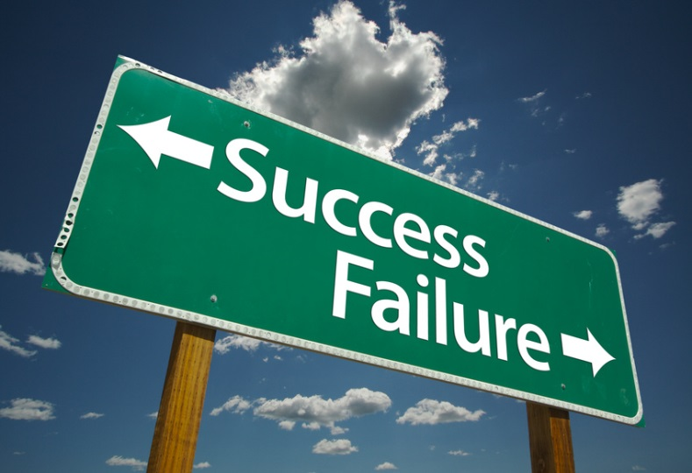
How Can We Address the Concerns?
Knowledge, understanding and planning!
Agency "closure" decisions
Agency "comfort letters"
Deal structure & contract terms
Corporate structure
Environmental insurance
Florida Programs: Tanks and Dry Cleaners
Brownfields: immunity/fixed review

Slide 7

Addressing Liability by Agency Closure Decisions
"No Further Action" or "SRCO"
Institutional Controls
Engineering Controls
"Monitoring Only"
Patience! Takes Time To Obtain

Slide 8


Addressing Liability with Insurance
Pollution Legal Liability
Markets Changing
Third Party Personal Injury
Third Party Property Damage
Cleanup Protection
On and Off Site Liabilities
Known and Unknown Contamination

Slide 9
Addressing Liability with Florida Programs
Tanks: EDI, ATRP, PCPP – Alive again!
Dry Cleaning and Voluntary Cleanup Agreements
Brownfields - Additional Support & Liability Protection

Slide 10


How Does Brownfield Designation Help?
Liability Protections
Regulatory Relief
Economic Incentives: e.g., Voluntary Cleanup Tax Credits

Slide 11
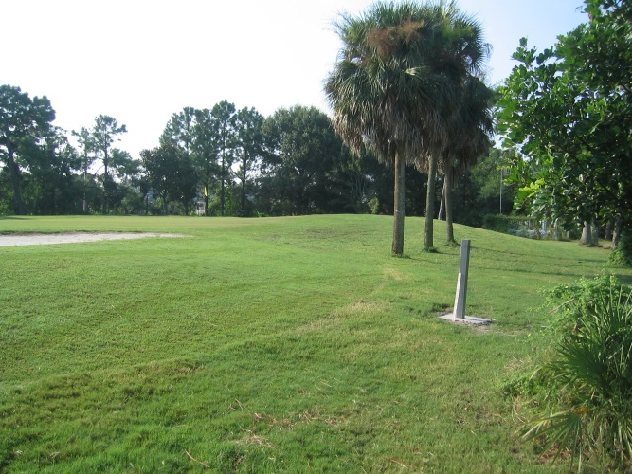
Golf Course Redevelopment: Countryside Executive Golf Course, Clearwater
  Technical Lead – HSA (now GHD)
  Approved for Recreational area, dog park, multi-family options
  Needed entire course site to make project work
  Brownfields tax credits provided the additional incentive to make the economics of the project work

Slide 12
Closed with Source Removal and Restrictive Covenant
32,000 tons of soil from top 6 inches over most of site and deeper in certain areas.
5,000 tons of soil blended on- site
Restrictive Covenant Limiting Groundwater use and impacts
SRCO Issued November 2016

Slide 13
Another Brownfield Project Example:
PINK PALACE HOTEL - Bradenton, Florida
Manatee River Hotel was finished in 1926
Valued at $2 million at the time
250 rooms – single occupancy for one night was $2.50!

Slide 14
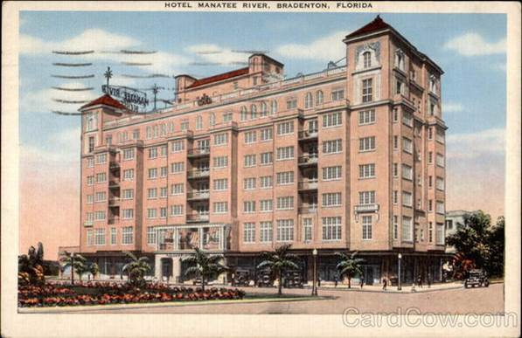
A Brownfield Redevelopment Project:
The “Pink Palace” Hotel - Bradenton

Slide 15

Site Rehabilitation Points:
Technical Lead – Terracon
Former Buried Heating Oil Tank with old free product and soil contamination
Organic Compounds in soils from on-site debris
SRCO - Soil Removal and Restrictive Covenant

Slide 16
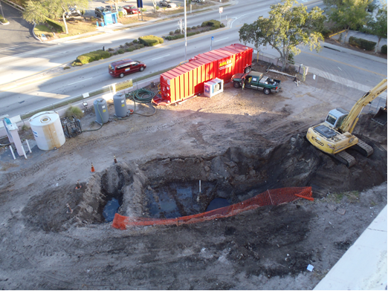

Slide 17
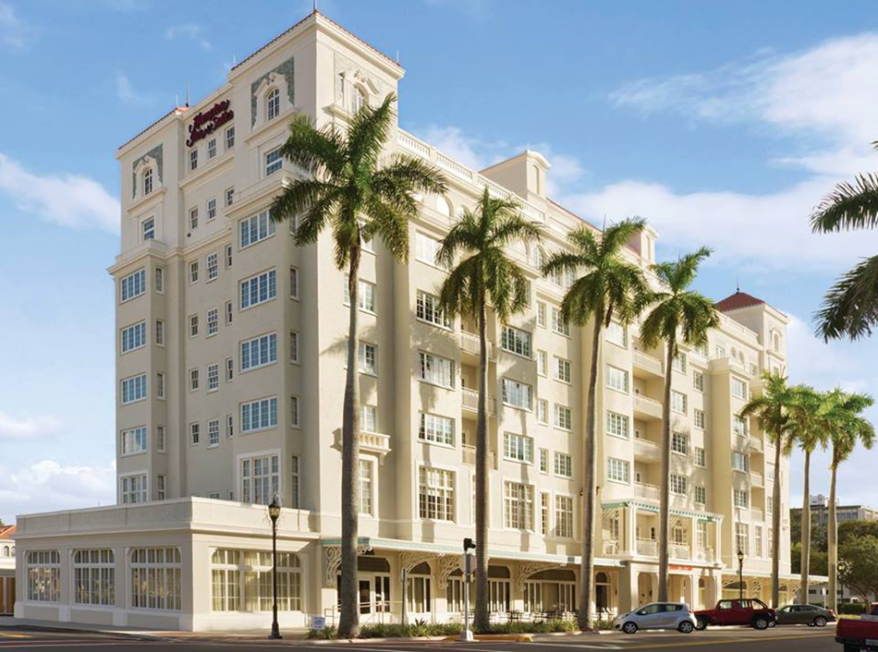
After: Hampton Inn Hotel Opened 2013

Slide 18
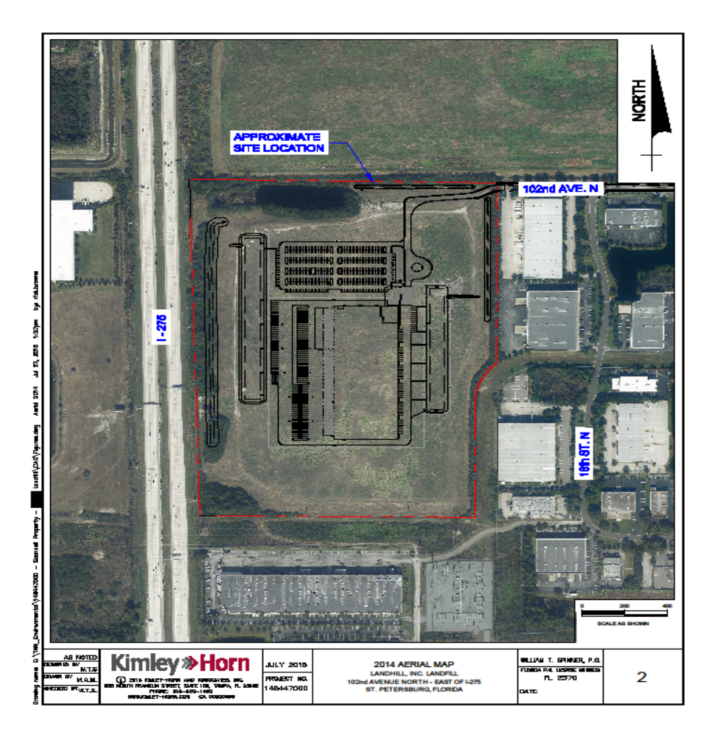
A Landfill redevelopment Example: Pinellas County Federal Express
Technical – Kimley-Horn
Permitted Closed Landfill
Developer Team had close working relationship with FDEP SW District.
Submittal and approval of Waste Relocation Plan
Incorporation of project into permit
Construction nearly completed

Slide 19
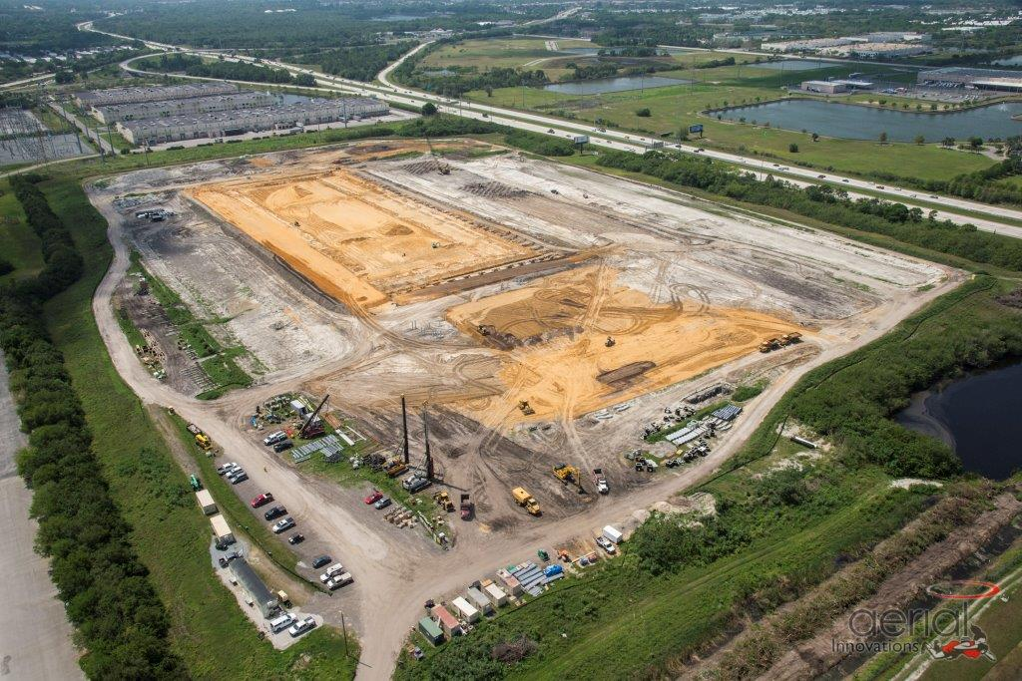

Slide 20
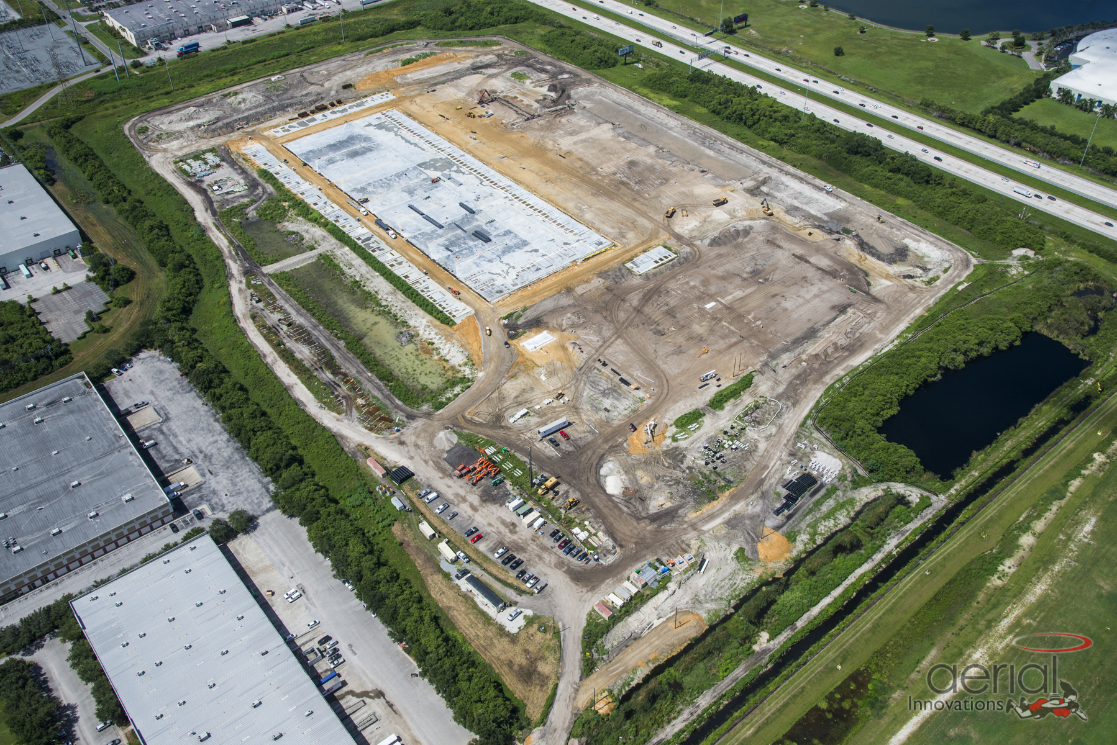

Slide 21
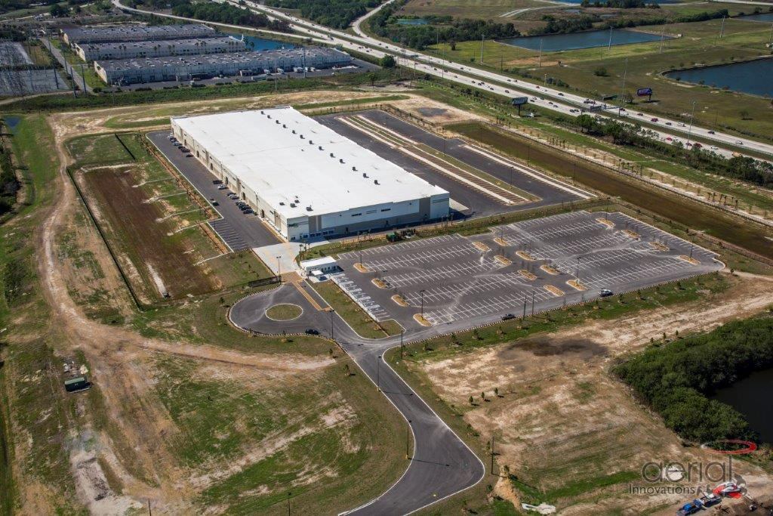

Slide 22
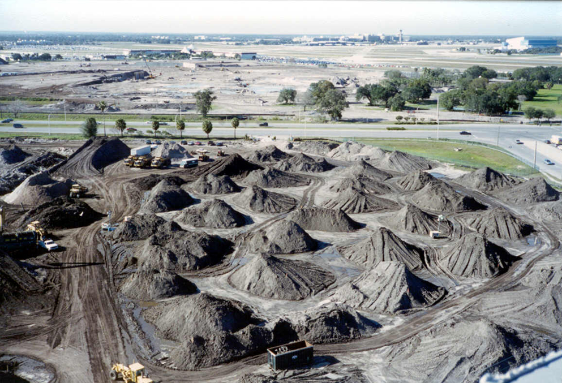
Note: Landfill Sites Can Proceed under Two approaches
“Pre-historic” or “Old Closed Landfills or Waste Disposal Areas” under Agency Guidance
&
Permitted Landfills under Chapter 62-701 and prior Rules

Slide 23
Increasingly, Development is Moving to Sites with Environmental Issues
Today’s Take Away:
With careful planning and the right development team, the advantages of contaminated sites often outweigh the risks and delay. With proper management of the risks, many sites over many years have been successfully financed, completed, and occupied without incident; and, thereafter leased, bought and sold, and refinanced by major lenders and real estate companies and investment groups.

Slide 24
Redeveloping
Properties with Environmental Issues
Frank L. Hearne, Esq.
Mechanik Nuccio Hearne & Wester, P.A.
305 South Boulevard
Tampa, Florida 33606
(813) 909-7400
frank@floridalandlaw.com
The
Development Perspective
2017 Pinellas Economic Leadership Symposium

