Slide 1
retrofitting suburbia
Professor June Williamson, RA LEED AP
The City College of New York / CUNY
Jwilliamson@ccny.cuny.edu
Images are for academic purposes only and may not have copyright approval
Notes:
What is to be done with vacant big boxes, dead malls, dying commercial strips, aging office parts and garden apartment complexes? Can we build a better burb?
I’m pleased to talk to you today about Retrofitting Suburbia

Slide 2
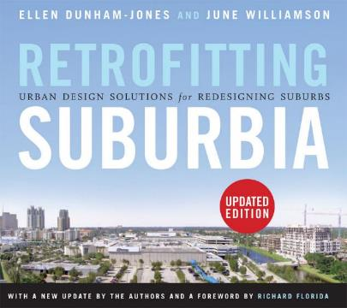
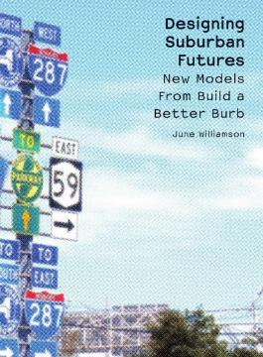
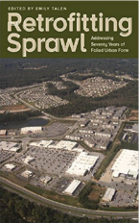

retrofitting suburbia
  prologue
  three strategies for suburban retrofitting
  eleven useful tactics
  next steps
Notes:
Here’s an outline of topics:
For more information, I invite you to consult the many books that have been written, by me and others.
Ellen and I, RS – and we are working on a follow-up companion volume
Me. Designing Suburban futures – comes from my work on the original Build A Better Burb urban design competition for Long Island, in 2010.
Emily Talen, ed. Retrofitting Sprawl (U of Georgia Press, 2015)
Me. Most recent essay in “World of Malls” catalog for exhibit in the architecture museum of Munich.
Poll audience – who grew up in suburbia??
Who lives there now?
Who does works in a suburban jurisdiction?

Slide 3
prologue late 20th century (sub)urbanization and property obsolescence
Notes:
Prologue

Slide 4
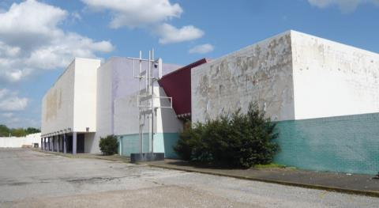
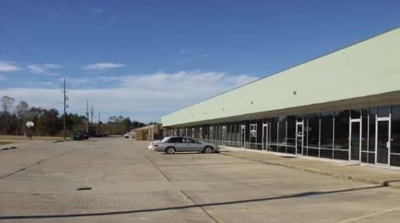
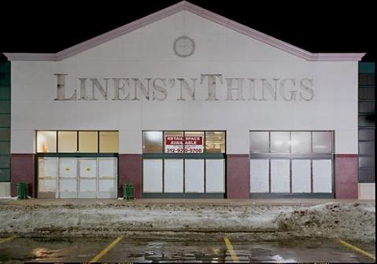
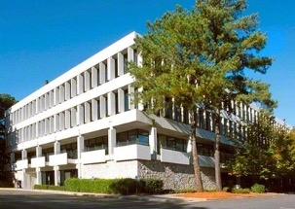
1100 shopping malls: 1/3 are dead or dying 50,000+ strip malls, 11% vacancy rate
350,000+ big box stores, 300 mil vacant sf
suburban office vacancy rates 16-24%
Notes:
The North American urban landscape is dominated by the products of late 20th century suburbanization, resulting in an unsustainable built environment littered with dead and sick malls, failing strip centers, vacant big boxes and office parks, and acre upon acre of asphalt parking lots. What to do?
It is my contention that we must ALL help to marshal the power of good design to help shape a more resilient future for our metropolitan surrounds, the suburbs.
I might also add that part of the build a better burb agenda to prevent more short-term commercial suburban form from getting built in the first place, especially on greenfield sites.

Slide 5
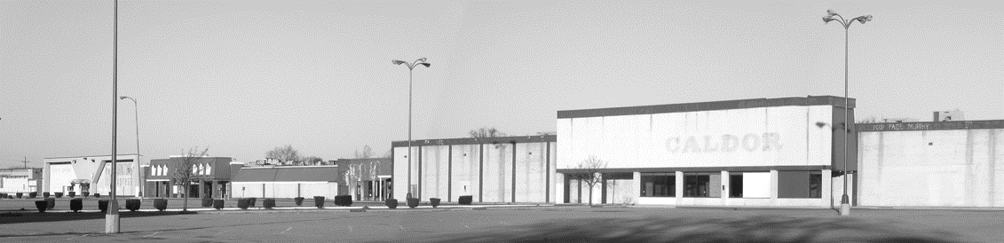
the 21st century BIG challenge
How do we accommodate more growth –
AND improve the quality of life in underinvested areas
AND improve the healthfulness and efficiency of our lifestyles
within our EXISTING urban & suburban places?
Or, how do we retrofit our least sustainable landscapes into more sustainable & resilient places?
Photo: June Williamson, from Retrofitting Suburbia (Wiley, 2009, 2011)
Notes:
5
The big challenge then is to improve the resiliency of the suburban landscapes where the VAST majority of the US population currently lives -- representing all income levels, all ages, all races, all countries of origin.
The basic proposition is: We have urbanized more than enough land already. We now need to steward it more sustainably.
In other words: it’s time to retrofit sprawl! – especially the obsolete commercial stuff.

Slide 6
the 21st century BIG challenge
Resiliency is:
“the need for urban systems to be reconceived and designed to have improved capacity to withstand disturbances – climate change, natural disasters, energy insecurity – without breaking down.”
Photo: June Williamson, from Retrofitting Suburbia (Wiley, 2009, 2011)
Notes:
6
Resiliency is “the need for urban systems to be reconceived and designed to have improved capacity to withstand disturbances – climate change, natural disasters, energy insecurity – without breaking down.”

Slide 7
  three strategies and 11 tactics getting from underperforming asphalt to incremental metropolitanism

Slide 8
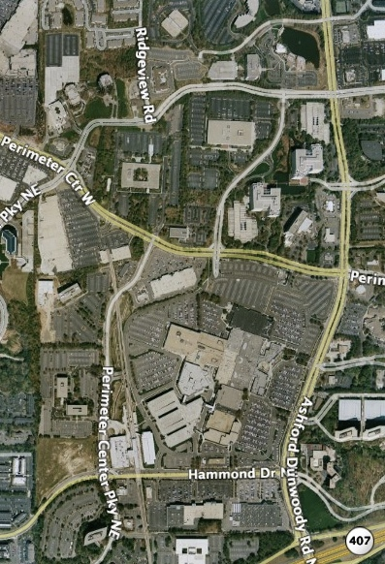
opportunities: underperforming asphalt
Prototypes of suburban form that are low-density, single-use, and car dependent:
  Residential subdivisions & garden apartments
  Strip corridors & vacant big box stores
  Regional shopping malls
  Infilling edge city
  Industrial and office parks
Notes:
Aging of physical fabric of “first suburbs”: especially of commercial properties - lots of underperforming asphalt (in our dramatically over-retailed suburban landscapes)
What can we do with all those surface parking lots?

Slide 9
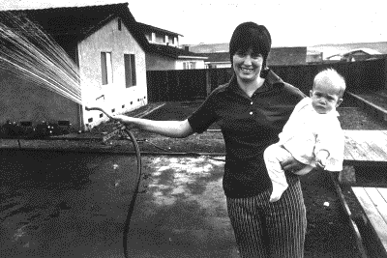

dynamics “driving” retrofitting
Mitigating impacts of GHG emissions and climate change
Rise in suburban poverty, decline of middle class
Public heath risks, epidemic levels of obesity and diabetes
Longevity, shift towards more 1- and 2-person households
Diversity, Increased immigration to postwar “first” suburbs
Leapfrogging development patterns lead to relative centrality for older suburban areas
1970s
Source: Bill Owens, Suburbia (1973)
2010s
Notes:
Various dynamics driving retrofitting:
- GHG emissions and climate change: suburbanites have 3x carbon footprint of urbanites
- Poverty on the rise in suburbs – now more living in poverty in suburbs than in central cities
- Public health concerns: Obesity and diabetes, correlated with sedentary lifestyles
Demographic change: rise in non-family households – esp. 1 & 2 person households,
Diversity in “first” suburbs
Leapfrogging patterns – new relative centrality

Slide 10
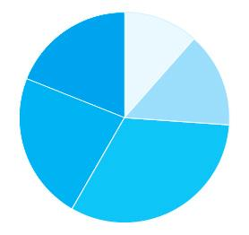

dynamics “driving” retrofitting
Mitigating impacts of GHG emissions and climate change
Rise in suburban poverty, decline of middle class
Public heath risks, epidemic levels of obesity and diabetes
Longevity, shift towards more 1- and 2-person households
Diversity, Increased immigration to postwar “first” suburbs
Leapfrogging development patterns lead to relative centrality for older suburban areas
Middle income Black
High income mixed
Middle income Asian
Low income Hispanic
Middle income mixed
Composition of Immigrant “Gateway” Suburbs in US
Notes:
Various dynamics driving retrofitting:
Diversity in “first” suburbs
Leapfrogging patterns – new relative centrality

Slide 11
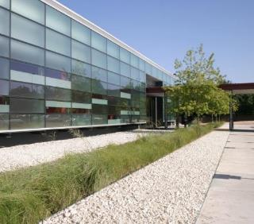
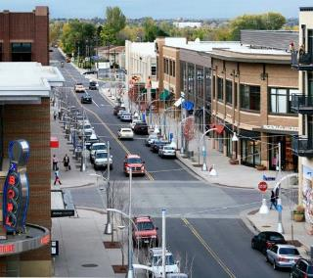
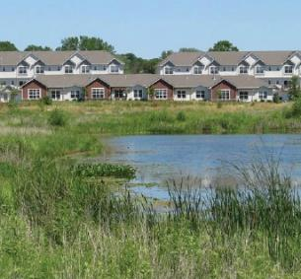
incremental metropolitanism
Remaking the metropolis into a sustainable polycentric system, through the systemic transformation of large prototypical single-use suburban sites through:
  Re-inhabitation,
  Re-development, and/or
  Re-greening.
Notes:
Ellen and I introduced the term “incremental metropolitanism” to advocate for a polycentric vision that could be advanced by the retrofitting of appropriate sites:
Densifying and diversifying of nodes along transit-served corridors;
De-densifying other sites for ecological repair.
We identify 3 main strategies or approaches:
- reinhabitation (or various forms of adaptive reuse),
- redevelopment (or urbanization by increasing density, walkability, use mix), and
- regreening (from small parks and plazas, to restoring wetlands ecologies and wildlife corridors).
- Alone or in combination.

Slide 12
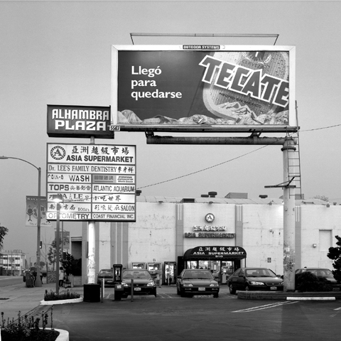
strategy:
Reinhabitation
Space for community
Serving uses that cannot afford new construction
“Third places”
Food as a catalyst for neighborhood revitalization
Keeping the lights on
Historic preservation
Photos: Philip Jones, from Retrofitting Suburbia (Wiley, 2009)
Immigrant businesses inhabit a strip, Los Angeles
Notes:
In many cases, the best strategy is to encourage and support re-inhabitation of older retail sites with small, community-oriented businesses – like those one finds serving immigrant communities with small Mom & Pop shops , health clinics, and job training.
12

Slide 13
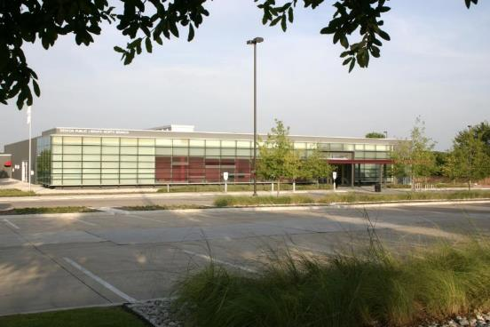
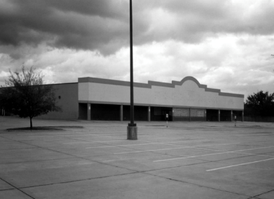
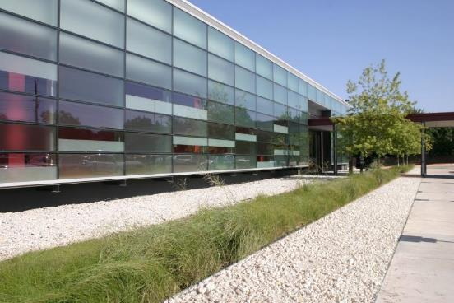
Before
from Food Lion Grocery Store to
North Branch Public Library
Denton, TX
Meyer, Scherer & Rockcastle, Ltd.
Photos: Peter Sieger, courtesy of Meyer, Scherer and Rockcastle, from Retrofitting Suburbia (Wiley, 2009)
Notes:
13
13
Many “ghostboxes,” the term for a dead big box store, have been converted to more community-serving uses – as in this dead grocery store retrofitted into a branch library.
- addition of sidewalks and pervious public green space
most importantly, the addition of a public, community use into an area dominated by private uses

Slide 14
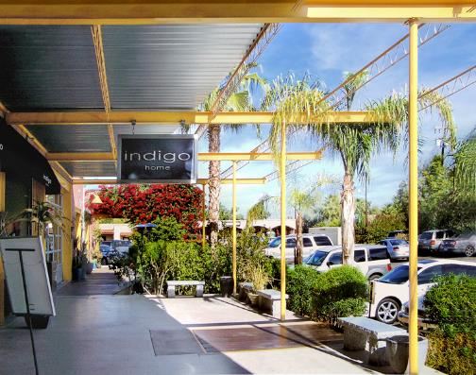
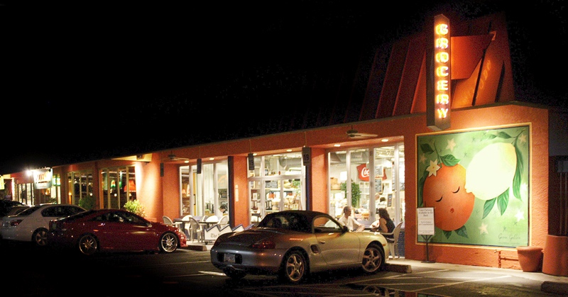
from strip center to hip “third place”
La Grande Orange Groceria
Phoenix, AZ
Bob Lynn, Kris and Craig DeMarco
Photos from Retrofitting Suburbia (Wiley, 2009)
Notes:
14
14
And, we must appreciate the power of FOOD to turn a place around.
This center was gradually repositioned, from strip to hip, starting with a boutique grocery and a coat of paint.
- It’s become a Third Place for the neighborhood, addressing the need identified by sociologist Ray Oldenberg.
- Not home, not work – but a third place to hang out.

Slide 15
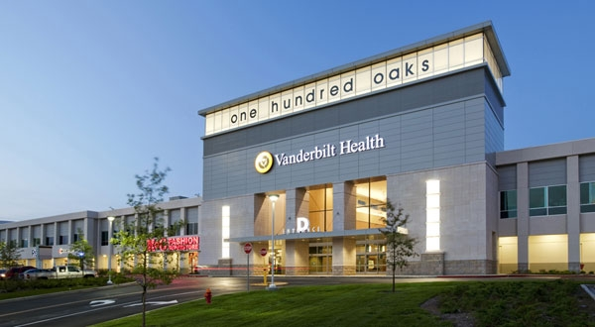
Meds & Eds: From dying mall to revived mall and university medical center
One Hundred Oaks, Nashville, TN
Source unverified
Notes:
Now there have been dozens of retrofits so far of regional shopping malls: this example shows the trend of reinhab with “meds and eds”.

Slide 16
Meds & Eds: From dying mall to revived mall and university medical center
One Hundred Oaks, Nashville, TN
Source: Vanderbilt University Medical Center

Slide 17
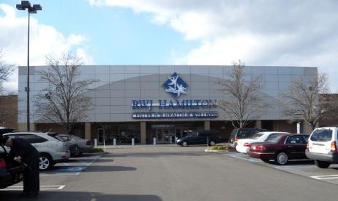
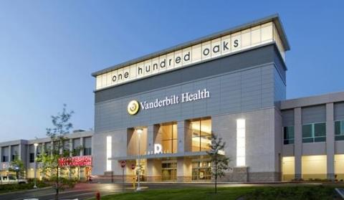
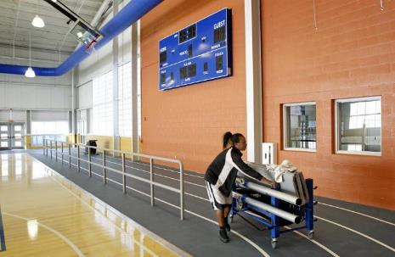
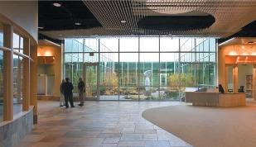
-
RWJ Hamilton Ctr for Health & Wellnesss, Hamilton, NJ: Former Ames Dept Store
100 Oaks Mall & Medical Center, Nashville TN: Medical center on 2nd floor of once-dying mall
Collinwood Recreation Center, Collinwood OH: from dead Big Lots store to public recreation center with bioswales on former parking lot
Wellspring Medical & Wellness Center, Woodburn, OR: in former K-Mart
Notes:
Other health and wellness oriented reinhabitions – addressing public health concerns, epidemics of obesity and chronic illness including diabetes.

Slide 18
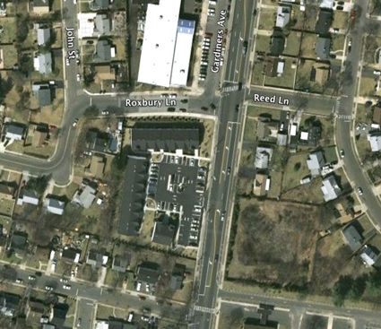
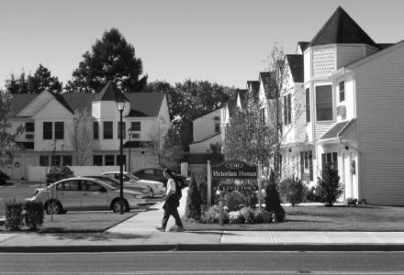
strategy:
Redevelopment
Increase density in appropriate locations
Urbanize by re-structuring the urban morphology
Green the infrastructure
housing for seniors
Levittown, NY
Photos: June Williamson, from Retrofitting Suburbia (Wiley, 2009)
Notes:
18
Redevelopment = systemic transformation of large, prototypical single-use, car dependent sites that have failed
In these cases, I contend that it is changing the urban structure, rather than the building uses and densities (which are more easily changed) that constitute a primary task of suburban retrofitting.
Here’s a smallish scale example, in iconic Levittown, NY - diversifying the housing stock
Most of the chapter length case studies in “Retrofitting Suburbia” are “redevelopment” retrofits

Slide 19
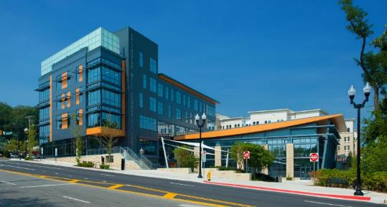
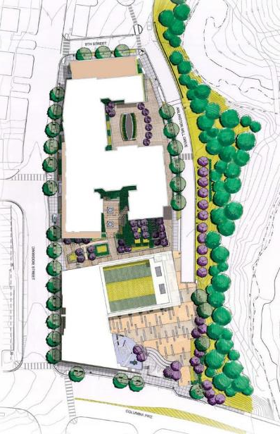
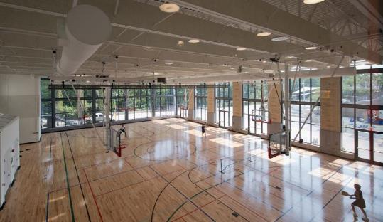
from big box store to community center & apartments
Redevelopment along Columbia Pike corridor, Arlington, VA
Arlington Mill Community Center, 2013 DCS Design for Arlington County, VA
source: photos by Eric Taylor, from website of DCS Design
Notes:
In Arlington, VA, a former Safeway big box was demolished for the just-opened five-story Arlington Mill Community Center. The neighborhood is very diverse as are many suburban areas; the residents are 2/3 non-white and 40% foreign born. The rear part of the site contains a 122-unit affordable housing building, with 12 barrier-free units.

Slide 20
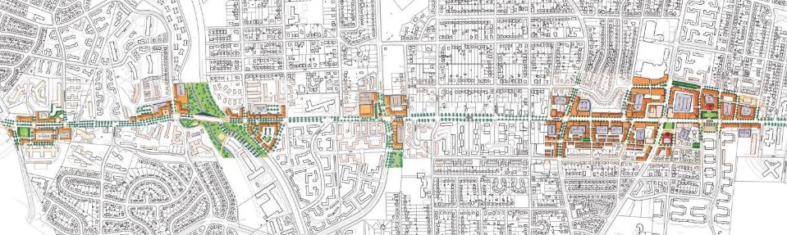
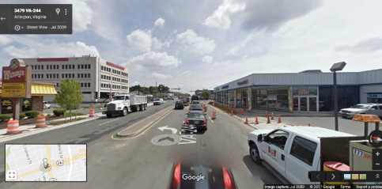
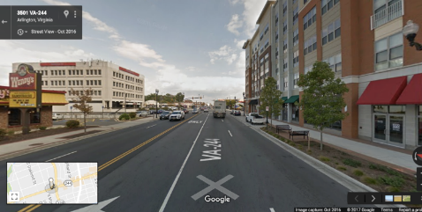
from commercial strip to complete street corridor
Columbia Pike Form Based Code, Arlington, VA
Dover, Kohl & Partners and Geoffrey Ferrell Associates for Arlington County Department of Community Planning, Housing and Development
2009 2016
Notes:
Arlington Mill Community Center is located in one of the nodes along Columbia Pike, a commercial strip corridor that is being gradually transformed through the mechanism of a form-based overlay code. The code identifies nodes along the strip for infill urban buildings that meet the street. (1/4” pedestrian shed radius)
Future streetcar or BRT
Neighbors can then access these nodes by foot or bike.
I think this kind of transformation can be envisioned for many a suburban strip.

Slide 21
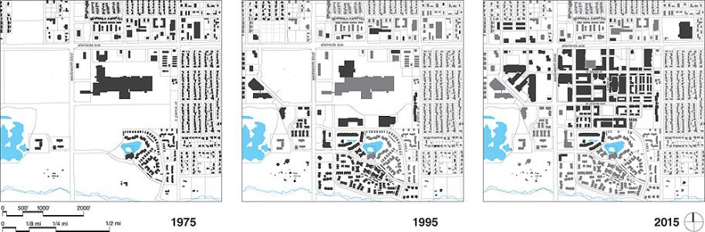
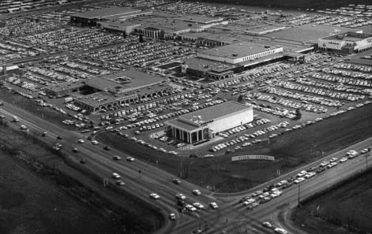
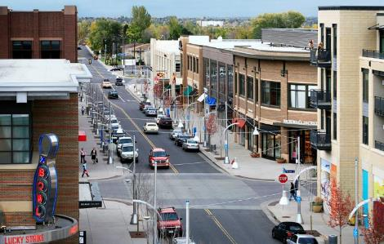
from regional mall to new downtown, mixed-use grid of walkable blocks
Belmar, Lakewood, CO, 2000-present
Continuum Partners / Elkus/Manfredi Architects / Civitas Inc. / Van Meter Williams Pollack
Before
Photos courtesy of Continuum Partners, from Retrofitting Suburbia (Wiley, 2009, 2011)
Notes:
21
Belmar

Slide 22
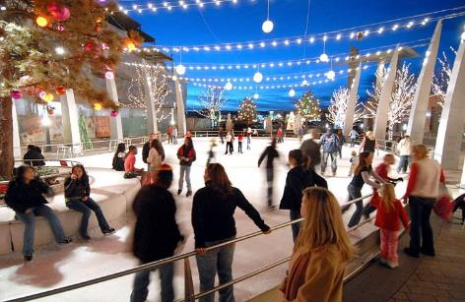
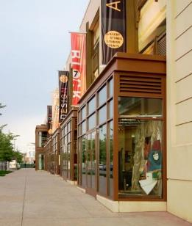
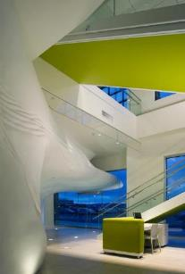
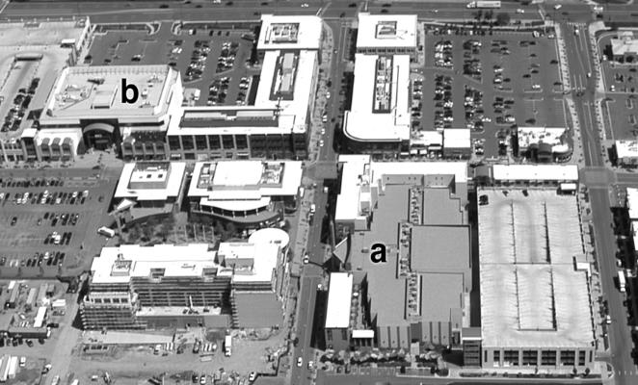
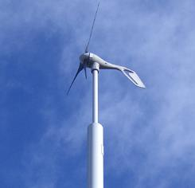
Public spaces, cultural spaces, wrapped boxes, wind turbines, PVs, and a mix of housing types
Photos by June Williamson or courtesy of Continuum Partners, from Retrofitting Suburbia (Wiley, 2009, 2011)
Notes:
22
UD tactics: Wrapped boxes and public spaces - hybridity
Wrapped cinema
Ice skating rink in plaza
Block 7 subsidized artist’s spaces as liner of parking garage
Federal grant for green energy features: wind turbines and PV arrays

Slide 23
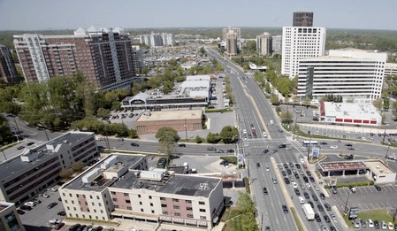
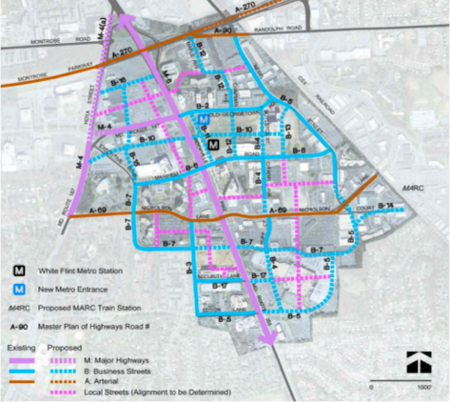
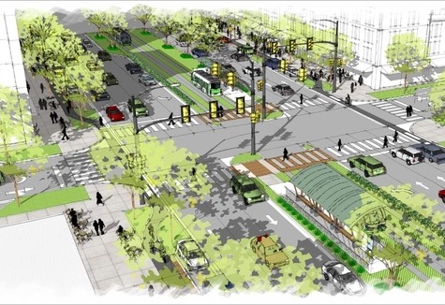
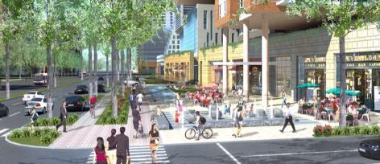
From edge city sprawl to developer-led walkable urbanism
White Flint, N Bethesda MD: W.F. Ptrship, Montgomery Cty, Glatting Jackson, var. designers
-new high-rise downtown over 20 years, $6-7 bil tax revenue, 10k residents – 25% affordable
Notes:
The updated WF Sector plan approved March, 2010 = catalyst. 10% comm’l prop tax increase in area will finance $208M in infrastruc improvements – it also incentivizes owners to go m-u w higher density AND to purchase Building Lot Termination easements in the county’s rural areas.

Slide 24
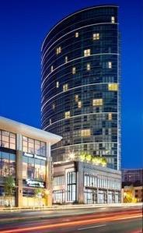
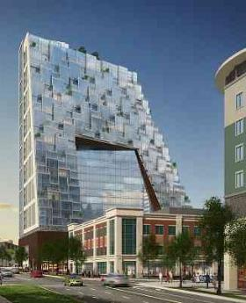
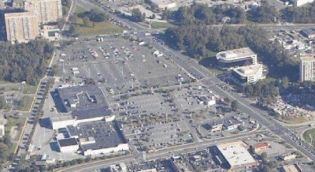
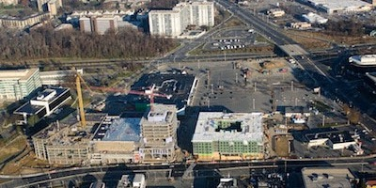
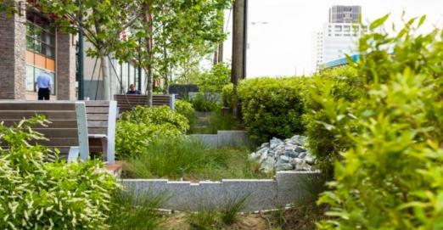

From edge city sprawl to developer-led walkable urbanism
White Flint, N Bethesda MD: W.F. Ptrship, Montgomery Cty, Glatting Jackson, var. designers
-new high-rise downtown over 20 years, $6-7 bil tax revenue, 10k residents – 25% affordable
Notes:
The updated WF Sector plan approved March, 2010 = catalyst. 10% comm’l prop tax increase in area will finance $208M in infrastruc improvements – it also incentivizes owners to go m-u w higher density AND to purchase Building Lot Termination easements in the county’s rural areas.

Slide 25





From IBM research & manufacturing site to Austin’s upscale second Downtown
Domain, Austin, TX : Endeavor Realty, Simon Retail, Gensler, various firms
2005 2015 2035
Notes:
Can’t compete w downtown Austin on “cool” – but can compete on floorplate, price, and parking. This is the downtown for the Dellionaires. Can still find a few IBM office bldgs surrounded by a sea of parking – but current phase is delivering walkable urban office in a live-work-shop environment.
It’s important to note that all this retrofitting isn’t displacing people who want to live in traditional suburban neighborhoods. It’s taking underperforming sites and creating pockets of transit-served walkability to offer urban choices for people.

Slide 26

strategy:
Re-greening
Reconstruct local ecology, daylight culverted streams, and clean runoff
Add parks to increase adjacent property values
Food and energy production
Carbon sequestration
Fritz Haeg, Edible Estates: Attack on the Front Lawn
Notes:
But, densification and adaptive re-use are not going to work everywhere. Sometimes regreening is the more appropriate strategy.
It is becoming more common to convert vacant properties into gardens and parks to stabilize home values and protect long-term natural resources.
26

Slide 27





from shopping center to wetland w/ new lakefront property investment
Phalen Village, St Paul, MN, U.Minnesota CALA (Dowdell, Fraker, Nassauer) and City of St. Paul
Before After
Notes:
Regreening also provides the opportunity to restore the local ecology - as in this example in the Phalen neighborhood of St. Paul. When the shopping center died, the city reconstructed the site’s original wetlands, creating lakefront property that succeeded in attracting the first new private investment in forty years to the low-income neighborhood.
Also providing wildlife habitat - diagram of bird migration patterns.
[I was there just a year ago, and saw a hawk at the lake.]
27

Slide 28



from parking lot to mixed-use TOD with condos, senior housing, daylit creek and wetlands
Thornton Place, Northgate Mall, North Seattle, WA: LEED-ND pilot program
Mithun Architects for Stellar Holdings & Lorig Associates
Daylighting Thornton Creek in Northgate Mall parking lot, LEED-ND pilot program
Photos: Sky-Pix Aerial Photography
source: Dunham-Jones, Williamson, 2011
Notes:
28
And here, in north Seattle, is an example that brings all three retrofitting strategies together.
The lower quadrant of parking at the historic Northgate Mall - where architect John Graham innovated the classic dumbbell mall type --has been redeveloped in a project that represents the negotiated resolution of a longstanding conflict with environmentalists.
This is the headwaters of Thornton Creek, serving a 680-acre watershed. It had been culverted in a 6 ft. diam pipe for half a century. Now, reengineered as soft infrastructure.
Numerous other investments combining to gradually transform and reorient this auto-dependent area into a transit-served , age-diverse, walkable node - adjacent quadrant of parking will be a light rail line terminus.

Slide 29
11 tactics for retrofitting suburbia derived from multiple case studies ranging from “reusing the box” to the imperative to invest in durable, environmentally-responsive, high quality design and materials for buildings and places that will be resilient over time.
Notes:
Now I’m going to review 11 urban design tactics used to pursue these strategies, derived from the examination of what has worked in multiple case studies.
They range from “reusing the box” as in the big box re-inhabitation retrofits, to the imperative to invest in durable, environmentally-responsive, high quality design and materials for buildings and places that will be resilient over time.

Slide 30
tactic #1
REUSE THE BOX
Notes:
Tactic #1: Reuse the box – reinhabitation examples

Slide 31




#1: REUSE THE BOX
Reused Foley’s prototype store at Belmar…
Photo and diagrams: June Williamson
Foley’s department store prototype, at Belmar and CityCenter Englewood, near Denver, Colorado
Notes:
Many of the examples I’ve already shown do this. Reused Foley’s anchor store (prototype) at Belmar.
Importance of good urban imagination to see the potentials of this tactic.

Slide 32
tactic #2
PROVIDE ENVIRONMENTAL REPAIR:
RE-ESTABLISHING WETLANDS & CREEKS
Notes:
Tactic #2: Provide environmental repair: re-establishing wetlands and creeks
The regreening examples I showed usually pursue this tactic.

Slide 33


#2: ENVIRONMENTAL REPAIR - WETLANDS & CREEKS
Daylighting Thornton Creek in Northgate Mall parking lot, LEED-ND pilot program
Photos: June Williamson
Thornton Place, North Seattle, WA: Mithun Architects for Stellar Holdings & Lorig Associates
Notes:
33
As does the Thornton Creek “Water Quality Channel”
Landscape architects and civil engineers are becoming more skilled and knowledgeable about these methods.

Slide 34
tactic #3
REVISE ZONING + PUBLIC WORKS STANDARDS
Notes:
Tactic #3: Revise zoning and public works standards

Slide 35

#3: REVISE ZONING + PUBLIC WORKS STANDARDS
ITE Manual:
Designing Walkable Urban Thoroughfares
Addresses pedestrians for first time
Trees no longer referred to as “fixed hazardous objects”
Sidewalks no longer referred to as “vehicle recovery zones”
Transect-based road design system expands the palette of context sensitive street types
Notes:
35
New ITE manual for Designing Walkable Urban Thoroughfares(read from slide)
I’m working now with a civil engineering colleague at the City College of New York on a guidebook to accommodating freight and emergency vehicles in complete streets.
You can also consider zoning changes to allow or legalize accessory dwelling units.
35

Slide 36
tactic #4
WALKABLE BLOCKS
Notes:
Tactic #4: Keep block size walkable
Rules of Thumb Block size: keep block perimeter under 1800 ft
Distance: 5 to 10 minute walk radii (1/4 to 1/2 mile)
Density: 8 d.u. min. per acre supports transit
Street design: sidewalks, visibility, traffic calming
Interesting stuff to look at while walking
People-watching

Slide 37


#4: WALKABLE BLOCKS
450 ft x 800 ft block - Texas donut “with fingers”
240 ft x 360 ft block
The District at Metuchen, Metuchen, NJ
Developer: Renaissance Properties
The Sheffield at Englewood South, Englewood, NJ
Developer: The S. Hekemian Group
Notes:
Metuchen (good) & Englewood (bad, not walkable) examples
Frankenstein blocks

Slide 38
tactic #5
USE SHALLOW LINER BUILDINGS
Notes:
Tactic #5: Use shallow liner buildings

Slide 39



#5: SHALLOW LINER BUILDINGS
Mashpee Commons, Mashpee, MA, Imai Keller Moore Architects and DPZ for Cornish Assoc.
20 ft. deep stores leased to local retailers, used as liners around parking lots
Photos: June Williamson, from Retrofitting Suburbia (Wiley, 2009, 2011)
Notes:
Mashpee Commons, 20 ft. deep liners around parking lots
Different from “outparcels”
Aside: Mashpee Commons, a retrofit of a strip center begun in the mid 1980s has now outlasted the center it replaced!

Slide 40


#5: SHALLOW LINER BUILDINGS
Belmar, Lakewood, CO
Developers: Continuum; Architects: Elkus Manfredi
Photo: June Williamson, from Retrofitting Suburbia (Wiley, 2009)
“Block 7” is a ground floor liner of small artists’ workshops (subsidized rent), enlivening the streetscape of the theater parking deck
Notes:
40
Belmar, “Block 7” ground floor liner – artists’ studios

Slide 41
tactic #6
REAL STREETS AND SIDEWALKS
Notes:
Tactic # 6: Real streets and sidewalks

Slide 42



#6: REAL STREETS + SIDEWALKS
Main Street as a well-furnished and popular outdoor room
Santana Row, San Jose, CA;
Street Works for Federal Realty Trust
Notes:
Santana Row, San Jose, CA --Better-proportioned streets
One good way to understand this when planning a project is to measure the width of historic main streets in your local towns. Also research historic photographs, which might reveal elements like street trees and wider sidewalks that were eliminated to make room for more lanes of traffic.

Slide 43
tactic #7
CONNECTIVITY
Notes:
Tactic #7: Connectivity – redevelopment as open-ended

Slide 44

#7: CONNECTIVITY
From 1 to 11 points of connection, retrofitting a residential golf community
Courtesy of Looney Ricks Kiss Architects, from Retrofitting Suburbia (Wiley, 2009, 2011)
Gramercy, Carmel, IN: Looney, Ricks, Kiss Architects for the Buckingham Companies
Notes:
This is a local example. We included this diagram in our first book and, although it wasn’t built, it is a good illustration of this tactic.
Gramercy, Carmel, IN
Golf course garden apartments retrofit
From 1 to 11 points of connection

Slide 45
tactic #8
FUTURE CONNECTIVITY + ADAPTABILITY
Notes:
Tactic #8: Future connectivity and adaptability

Slide 46


#8: FUTURE CONNECTIVITY + ADAPTABILITY
Planning for potential future connectivity at Mashpee Commons & Belmar
Notes:
Potential future connections at Mashpee Commons and Belmar

Slide 47


#8: FUTURE CONNECTIVITY + ADAPTABILITY
Anticipatory or Planned Retrofitting:
Lay out parking lots as future building sites with utilities and trees lining the “streets”
Photo: Ellen Dunham-Jones
CityCenter Englewood, City of Englewood, CO, Miller Weingarten Realty, Trammell Crow Residential, David Owen Tryba Architects, Calthorpe Associates
Notes:
Anticipatory or Planned Retrofitting: City Center Englewood
Parking lots laid out in block form, utilities placement, legal construct as well as design

Slide 48
tactic #9
DIVERSITY IN HOUSING CHOICE + PRICE
Notes:
Tactic #9: Diversity in housing choice and price

Slide 49



#9: DIVERSITY IN HOUSING CHOICE + PRICE
Photo courtesy of RTKL Baltimore
The Towers at University Town Center, Hyattsville, MD; RTKL
910-bed apartment building, marketed to college students, close to transit and part-time service jobs
Notes:
The Towers at University Town Center, Hyattsville, MD – 4 beds, 4 baths
Missing Middle housing types, such as duplexes, fourplexes, bungalow courts, mansion apartments, and live-work units

Slide 50

#9: DIVERSITY IN HOUSING CHOICE + PRICE
Missing Middle housing diagram
Dan Parolek, Opticos Design, Inc. http://missingmiddlehousing.com/
Notes:
Missing Middle housing types, such as duplexes, fourplexes, bungalow courts, mansion apartments, and live-work units

Slide 51


#9: DIVERSITY IN HOUSING CHOICE + PRICE
The Cottages on Greene, East Greenwich, RI
Architect: Union Studio
15-unit ”missing middle” cottage courtyard on 1-acre site, 33% affordable
Notes:
Cottages on Greene is a privately financed infill development composed of mixed income housing located in the historic downtown of East Greenwich, Rhode Island. Prior to construction, Cottages on Greene’s nearly one-acre site had sat derelict for several years. In early 2009, as the recession slowed development, a team led by 620 Main Street Associates responded by providing a project concept that leveraged the site’s walkable location and an emerging demand for scaled-down, urban-style living. As a 15-unit “cottage” development, a style influenced by the preserved cottage on the site, Cottages on Greene has contributed five deed-restricted units to the community’s supply of affordable housing. The Congress for the New Urbanism awarded the project an Honorable Mention in its 2011 Charter Awards program, which recognizes projects for excellence in walkable and sustainable design.1 Completed in November 2010, Cottages on Greene demonstrates how innovative housing solutions can succeed.

Slide 52
tactic #10
ADD NEW HOUSING UNITS TO EXISTING NEIGHBORHOODS
Notes:
Tactic #10: Add new units to existing subdivisions - reinhabitation

Slide 53



#10: ADD NEW UNITS TO EXISTING ‘HOODS
Zoning to permit accessory dwelling units
Licton Springs DADU, Chad Rollins, Seattle, WA
Courtesy of Chad Rollins and Jonathan Reich, from Retrofitting Suburbia (Wiley, 2009, 2011)
Notes:
These units can:
increase d.u. capacity, up to the min. threshold to support transit
provide more affordable rental units, or opportunities for multigenerational households
rental income stream for older homeowners who may be on fixed incomes
But there is NIMBY resistance.
Seattle sponsored a design competition and built three model units in one neighborhood.
Acceptance led to expansion of the rezoning throughout the city - and several other municipalities in pacific northwest.
I’m working my influence to initiate similar changes on Long Island, where there are already many illegal apts.
Licton Springs DADU, Seattle (result of a design competition)

Slide 54
tactic #11
INVEST IN QUALITY ARCHITECTURE
Notes:
Tactic #11: Invest in quality architecture

Slide 55



#11: INVEST IN QUALITY ARCHITECTURE
Consider organizing, sponsoring, or participating in a design competition and/or exhibition
DADU Competition (City of Seattle)
ReBurbia (Dwell Magazine/Inhabitat)
TownShift: Suburb into City (City of Surrey, British Columbia)
Adapting Suburbs in the 21st Century (RRCDC)
Build a Better Burb: Be Bold (Long Island Index/Rauch Foundations)
Foreclosed: Rehousing the American Dream (MoMA New York)

Slide 56

Notes:
An article summarizing these tactics is available on the Build a Better Burb website – now powered by CNU, check it out -- and they are also discussed in the Designing Suburban Futures and Retrofitting Sprawl books.

Slide 57

Notes:
My latest initiative with the Long Island Index was the ParkingPLUS Design Challenge. In collaboration with Kaja Kuhl.
We called our project ParkingPLUS—the “plus” added to signal that we wanted designs to transcend the structured parking program. The central question was: “How can transit-adjacent surface parking lots in suburban downtowns be leveraged for other uses beyond parking while at the same time more efficiently accommodating cars?”

Slide 58


FOUR SITES FOR PARKING PLUS
Notes:
Four suburban downtown parking lots sites paired with four design teams, selected through a highly competitive process.
Rockville Centre and Westbury in Nassau County; Ronkonkoma and Patchoque in Suffolk County.
Challenging negotiations to identify civic leaders willing to partner with us on this initiative – an education in itself in the complexities of suburban politics; political fragmentation is often cited as a significant impediment to progressive change.

Slide 59

ROCKVILLE CENTRE
Paired with:
Utile, Inc. (Boston)
Notes:
I will show you just one of the four resulting projects, designed by the Boston-based firm Utile, Inc.

Slide 60


Notes:
The tracks at this station in this community, less than a 40 minute ride from Manhattan, are elevated with a concrete colonnade that gave inspiration to the design, a garage prototype with a ground floor of soaring, monumental, arches, that are economical to construct in tilt-up concrete.

Slide 61

Notes:
A plan showing 3 versions of the prototype, plugging into new and existing open spaces along the rail line.

Slide 62

Notes:
The prototype is designed with flat floor plates rather than sloped and greater than typical floor-to-floor heights to anticipate conversion to other uses, should the demand for parking decline in the future.
The design also demonstrates a plug-and-play concept for additional uses, from housing to tennis courts, and retail space to a relocated police station.

Slide 63
Notes:
The design for the flexible use of the ground floor is distinctive It allows for other uses to take over the space on weekends and evenings for markets or festivals, when the need for commuter parking space is less.

Slide 64
  next steps
  Raising the bar in response to 21st c. challenges
Redesigning water and energy for resilience
Reducing auto dependency
Improving public health
Retrofitting for an aging society
Ramping up affordability
Capitalizing on social capital networks
Creating and competing for jobs
Learning from international examples
Notes:
Ellen and I are working on a follow up book of new case studies; we’ve organized it around presenting retrofits that raise the bar in response to a catalog of 21st century challenges.

Slide 65
  next steps
  CNU’s Build a Better Burb Sprawl Retrofit Initiative is pursuing 5 tracts for getting it done
Municipalities: How do we help small to mid-sized towns and suburban municipalities?
Citizens: How do we help citizens go from "No way" to "Yes please!”?
Developers: How do we help developers to achieve successful retrofit through small, incremental steps?
Finance: How are the sprawl retrofit projects financed?
Equity: Can incremental Sprawl Retrofit provide cost-effective, widely applicable strategies for affordable housing and workplace?

Slide 66
  next steps
  What can you do in Pinellas County?
Conduct a “grayfield audit” of opportunity sites for retrofitting
Develop a framework for incremental metropolitanism
Optimize mobility network of transit served and servable nodes and corridors
Consider new use mixes
Incorporate missing middle housing types
Sponsor an ideas competition and/or design challenge

Slide 67
thank you!
Professor June Williamson, RA, LEED AP
The City College of New York / CUNY
Jwilliamson@ccny.cuny.edu

