Slide 1
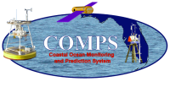
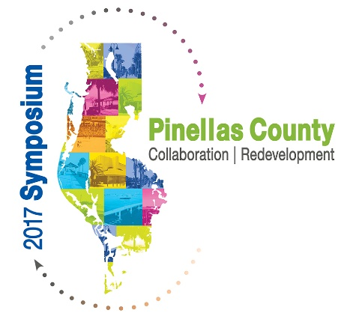
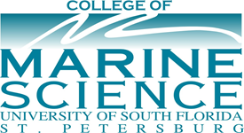
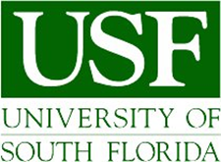
2017 Pinellas County Economic Leadership Symposium
  Workforce Panel: Preparing for the Future
  Invited Speaker: Dr. Cliff Merz, PE
  USF College of Marine Science,
  Commissioner City of Safety Harbor
Program and HF Radar Operations Director, Coastal Ocean Monitoring and Prediction System (COMPS) (http://comps.marine.usf.edu/)
  Former President of the University of South Florida Chapter of the National Academy of Inventors (NAI) (http://www.research.usf.edu/nai/nai-usf-chapter.asp)
  USF College of Marine Science
  St. Petersburg, Florida 33701
  Office: (727) 553-3729
  Email: cmerz@usf.edu
  Presented: April 20, 2017
Location: St. Petersburg College
Seminole Campus

Slide 2
Introduction – Preparing for the Future
Studies have shown that student attrition and poor performance results from:
    Lack of INTEGRATION.
    Poor ACADEMIC SUPPORT and PREPARATION.
    Lack of SOCIALIZATION with the students home department.
    Lack of MENTORING (Solem, Lee, & Schlemper, 2009).
Similar analogies are often found in poorly performing businesses or industries.
The following slides present some workforce development efforts underway at USF to better prepare our students, faculty, and community for the future.

Slide 3
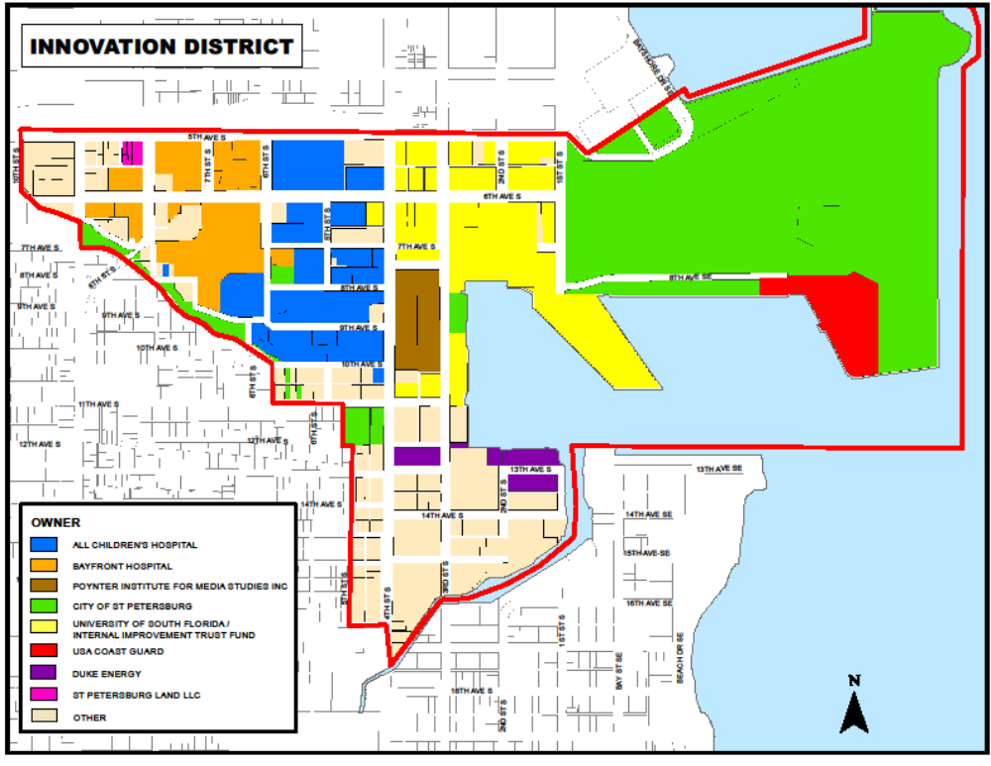
St. Petersburg Waterfront - Innovation District
- Integration -
Within the Innovation District, St. Petersburg’s marine and environmental sciences flourish in downtowns' Bayboro Harbor Area.
Anchoring the innovation district is the St. Petersburg Ocean Team.

Slide 4
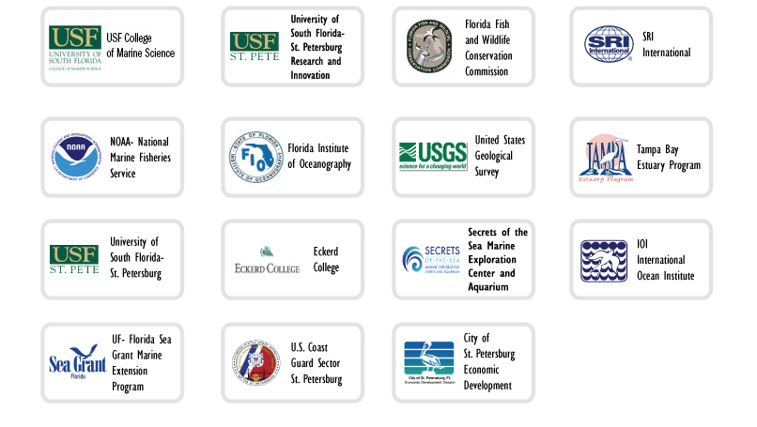

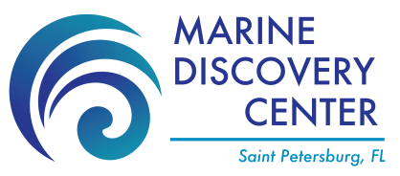




The Ocean Team is the premier consortium of public and private marine science, oceanographic, and environmental research agencies and institutions in the Southeastern United States.

Slide 5
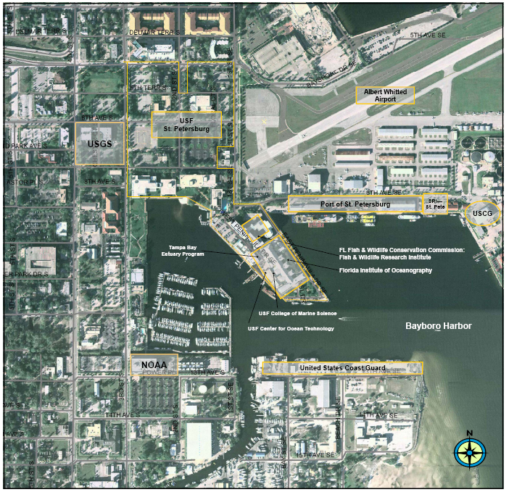
St. Petersburg Ocean Team – Economic Impact
Industry “clusters”, like the Ocean Team draw productive advantages from their proximity and similarities between their workforce and vendor needs, both within the district and county-wide.
The Ocean Team along with its related agencies and businesses employ more than 1600 people whose employees generate an estimated $143 million in annual household earnings and contribute $251 million to Pinellas County’s gross county product.*
* Tampa Bay Regional Planning Council, 2010 economic analysis.

Slide 6
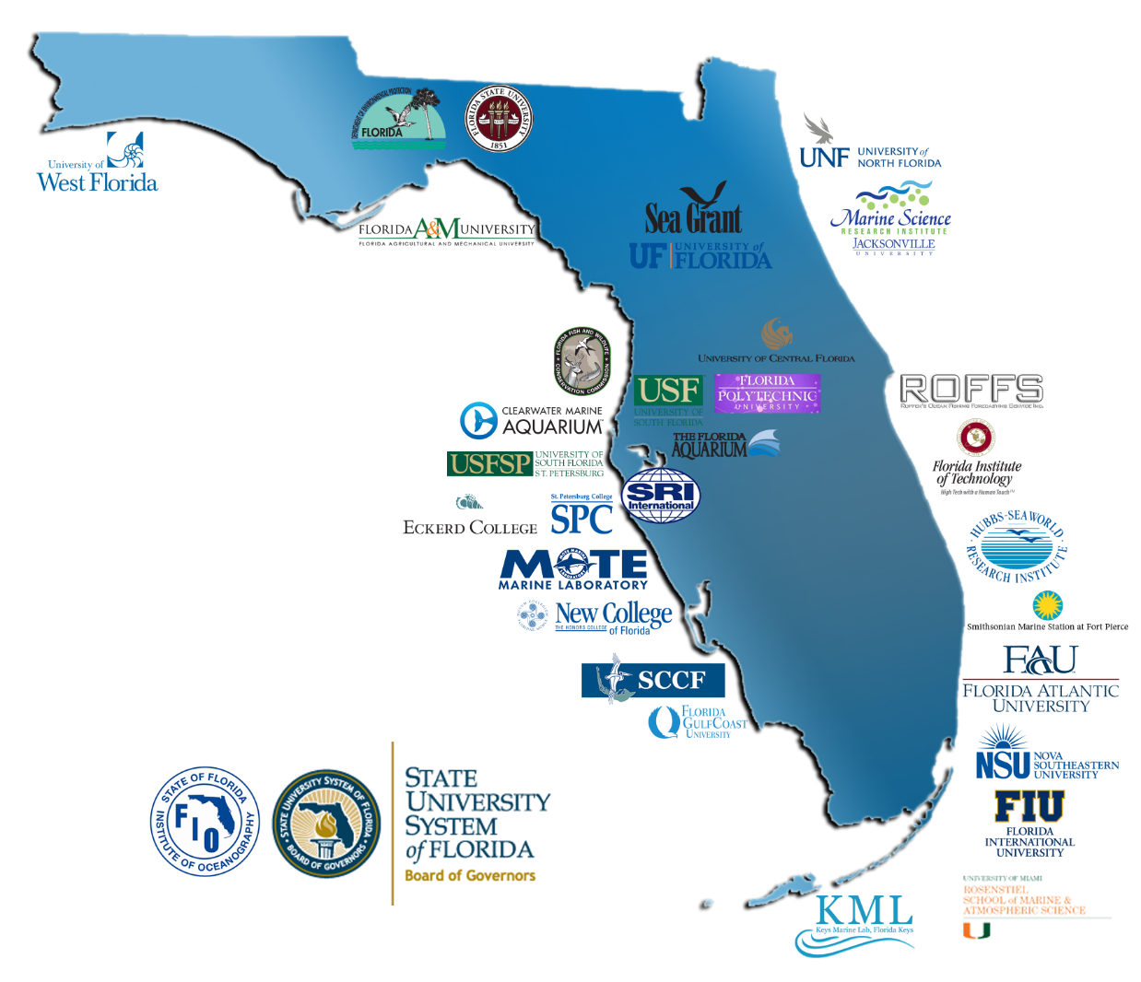
Florida Institute of Oceanography (FIO)
Coupled with the Florida Institute of Oceanography (FIO), the Ocean Team is able to conduct marine and environmental research in Florida, the Caribbean, and beyond.
FIO supports and provides underlying technology, equipment, facilities, services, and resources to its 30 member institutions for academic programs and research.
FIO is an Academic Infrastructure Support Organization (AISO) established by the Florida Board of Governors and hosted by the University of South Florida (USF).

Slide 7
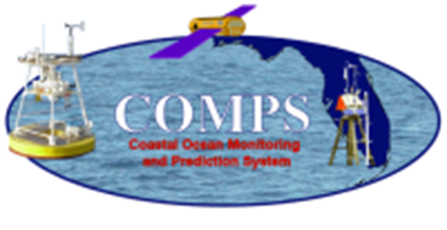
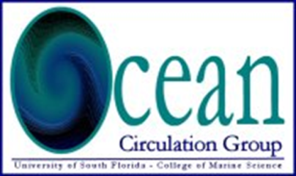
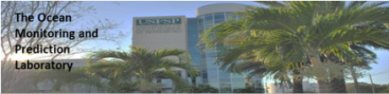
Coastal Ocean Monitoring and Prediction System (COMPS)
COMPS Buoy Sites: Robert H. Weisberg (PI), Yonggang Liu (Co-PI)
COMPS HF Radar Sites: Robert H. Weisberg (PI), Clifford R. Merz (Co-PI)
COMPS Coastal Sites: Mark E. Luther (PI), Clifford R. Merz (Co-PI), Jeff Scudder (Co-PI)
COMPS Modeling : Robert H. Weisberg (PI), Yonggang Liu
COMPS Program Director and HF Radar Site Operations: Clifford R. Merz
COMPS Oceanographic Site Operations: Jason Law
COMPS Coastal Site Operations: Jeff Scudder
COMPS Data Analyst/Oceanographer: Dennis Mayer
COMPS Systems Administrator: Jeff Donovan
Center for Ocean Technology (COT)/Engineering: Randy Russell

Slide 8
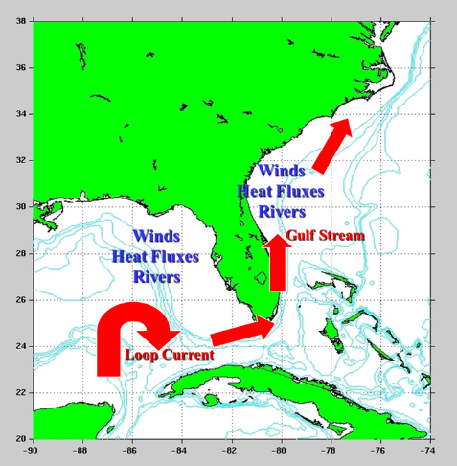
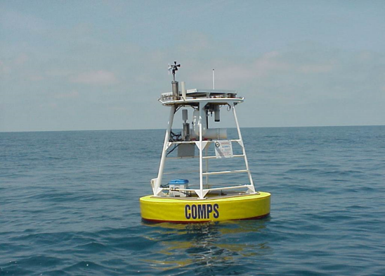
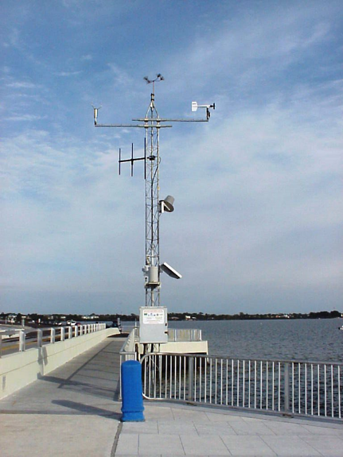
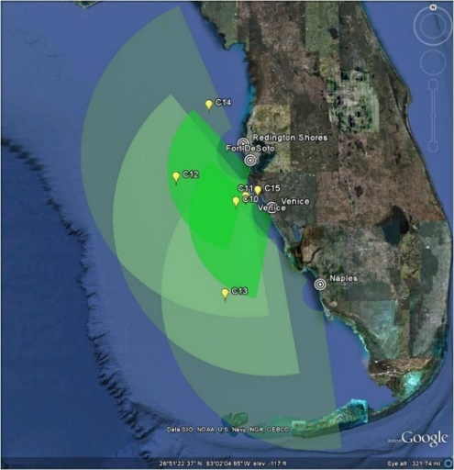
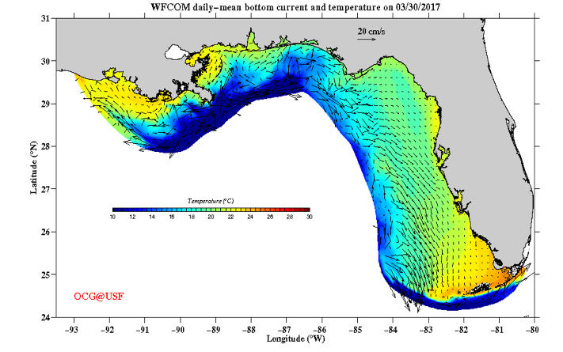
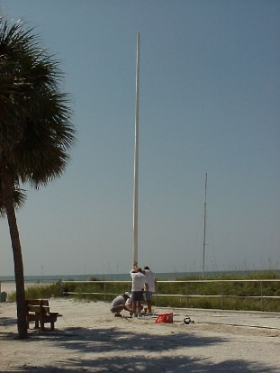
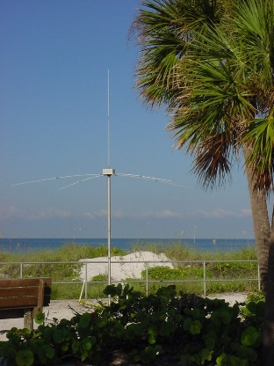
COMPS Program Goal
The COMPS Program was implemented as a State of Florida legislative initiative in 1997. This support has been supplemented by other state and federal programs.
COMPS Overall Program Goals are:
    To provide real-time data for various societal needs.
  Initiated to improve our understanding of the workings of the coastal ocean for a variety of environmental applications, including hurricane storm surge along the West Coast of Florida’s West Florida Shelf (WFS).
    To Foster Continued Educational Outreach and Mentor Multidisciplinary Workforce Development.

Slide 9
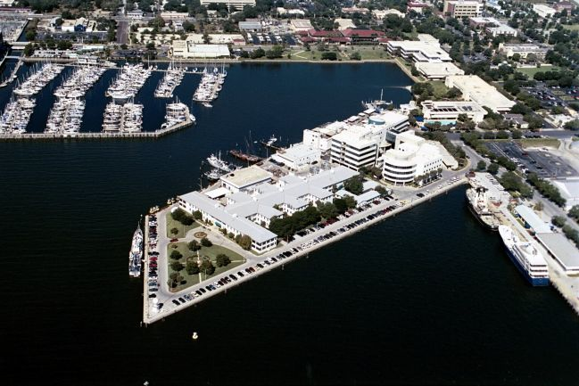
USF - College of Marine Science
- Academic Support and Socialization -
50 Years of Advancing Marine Science: 1967 - 2017
1967 - Marine Science Institute founded as a research center of excellence on USF’s Bayboro Campus at the former US Maritime base – evolving into our USF CMS today.
2017 - C.W. Young Marine Science Complex –
    11 acre waterfront campus
    3 major buildings
    Dockside facilities for most oceanographic vessels
    2 State of Florida Research Vessels (FIO)
27 Tenure-track Faculty and 47 Research Associates
As of fall 2016, USF CMS has produced 608 graduates (404 MS and 204 PhDs).
Strong Education and Outreach program that reaches many regional primary and secondary school age children.
~14 M in research funding.
~16 M in endowments promoting 22 fellowships averaging from $10,000 to 22,000.

Slide 10
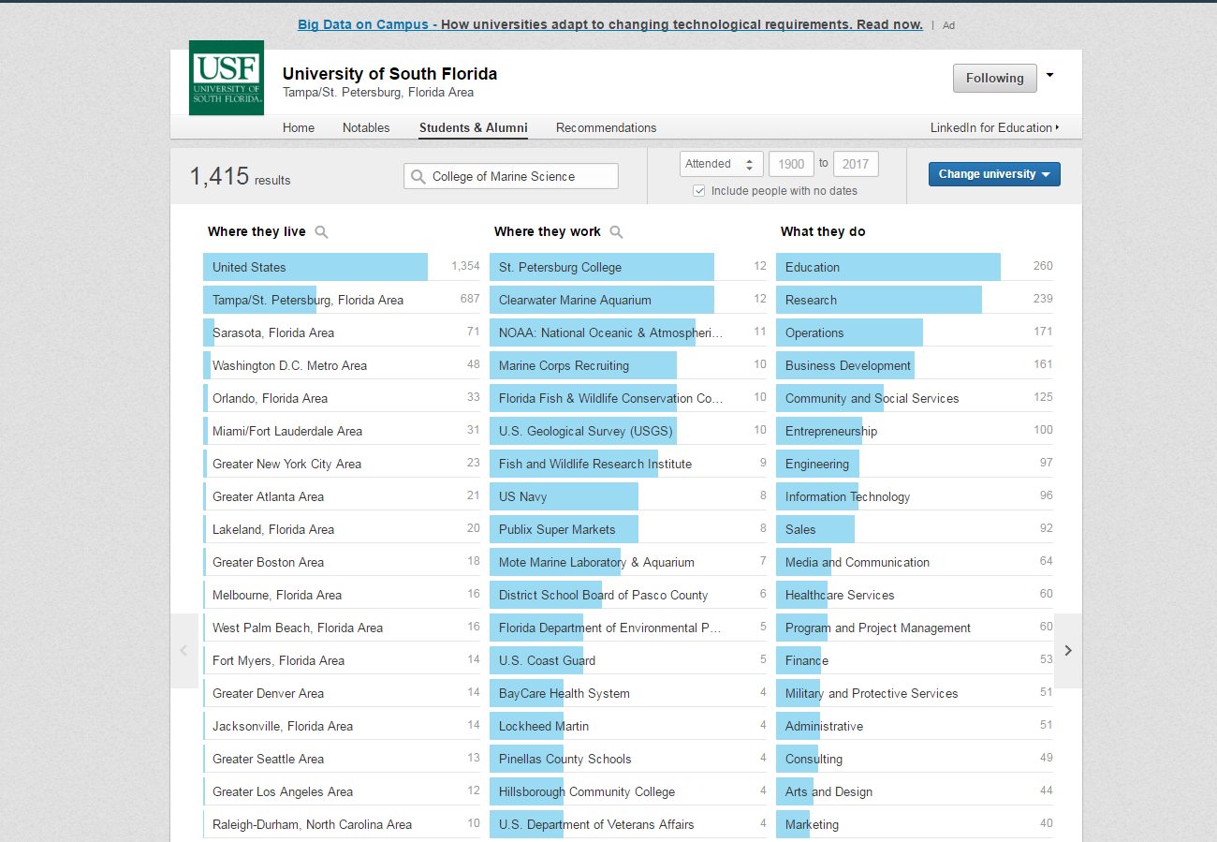
USF CMS Graduate Student Success Model
100 Graduate students (32% MS and 68% PhD) and 20 Post Doctoral Fellows on Average.
Mentored, research intensive program in which students work closely with their faculty advisors as apprentices.
Attrition rate between 5 - 7% and an average time-to-degree of 6.5 years for PhD and 3.5 years for MS students.
10-Step Graduate/Undergraduate student program designed to improve overall success.*
Recruitment Weekend
New Student orientation
Student Group
Lunch with the Dean
Spring Fling
Annual Student Workshop
Student Participation on College Communities
Graduate Student Symposium
Weekly Seminars – especially in 1st year
Annual Progress Reports
*Sheehy, B (2016). “Graduate Student Success: A Model that Works”, NACADA. http://www.nacada.ksu.edu/Resources/Academic-Advising-Today/View-Articles/Graduate-Student-Success-A-Model-that-Works.aspx.

Slide 11

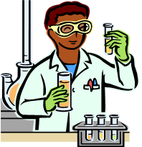
Mentoring
- Mentoring -
Before a few mentoring examples, let me focus you on the underlying construct connecting all – STEM.
STEM education grows out of the idea that the boundaries between science, technology, engineering, and math are permeable and interdependent.

Slide 12
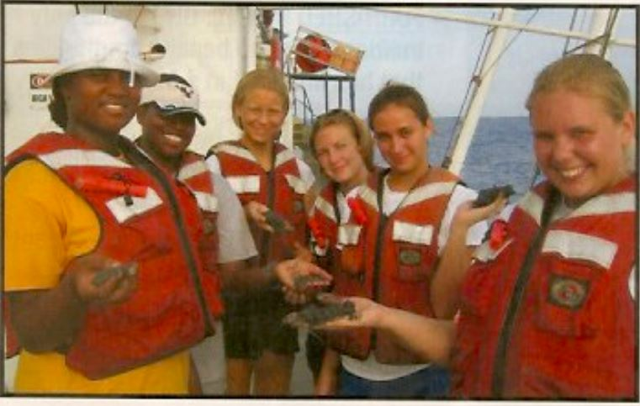
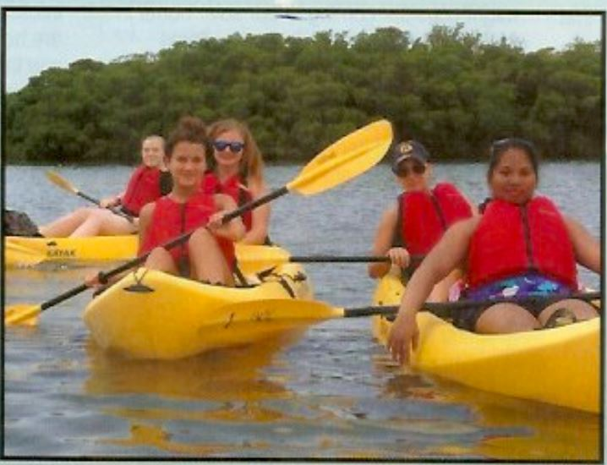
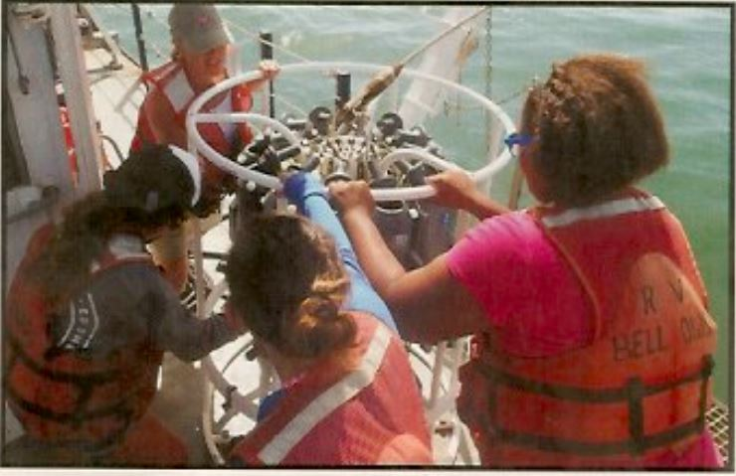
USF CMS Unique Oceanography Camp for Girls (OCG) – 25 Years at The Marine Science Campus
In the 1990’s several national studies revealed a tremendous drop in the number of women pursuing math and science degrees.
To address this shortfall, USF CMS began the first Oceanography Camp for Girls in 1991, A National Science Foundation (NSF) Model Program for Woman and Girls.
The all-girls setting dissolves social barriers to learning, takes place in an authentic science environment and advances a positive sense of self.
Under the interdisciplinary umbrella of Oceanography, participants are directly involved and mentored in disciplines in which women and minorities are most often underrepresented; chemistry, geology, physics, engineering, and mathematics.
Program strengths include mentored interdisciplinary learning with participation in real-word research projects and problem solving.
Open to all girls in Pinellas County schools who are completing the 8th grade – Session is 3-weeks in the summer. Cost is free but the session size is limited to 30 girls.

Slide 13
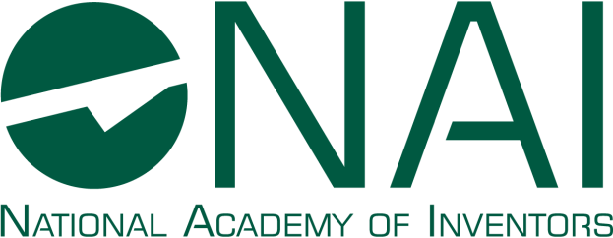
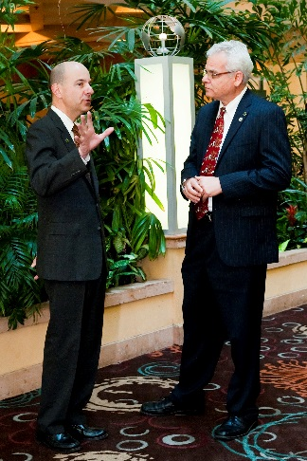
National Academy of Inventors
Founded at USF in 2010 by Dr. Paul Sanberg.
501(c)(3) non-profit member organization.
U.S. and international universities, and governmental and non-profit research institutes.
3,000 individual inventor members and Fellows spanning more than 240 institutions.
The NAI mission is to recognize and encourage inventors with patents issued from the U.S. Patent and Trademark Office, enhance the visibility of academic technology and innovation, encourage the disclosure of intellectual property, educate and mentor innovative students, and translate the inventions of its members to benefit society.

Slide 14
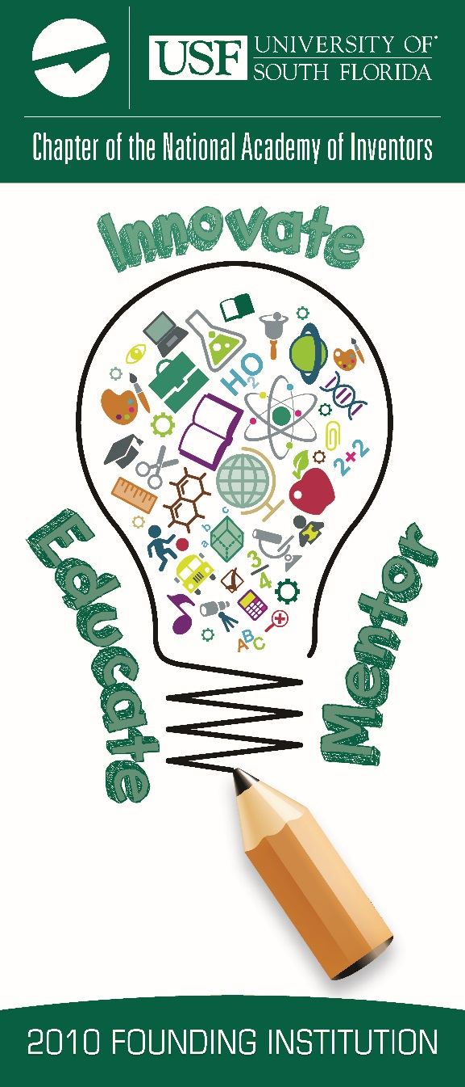
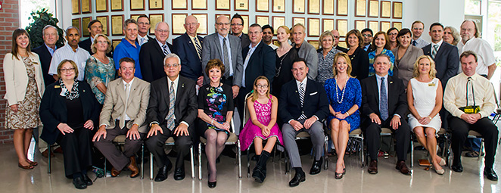
USF Chapter Of the NAI
USF became the Founding Chapter of the National Academy of Inventors (NAI) with 131 members.
Today, the USF Chapter has over 400 regular and honorary members, and is the largest chapter in the NAI.
USF has received 859 issued US patents since FY2007, with 73 originating from USF CMS.
The NAI’s mission is to educate and mentor innovative students, and translate the inventions of its members to benefit society.
Examples include:
      Sponsor partner seminars and workshops in conjunction with USF Patents and Licensing.
      Serve as judges and mentors in STEM and innovation-related events and competitions.
      Semi-annual workshops for training in Technology, Innovation & Entrepreneurship.
Following are a few USF examples supported by USF CMS and USF NAI Chapter members.
Notes:
Examples of STEM Competitions: CADE Museum Prize and the Healthcare Innovation Pitch Competition

Slide 15
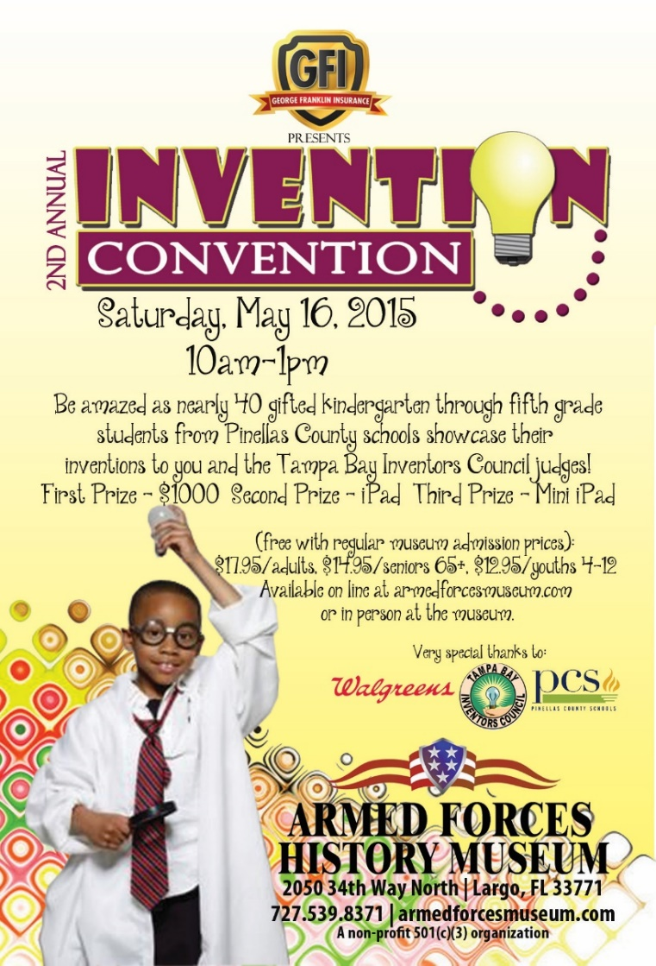
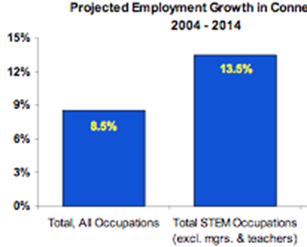
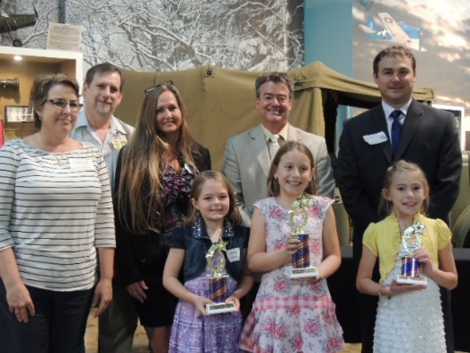
Pinellas County Schools (PCS) Invention Convention - STEM
Members of the USF Chapter of the NAI served as judges in PCS’s 2015 and 2016 Invention Convention.
It has been estimated that 75% of future Career and Technical (CT) jobs will require STEM skills.
Industries such as:
      Healthcare
      Aerospace
      Computers
      BioScience
      Financial
      Marine Science/Oceanography
      Ocean Engineering
      Manufacturing
      And many others
By endeavoring to blend science, technology, engineering, and math in its approach, STEM education seeks to create learning opportunities and skill development for all students.

Slide 16
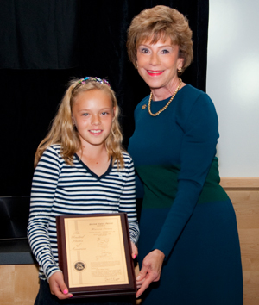
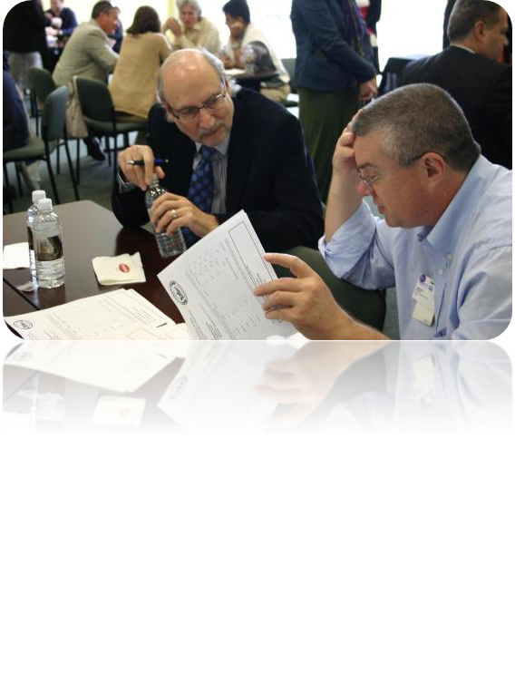
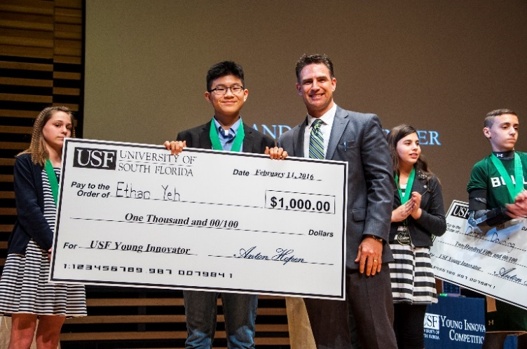
USF Young Innovator Competition - STEM
Annual competition since 2007, which recognizes Tampa Bay area youth innovators.
Final competition is held each year at USF on Edison’s birthday.
Members of the USF Chapter of the NAI serve as second-round judges.
USF Young Innovator Competition
      Open to all students K – 8.
      2016 competition drew over 700 entries from 5 Tampa Bay counties.
      1st competition winner and youngest member of the USF NAI Chapter received 1st patent at age 11.
Notes:
Examples of STEM Competitions: CADE Museum Prize and the Healthcare Innovation Pitch Competition

Slide 17
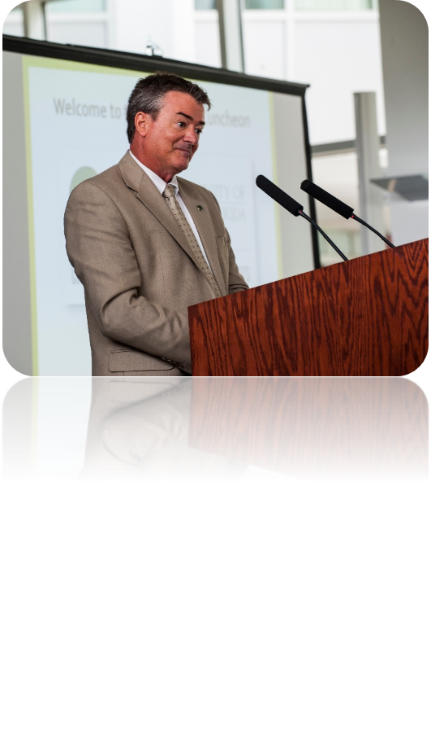
Semi-annual Workshops for Training in Technology, Innovation & Entrepreneurship
Spring 2016: "Collaborative Innovation - From Ideas to Action: Panel discussion with Leaders of Tampa Bay's Incubators & Accelerators“.
    Moderator: Mark Sharpe. Tampa Innovation Alliance (USF Tampa, Hillsboro).
    Panelist: Steve Allen. Technical Arts Facility for Innovation and Entrepreneurship – TAFFIE (Clearwater, Pinellas).
    Panelist: Stephanie Ashley. Business Incubation and Economic Development, USF Research Foundation, Inc. (USF Tampa, Hillsboro).
    Panelist: Tonya Elmore. Tampa Bay Innovation Center - TEC Garage (St. Petersburg, Pinellas).
    Panelist: Linda Olson. Tampa Bay WaVE (Tampa, Hillsboro).
Fall 2016: “Nurturing The Innovators Of Tomorrow: An Informational panel about becoming an National Science Foundation (NSF) I-Corps Program Mentor”.
    The focus of this workshop was to introduce audience/community to the NSF's I-Corps program which fosters entrepreneurship leading to the commercialization of technology and appeal to audience members covering a 5-couty area to participate and get involved as an I-Corps team business mentor.
Notes:
Examples of STEM Competitions: CADE Museum Prize and the Healthcare Innovation Pitch Competition

Slide 18

NSF I-Corps
Purpose: to provide access to entrepreneurial resources to help determine the readiness to transition technology to commercial products.
Teams funded at Universities that have existing innovation/entrepreneurial units, to enable them to nurture students and/or faculty who are engaged in projects having the potential to be transitioned into the marketplace.
Team composition:
    Entrepreneurial Lead: grad student or post-doc.
    Principal Investigator: faculty researcher.
    Mentor: business person.
Curriculum based on Lean Startup and Evidence Based Entrepreneurship concepts developed by Steve Blank at Stanford.
Notes:
Discovery before implementation

Slide 19
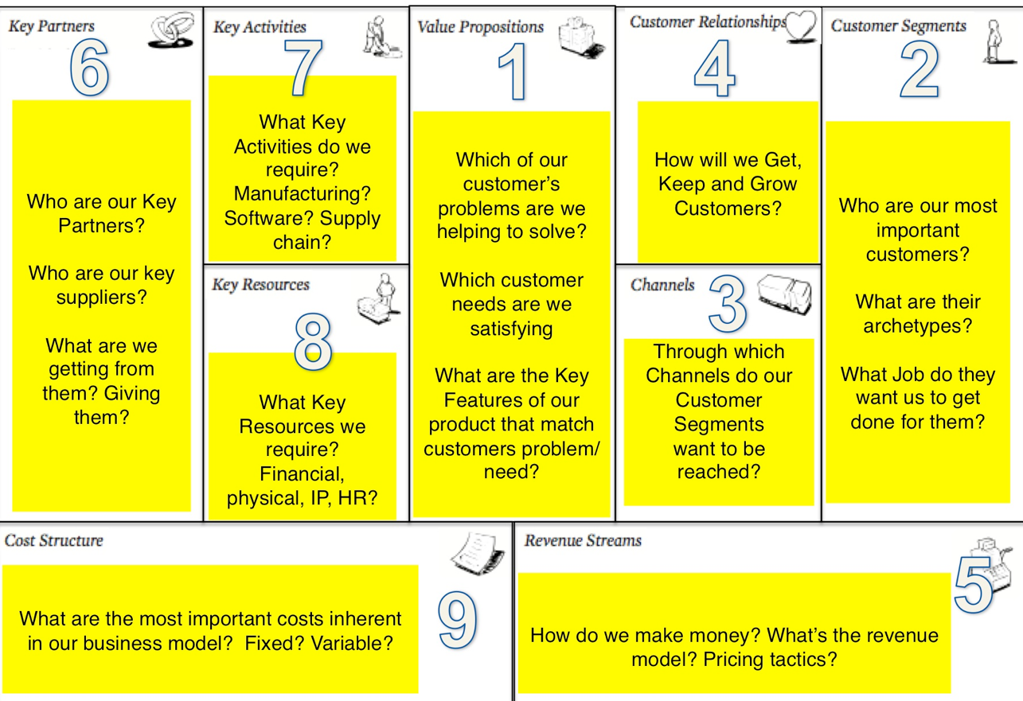
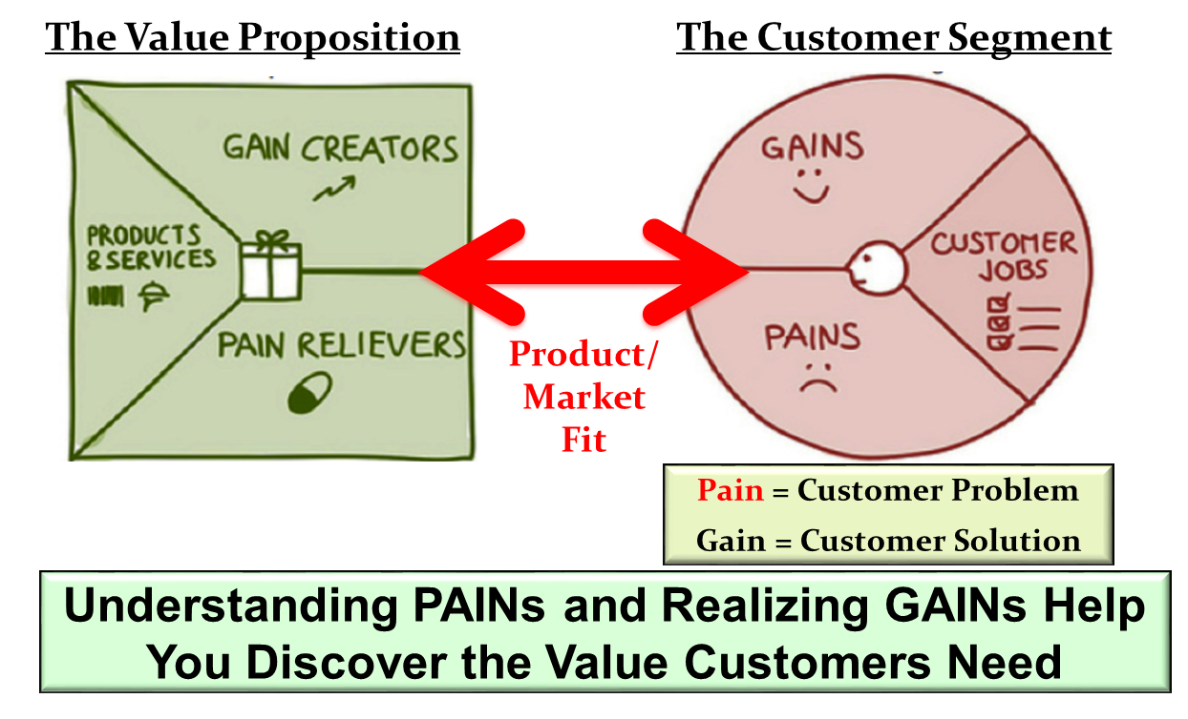
Business Model Canvas
Searching for Customer Needs
Notes:
Information from interviews is analyzed and findings are recorded on the business model canvas

Slide 20
I-CORPS Benefits
Faculty and students learn language of business.
Mentors get to assist students embark on an entrepreneurial journal.
Involvement with cutting edge new technology.
New contacts, nationwide.
Potential income, equity opportunity as part of startup.
Connect with investors, mentors, and industry.
Identify commercial potential for ideas.
Startup and/or Licensing.
Follow-on SBIR/AIR/BIC/GOALI grant success.
Ultimately then leading back to INTEGRATION!

Slide 21
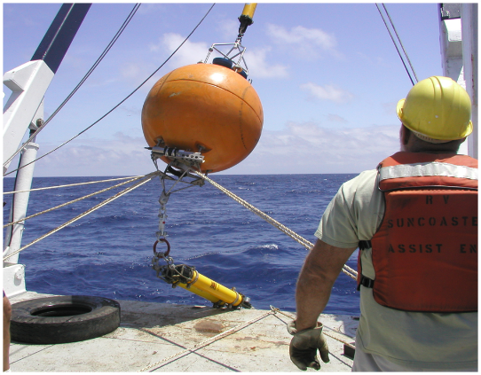
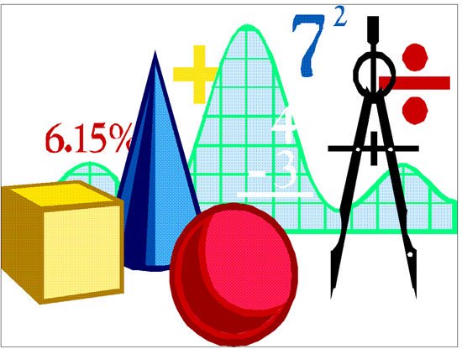
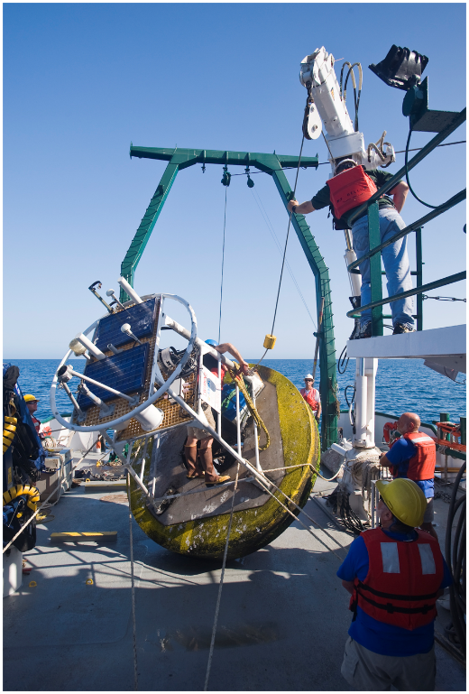
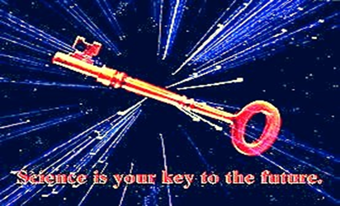

Summary - The Workforce Future
75 % of future jobs will require a blended, multi-disciplinary education and skill set.
Not just STEM careers, it is STEM in every job.
Technology as a “global knowledge economy” is the future, and it requires different skills.
Business and industry both Want and Need employees with these workforce skills!
Notes:
We know that the top 10 in-demand jobs in 2010 did not exist in 2004. The U.S. Department of Labor estimates that today's learner will have 10-14 jobs by the age of 38. The amount of new technical information is doubling every 2 years For students starting a 4 year technical degree this means that half of what they learn in their first year of study will be outdated by their third year of study.We are currently preparing students for jobs that dont yet exist using technologies that haven't been invented in order to solve problems WE DON'T EVEN KNOW ARE PROBLEMS YET.
Kids now spend 6.5 hours a day interacting with technology
The need is for accessing information, collaborating, analyzing and synthesizing, not memorizing.
Recent reports show that top STEM performing high school students go into jobs that may not be classified as STEM, but use those skills, http://www.edweek.org/ew/articles/2009/10/28/10engineer.h29.html
Need for Diversity Making a Case for Diversity in STEM Fields, Daryl Chubin, Shirley Malcom, November 2008, http://mentornet.net/documents/about/news/newsart.aspx?nid=37&sid=2
Tapping America’s Potential: The Education For Innovation Initiative, Gaining Momentum, Losing Ground
, Business Roundatable, July 2008, http://www.tap2015.org/resource/tap_2008_progress.pdf

Slide 22
Questions?
Thank you for your time and attention!

