Slide 1
St Petersburg College Programs and
Work-Based Learning
Jason Krupp, PhD, Director of Workforce Services
April 20, 2017

Slide 2


Career and Academic Pathways
Articulation Agreements Between Training Providers
Pinellas County School Career Academies
College Credits
Apprenticeships
Notes:
New or expanded sites receive a $1200 stipend for training.
Help you set up the apprenticeship.
Promote your apprenticeship openings.
Articulate training to college credit.
Access related training (soft skills, Industry certification) at SPC

Slide 3
SPC Programs
3 Adult Vocational
56 Certificates
37 AS Degrees
20 BS/BAS Degrees
AA Transfer Degree
2015-16
44,350 Students Enrolled
8,105 Credentials Awarded
Notes:
+

Slide 4
Salaries of SPC Graduates
Florida Department of Education, Smart College Choices
Notes:
In the State’s performance funding SPC was ranked #1 Earnings of Graduates; #5 in the nation (Brookings Report) – show images

Slide 5
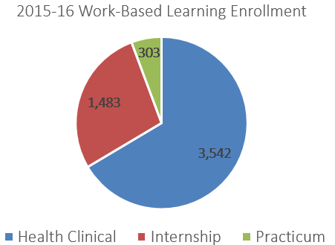
Internships and Work-Based Learning
An internship is a supervised, practical learning experience in the workplace that offers the student an opportunity to apply, connect, and extend academic theory and competencies to build professional skills and networks.
Supervised by Faculty
One College Credit Awarded for Each 60 Hours
Notes:
An Internship at SPC is a supervised, practical learning experience in the workplace that offers the student an opportunity to apply, connect, and extend academic theory and competencies to build professional skills and networks. Over 5,000 students per year participate in work-based learning courses such as internships, practicum courses, and clinical experiences.
Over 700 businesses have partnered with the college to host SPC college credit internships over the past three years.
In the Fall term, 43 students interned with 27 companies.

Slide 6



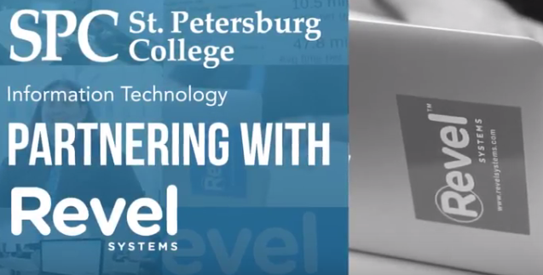
Information Technology
B.A.S. in Technology Development and Management
Computer Information Technology A.S. Degree
  Help Desk Support Specialist Certificate
Computer Programming & Analysis A.S. Degree
  Computer Programmer Certificate
  Computer Programming Specialist Certificate
Computer Networking A.S. Degree
  Computer Support Certificate
  Cisco Certified Network Associate Certificate
  Linux System Administrator Certificate
  Microsoft Certified Solutions Associate Certificate
Web Development A.S. Degree
  Web Development Certificate

Slide 7






Life Sciences & Medical Technologies
Dental Hygiene
Emergency Medical Services
Funeral Services and Arts
Health Information Technology
Health Services Administration
Health Sciences
Nursing
Orthotics and Prosthetics Technology
Physical Therapist Assistant
Radiography
Respiratory Care
Veterinary Technology
Health Sciences Short-Term Training &
Continuing Education
Notes:
Over 1,000 Student clinical placements each semester

Slide 8
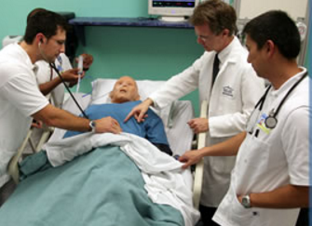
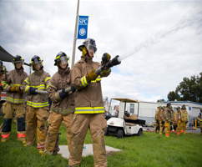
Licensure Pass Rates
Programs | 2015-16 | National or State Average
Corrections State Exam | 100 | 77
Dental Hygiene National Exam | 97 | 95
Education State Exam | 100 | N/A
Emergency Medical Technician National Exam | 96.3 | 70*
Fire Academy State Exam | 97.1 | 93.5*
Funeral Services
National Exam Arts | 95 | 74
National Exam Science | 93 | 77
Health Info Management National Exam | 82 | 69
Law Enforcement State Exam | 93 | 81.3
Nursing National Exam | 90.9 | 82.7
Paramedic National Exam | 82 | 72*
Physical Therapist Assistant National Exam | 100 | 88.8
Radiography National Exam | 100 | 88.4
Veterinary Technology National Exam | 73.2 | 65.5
* 2016 State Average
Source: 2016-17 St. Petersburg College Fact book, Table 9; Program Data

Slide 9
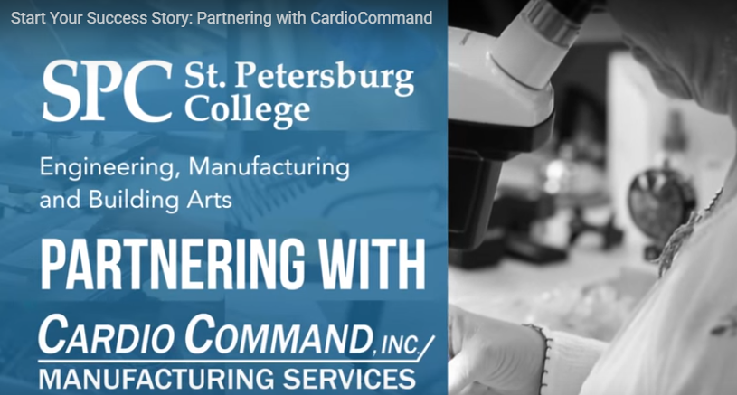



Advanced Manufacturing
Engineering A.A. Transfer Plan
Biomedical Engineering Technology
A.S. Degree
Engineering Technology A.S. Degree
  Computer-Aided Design and Drafting Certificate
  Engineering Technology Support Certificate
  Lean Six-Sigma Green Belt Certificate
  Rapid Prototyping and Design Certificate
  Six Sigma Black Belt Certificate
Notes:
Engage in 3D printing process using additive manufacturing techniques
Understand the electronics and precision needed for building robots
Learn entrepreneurial skills used by successful business owners
Tour an Advanced Manufacturing Facility

Slide 10

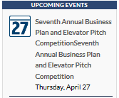
Business and Financial Services
International Business B.A.S. Degree
Project Management Bachelor's Certificate
Management & Organizational Leadership
B.A.S. Degree
  Hospitality and Tourism Management A.S. Degree
  Industrial Management Technology A.S. Degree
Business Administration B.S. Degree
Business Administration A.S. Degree
    Accounting Technology Operations Certificate
    Business Administration Certificate
    Entrepreneurship Certificate
    Management/Leadership Certificate
    Marketing Certificate
    Supply Chain Management Certificate
Notes:
Dominic Gianfrancesco, a graduate of SPC's College of Business, started his career with Tech Data after a six-week internship in San Jose, Costa Rica, where he worked as a Business Analyst. One of the world's largest technology distributors, Tech Data, liked what they saw and offered him a position when he returned to Florida.

Slide 11
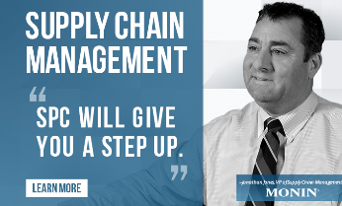

Business and Financial Services
Certifications Aligned with Curriculum
Supply Chain Management Principles | Customer Service Operations
Warehousing Operations | Transportation Operations
Demand Planning | Supply Management & Procurement
Inventory Management | Manufacturing & Service Operations
Notes:
LINCS (Leveraging, Integrating, Networking, Coordinating Supplies) is a national supply chain management education and training program funded by a $24.5 million U.S. Department of Labor TAACCCT grant. The Trade Adjustment Assistance Community College and Career Training grant program is a multiyear, nearly $2 billion initiative to expand targeted training programs for unemployed workers, especially those impacted by foreign trade. Read full story.
The program is administered by a consortium of 9 colleges and 3 universities led by a national team from Broward College in Fort Lauderdale. Consortium members include: Rutgers University, Northwestern University, Georgia Institute of Technology, Essex County College, Union County College, Harper College, Broward College, St. Petersburg College, Florida State College at Jacksonville, San Jacinto College, Columbus State College, California State University, Long Beach City College.
At SPC, you can earn the following entry to mid-level SCPro Fundamentals certifications:
Supply Chain Management Principles
Customer Service Operations
Transportation Operations
Warehousing Operations
Supply Management & Procurement
Demand Planning
Inventory Management
Manufacturing & Service Operations

Slide 12
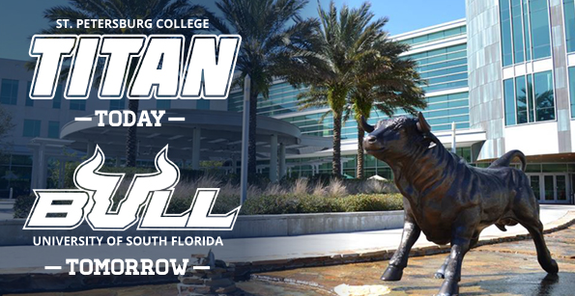
Career & Academic Pathways
Articulation agreement between SPC and USF
Guaranteed admission to over 20 majors

