Slide 1
Pinellas County Schools
Engaging Students for
Career and College

Slide 2
The Engagement Continuum
Elementary
Middle
School
High School
Post
Secondary
STEM Academies
Science Labs
Science Clubs
Math Clubs
• Accelerated Academics
• Dual Enrollment
• Internships
• Industry Certification
• Future Plans
• Technical College
• State College
• University
• Military
• Apprenticeships
• Career Entry
• Career Academies
• STEM Academies
• Industry Certification

Slide 3
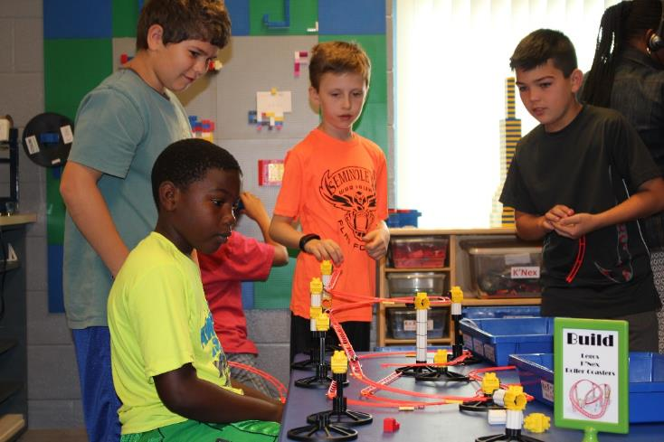
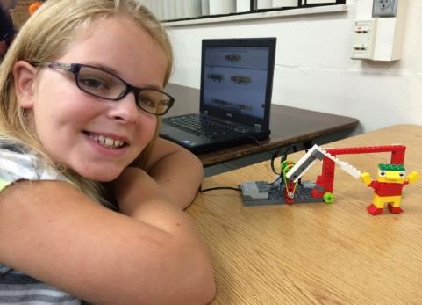
Elementary
Elementary

Slide 4
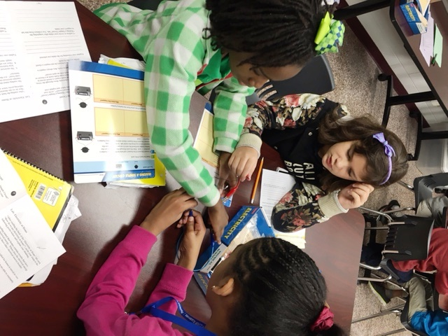
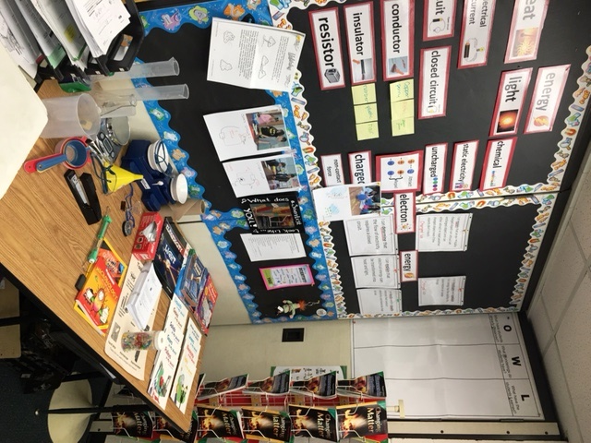
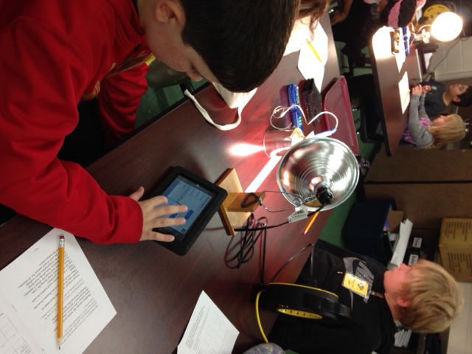
Science Labs and STEM Academies in Elementary Schools

Slide 5
STEM Academy Growth
2013 – 2014 | 56 STEM Academies | 1,120 Students Impacted
2014 – 2015 | 156 STEM Academies | 2,500 Students Impacted
2015 - 2016 | 228 STEM Academies | 4,560 Students Impacted
2016 - 2017 | 251 STEM Academies | 5,271 Students Impacted

Slide 6
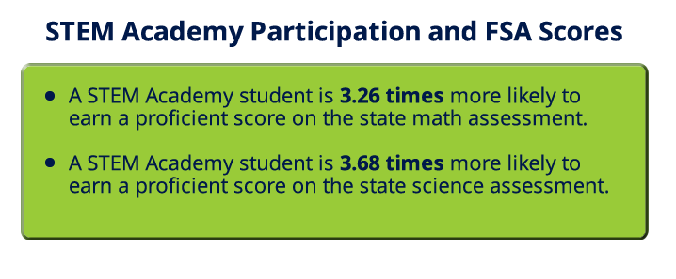

Slide 7
Middle School
Career and Technical Courses Grades 6 – 8
Career Academies in all middle schools
Over 2200 MS industry certifications
Pre-IB programs
PSAT administered to all 8th grade students
High school credit courses beginning in grade 7
Visual and Performing arts programs
Middle
School

Slide 8
High School
High School
Career Academies in every high school
Over 22,000 students enrolled in CTE programs
Career and College Dual Enrollment
Internships
Project-based Learning

Slide 9
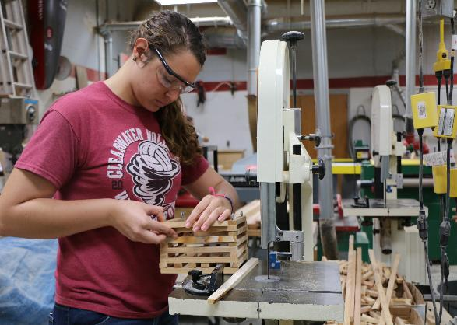
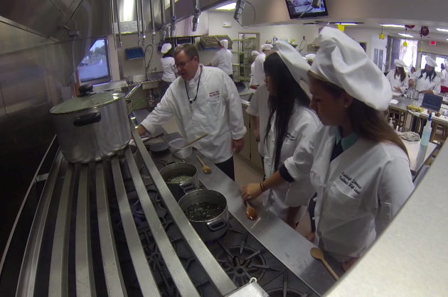
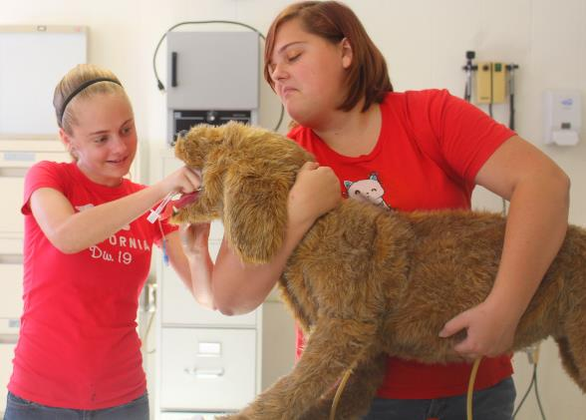
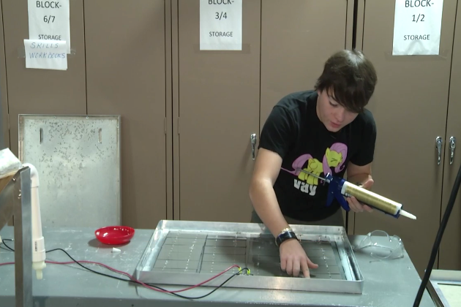
Career Academies

Slide 10
Academies of Pinellas
Partnership with Pinellas County Schools, Career Education Board, Pinellas Education Foundation
Established Goals 2012 – 2017
        50% of all high school students enrolled in an Academy
35% of high school graduates will have at least one industry certification
        Academy Site Visits – Twice annually (46 visits)

Slide 11
Current Status of AOP Goals
52 Registered CAPE Academies
  12 academies in 8 middle schools
  40 academies in 16 high schools
Academies of Pinellas Enrollment – 53%
Graduates with Industry Certification – 27%

Slide 13

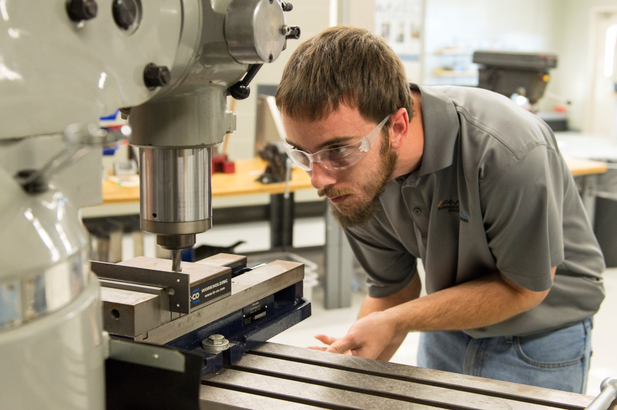


Slide 14
Growth in Industry Certifications
2015-2016: 10,357
2014-2015: 7,517
2013-2014: 4,135
2012-2013: 3,815
2011-2012: 2,222

Slide 15
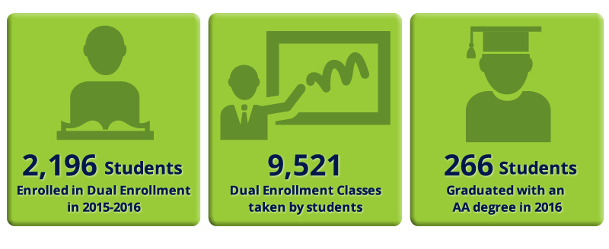
Dual Enrollment Participation

Slide 16

High School
High School
https://pinellas.futureplans.org/

Slide 17
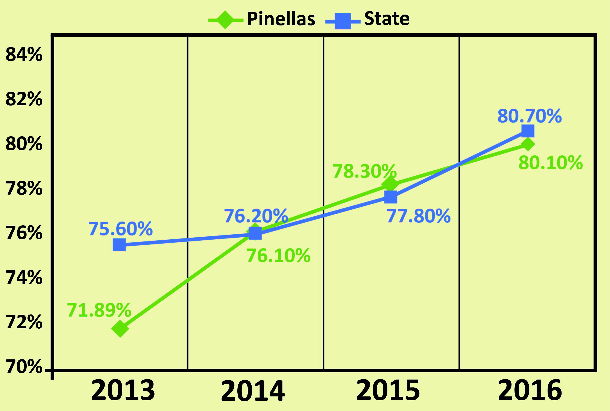
Graduation Rate

Slide 18
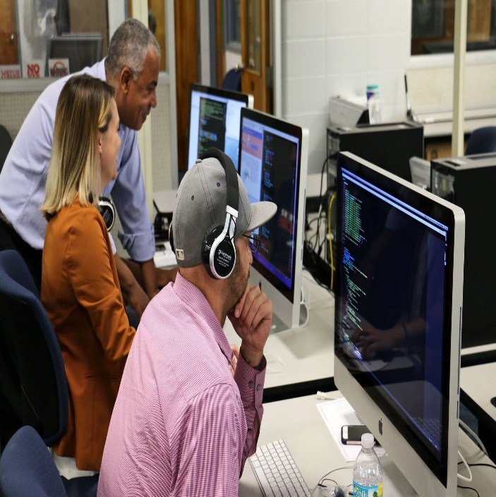
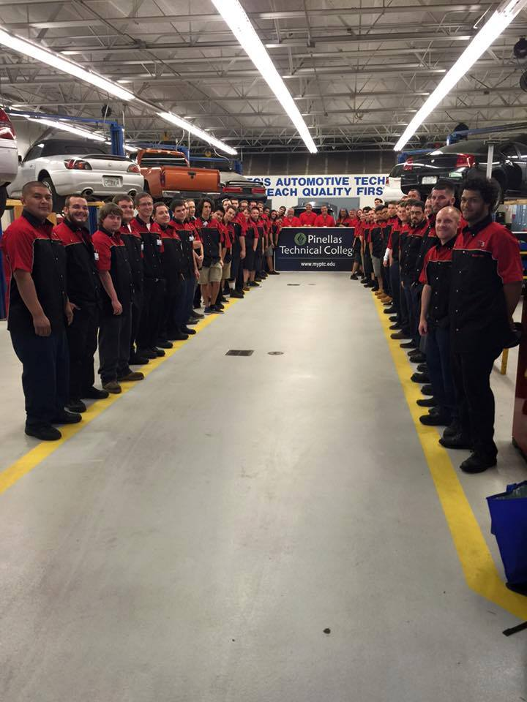
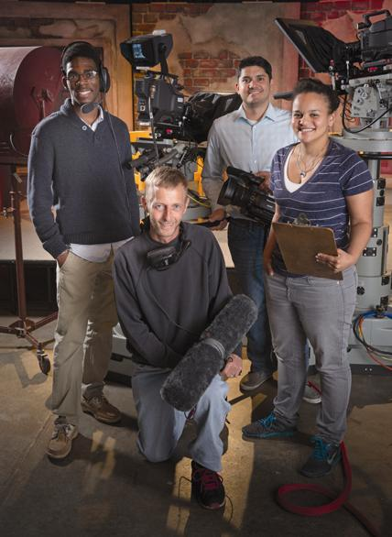
Opportunity Starts Here!

