Slide 1
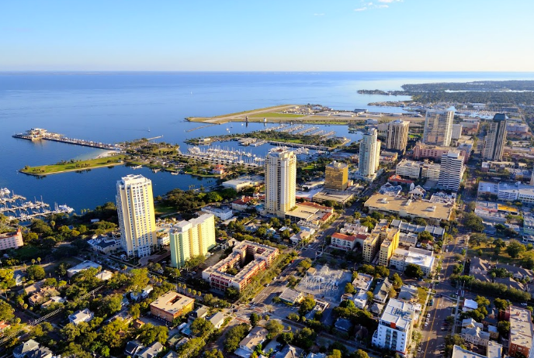
Intentionality:
Competing in the 21st Century

Slide 2
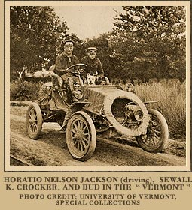
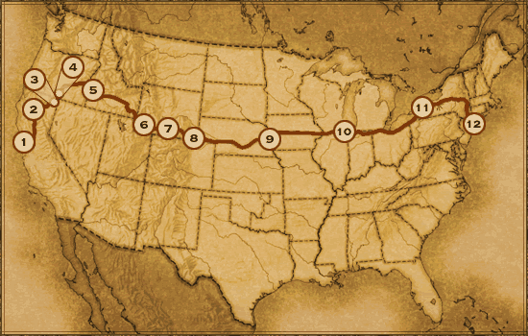
America’s First Road Trip
Horatio Nelson Jackson, Sewall K. Crocker & Bud
1-2 December 2009
Source: www.pbs.org
Notes:
2

Slide 3

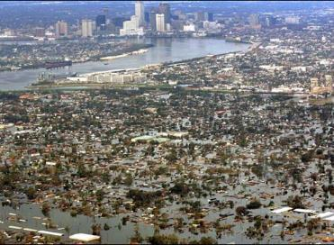

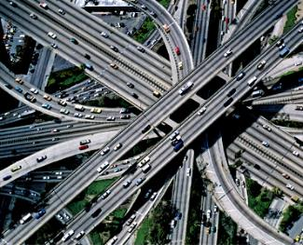
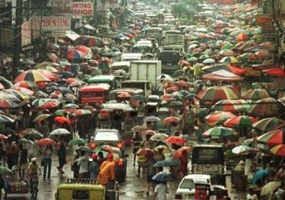
Six Converging Forces
Globalization
Environmental
Technological Innovation
Demographics
Financing the Future
Talent
Notes:
3

Slide 4
Employment: Employment Trends, 1990-2016
 | Manufacturing |  |  | Professional and Business Services |  |  | Education and Health Services
U.S. Metro | 1990 | 2015 | % Change | 1990 | 2015 | % Change | 1990 | 2015 | % Change
Baltimore | 126 | 55.2 | -56% | 121 | 237.3 | 96% | 151 | 270.7 | 79%
Denver | 84 | 69.7 | -17% | 132 | 266.6 | 102% | 74 | 187.9 | 154%
Philadelphia | 342 | 182.9 | -47% | 306 | 472.6 | 54% | 367 | 629.8 | 72%
Pittsburgh | 130 | 85.3 | -34% | 127 | 186.1 | 47% | 166 | 246.6 | 49%
Research Triangle | 76 | 62 | -18% | 66 | 162 | 145% | 54 | 138 | 156%
San Diego | 121 | 105.5 | -13% | 128 | 239.5 | 87% | 92 | 204 | 122%
San Francisco | 173 | 126.6 | -27% | 280 | 483.8 | 73% | 188 | 349.8 | 86%
Seattle | 230 | 180.4 | -22% | 141 | 281.8 | 100% | 129 | 269.2 | 109%
Tampa-St. Petersburg-Clearwater, FL | 80.9 | 65 | -20% | 50.3 | 239 | 375% | 115.2 | 205 | 78%
U.S. Total | 17,413 | 12273 | -30% | 10,747 | 20,669 | 92% | 11,380 | 23,145 | 103%
Leisure and Hospitality growth since 1990: 40%
Source: Bureau of Labor Statistics, Occupational Employment Statistics (OES);

Slide 5
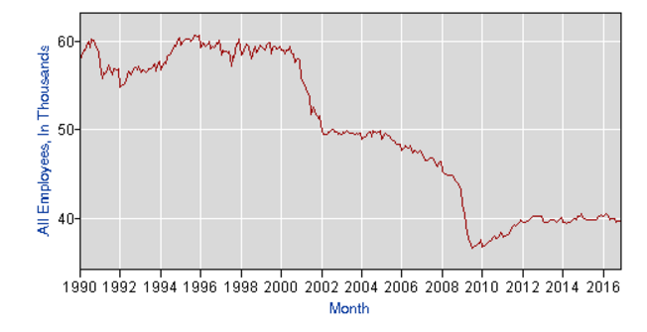
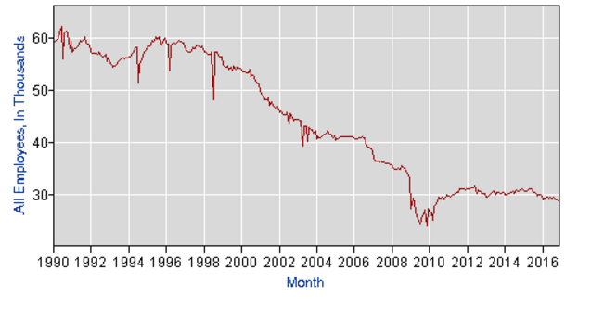
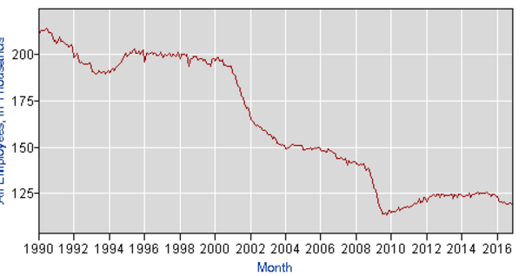
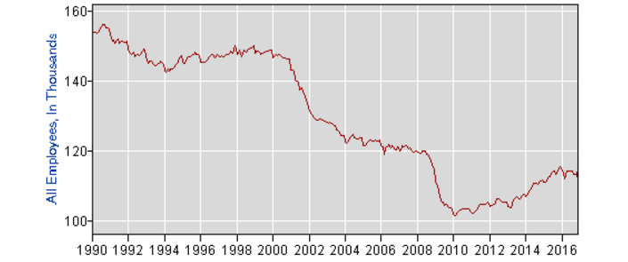
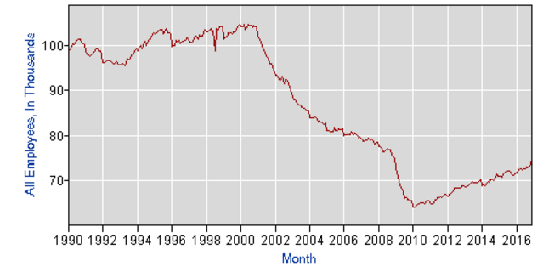
Changing Economy: Ohio Manufacturing
Akron
Youngstown
Cleveland
Cincinnati
Columbus

Slide 6


Demographics: Boomers
Seniors from 65-75 will be the fastest growing group this decade
Will grow from 28 to 42 million – a 50% growth by 2020
Children of the 60s, have redefined every age they entered
When will they retire? For most, not for years

Slide 7


Demographics: Millennials
Late teens to early 30s - 83 million
The largest generation in US history
At the prime household formation age
Six times less likely to have a car than their parents

Slide 8
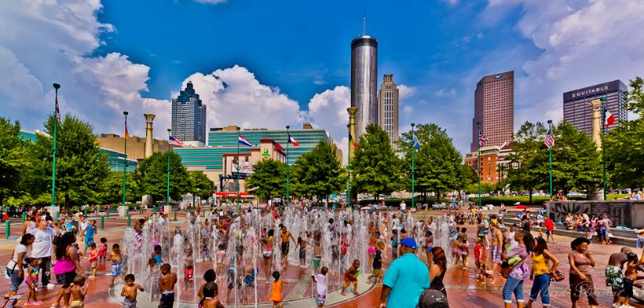
Intentionality
Intentionality: The point at which a community decides to become something other than what is has been traditionally
Sense of Place
Diversity of Jobs

Slide 9
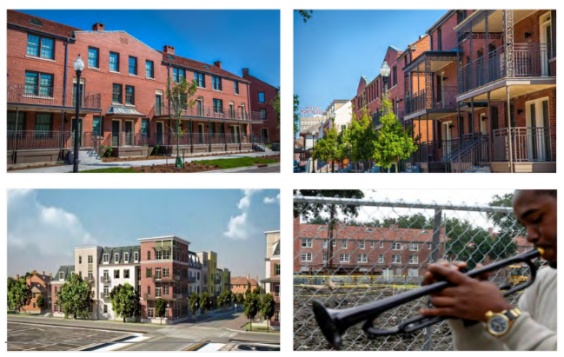
An Appetite for Risk
Land Control
Flexible Funding
Sophisticated Staff Capacity
Strategic Vision

Slide 10
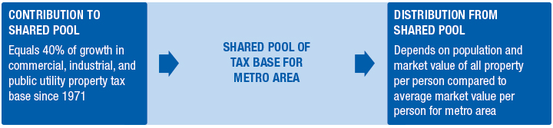
Minneapolis Region
Fiscal Disparities Program
Seven-counties, 179 local governments
The program shared $594 million in tax revenue for 2015.ta
This represents nearly 35% of total commercial, industrial, and public utility property tax base and 11% of total tax base in the seven-county metro area.

Slide 11
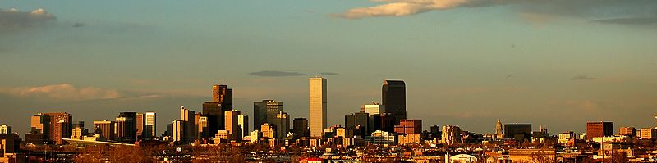
Denver
Link infrastructure and development
In 2004, Fastrak Referendum
$2 Billion Bond Approval
119 miles of light rail
7 Counties & 32 Municipalities
78 Stations

Slide 12
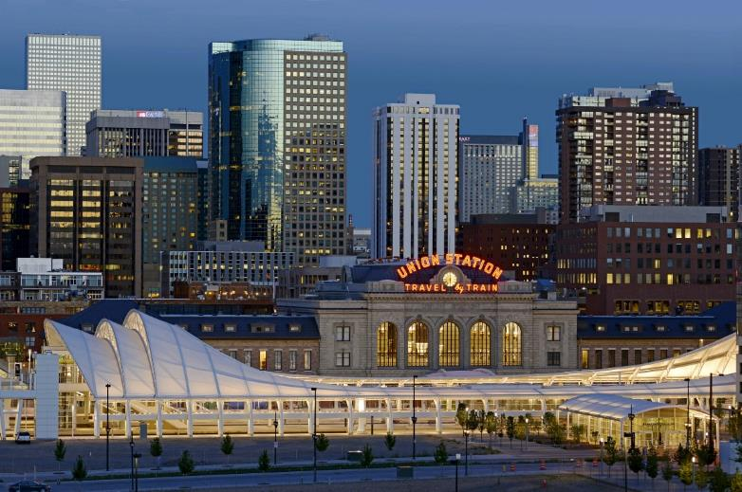
Denver: Union Station Development
$1.7 billion project, funded with public and private money
3,500 residential units
Two grocery stores
1.5 million square feet of office space

Slide 13
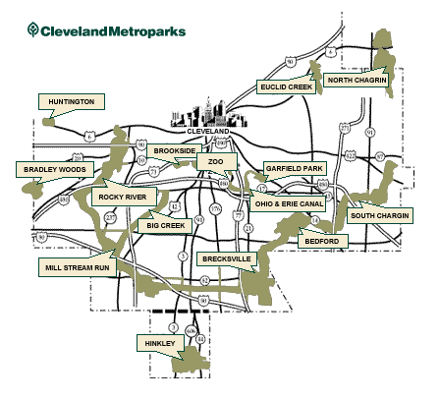
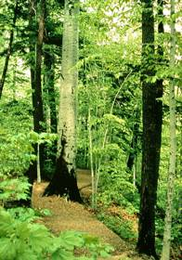
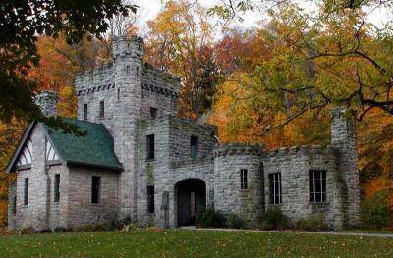
Cleveland: Metroparks
Tax district includes 5 counties
North Chagrin Reservation
Squires Castle
Notes:
13

Slide 14
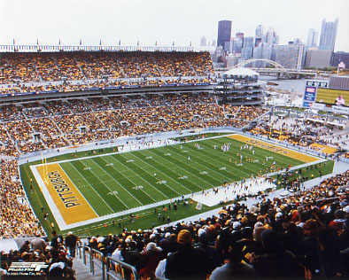

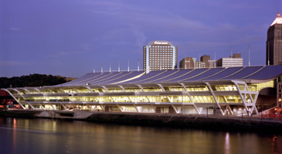

Allegheny County/ Pittsburgh
Regional Asset District
Regional Asset sales tax .5%
Used for regional amenities
Heinz Field
Pittsburgh Zoo
David L. Lawrence Convention Center
Notes:
14

Slide 15
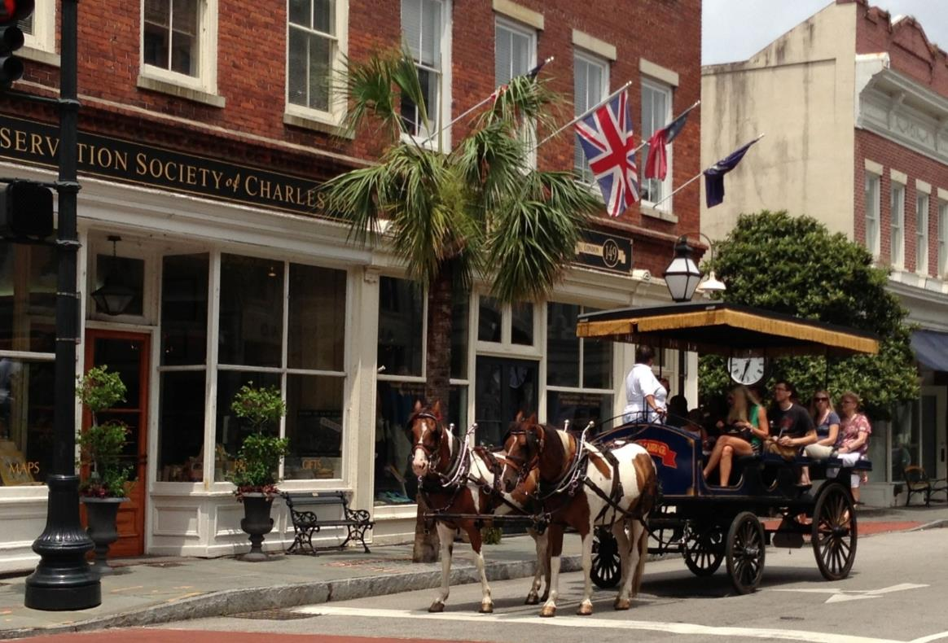
Historic Preservation
Charleston, South Carolina

Slide 16
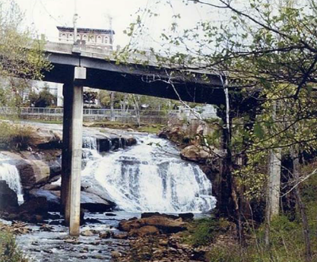
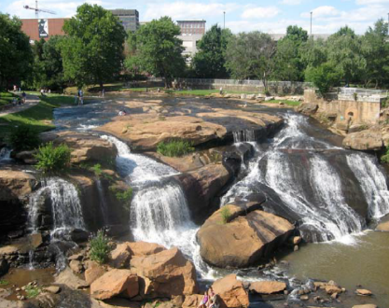
Greenville, South Carolina
Before and After

Slide 17
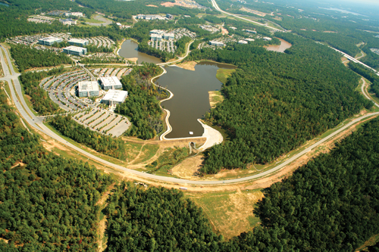
Research Triangle
Largest high-tech research park in North America
20 million sq. ft. of developed space
Home to 157 companies
Employs 39,000 people
Notes:
17

Slide 18
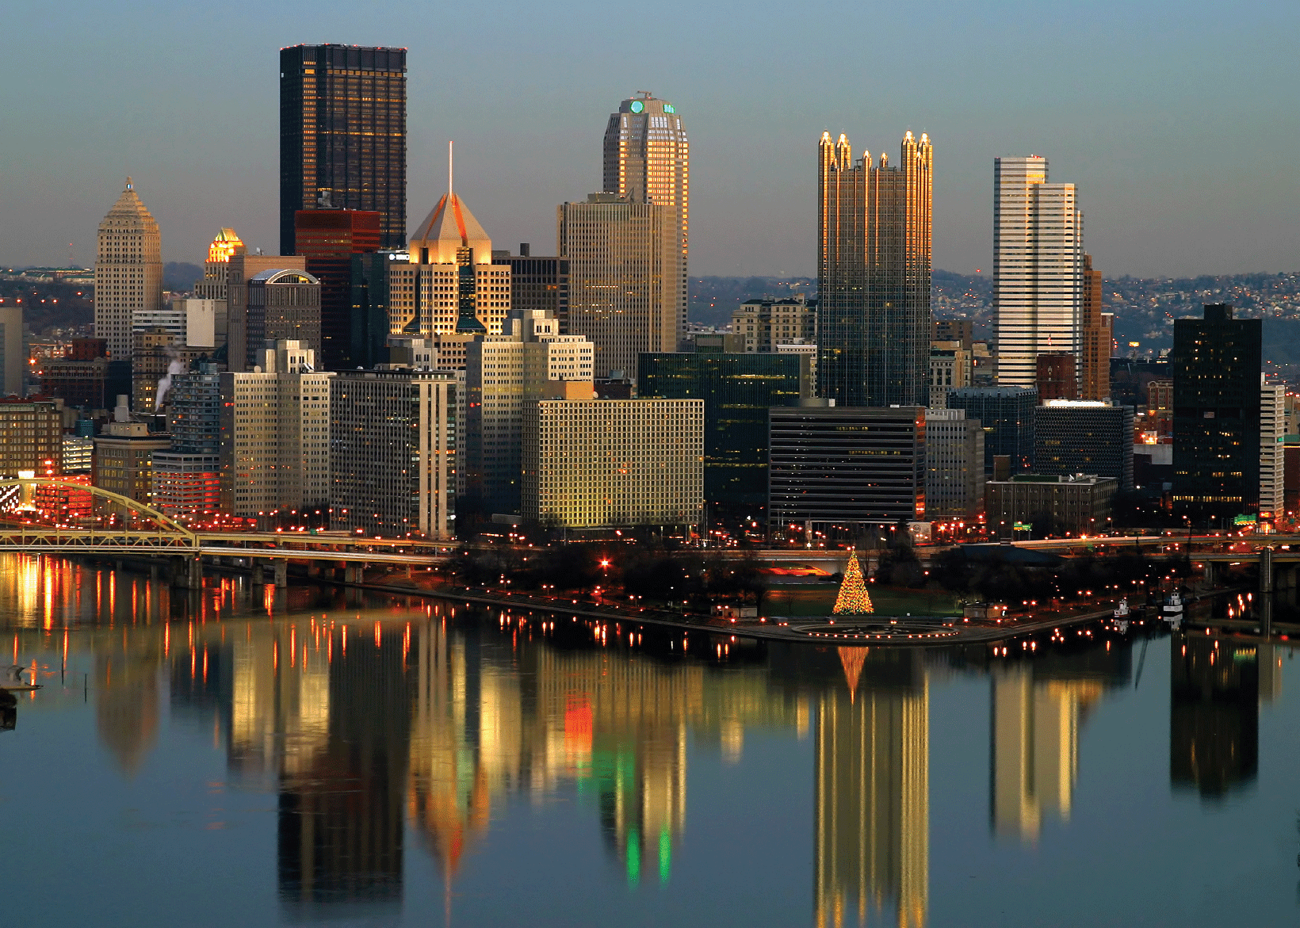
Pittsburgh

Slide 19
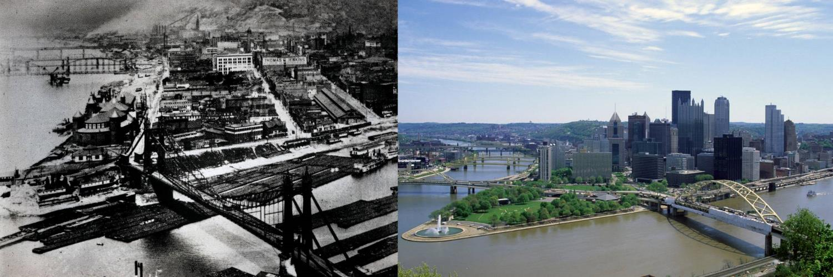
Transforming Pittsburgh
“Pittsburgh is certainly not going to escape a national recession. But it can provide lessons for how to survive it: invest in knowledge, compete globally, rewrite the old rules of business.” - Time Magazine “Finding One Economic Bright Spot on Main Street”, 10/09/2008
“Deindustrialization in Pittsburgh was a protracted and painful experience. Yet it set the stage for an economy that is the envy of many recession-plagued communities…”
-New York Times, 01/07/2009
Notes:
19
19

Slide 20
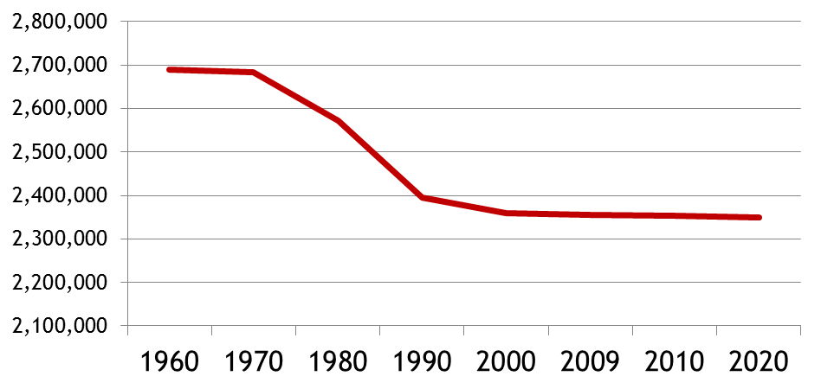
Pittsburgh MSA Population, 1960-2020
Source: US Census Bureau

Slide 21
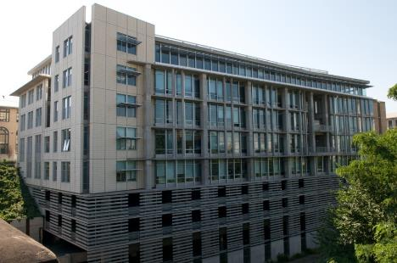
The Collaborative Innovation Center at Carnegie Mellon
JOBS
To be Created: 489
NEW PROPERTY TAXES
Collected During TIF: $239,000
Collected After Expiration: $598,000
SPURRED INVESTMENT
$55 Million
State of the Art facility adjacent to Carnegie Mellon University that will:
  Attract Private technology firms to expand research and education collaborations
  Accelerate development of new technologies
  Support growth of region's technology industry base
Notes:
21
21
21

Slide 22
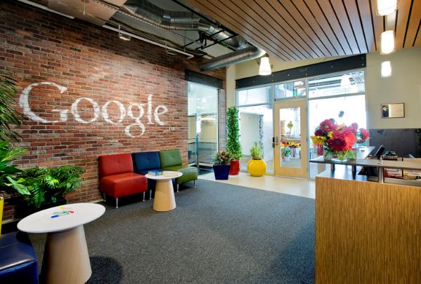
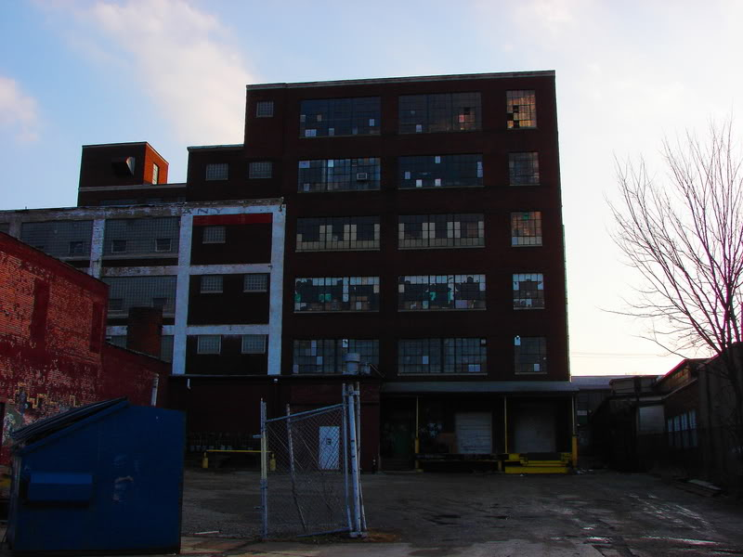
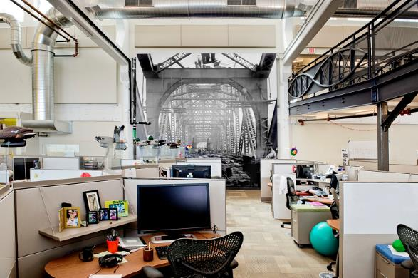
From Vacant Nabisco Building to Google Offices
Notes:
22

Slide 23
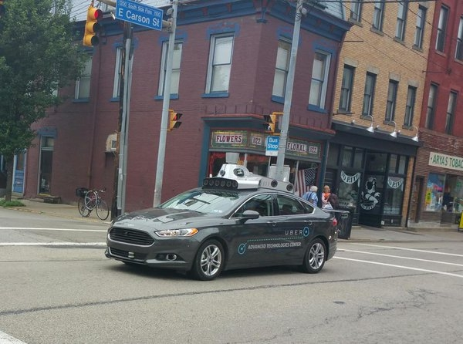
Uber driverless car

Slide 24
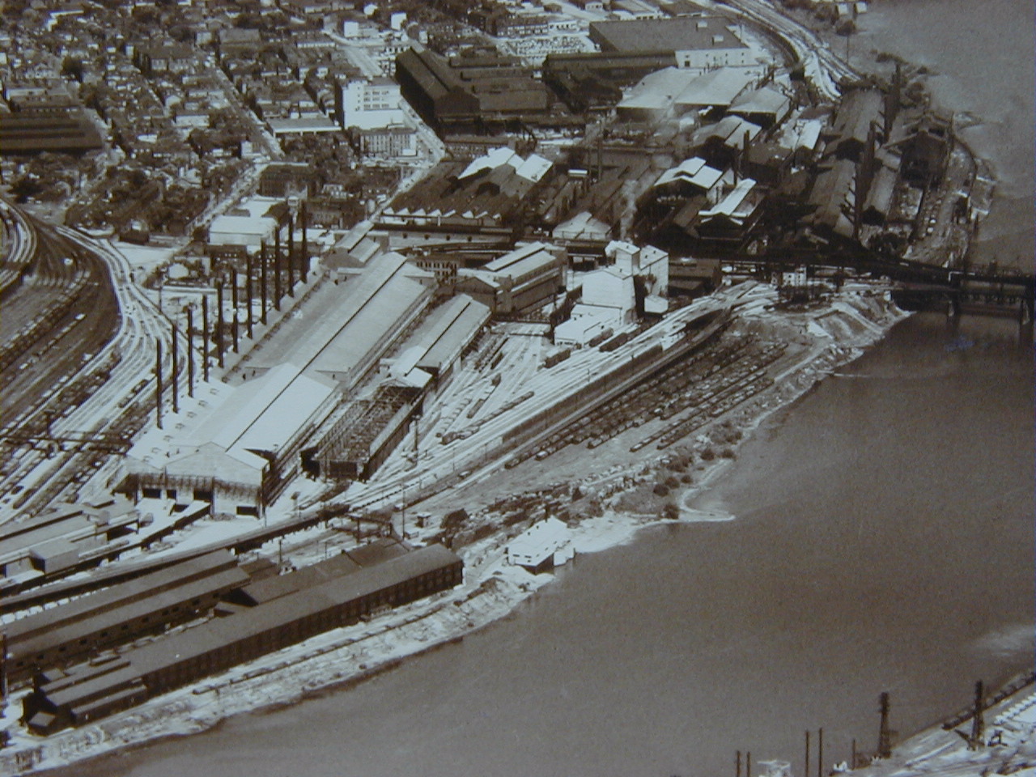
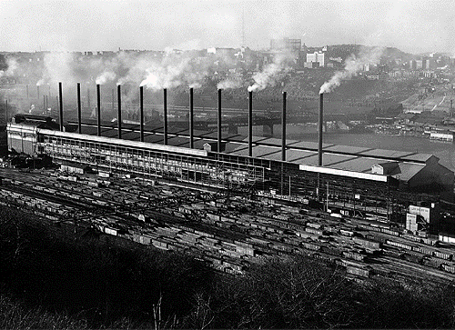
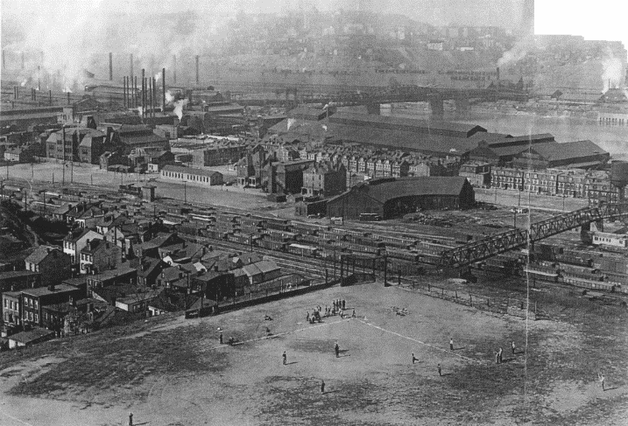
The South Side Works was a steel mill
Notes:
24

Slide 25
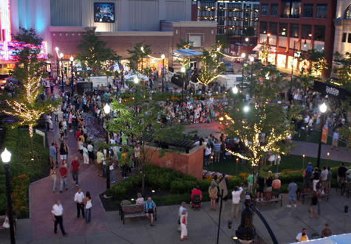
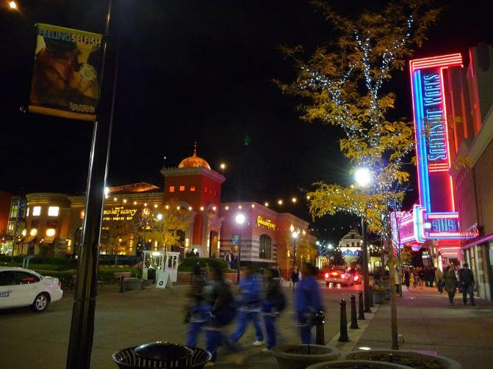
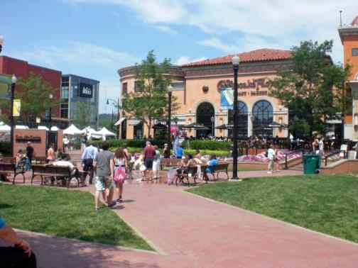
Now you can go to the movies, eat, shop…
Notes:
25

Slide 26
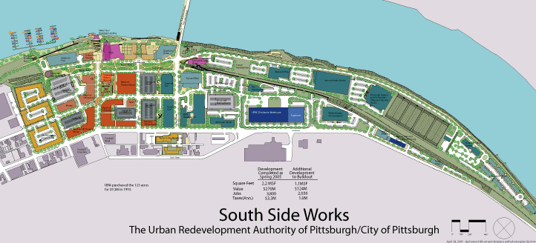
The mixed-use site masterplan has
reconnected the neighborhood to the river
Development Cost: $650 Million
TIF Proceeds: $21 Million
Other Public: $128 Million
Private Investment: $301 Million
Public investment funded site remediation, roads, parking garages, bridges, trails, and parks.
Notes:
26

Slide 27
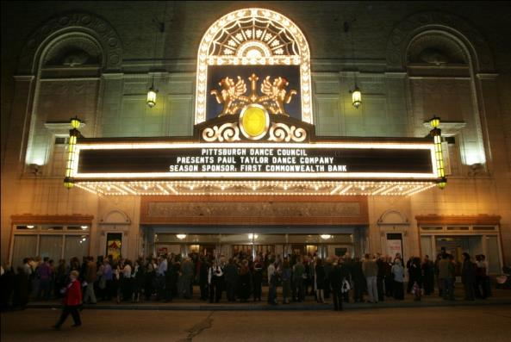
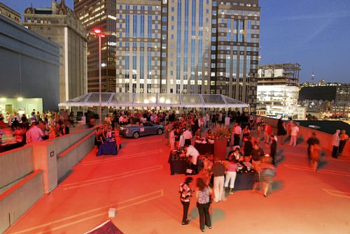
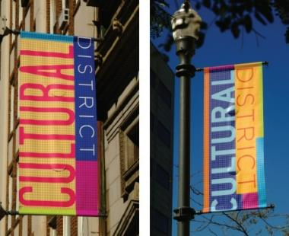
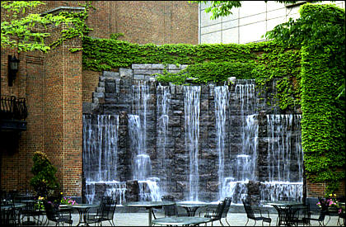
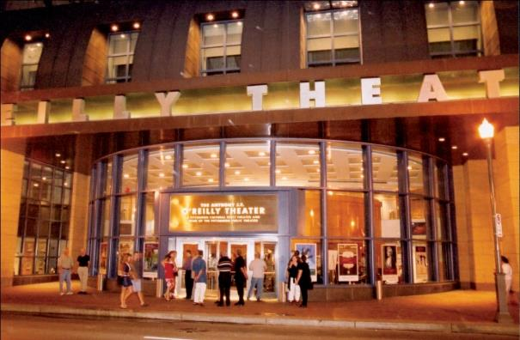
The Cultural Trust

Slide 28
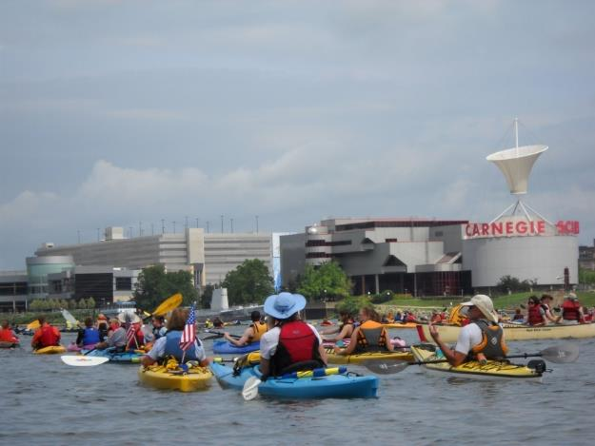
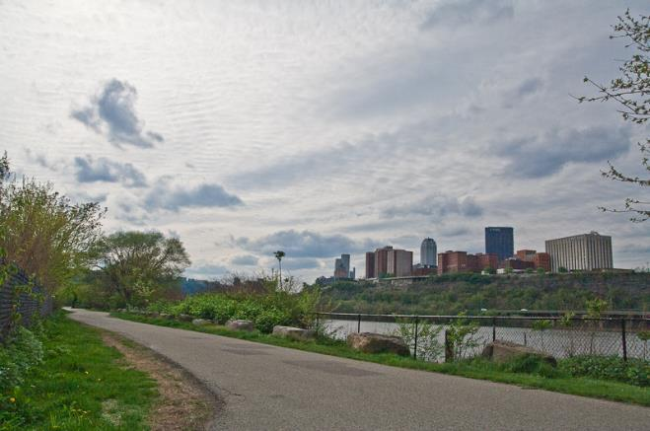
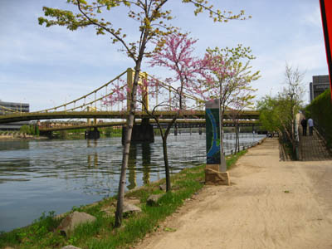
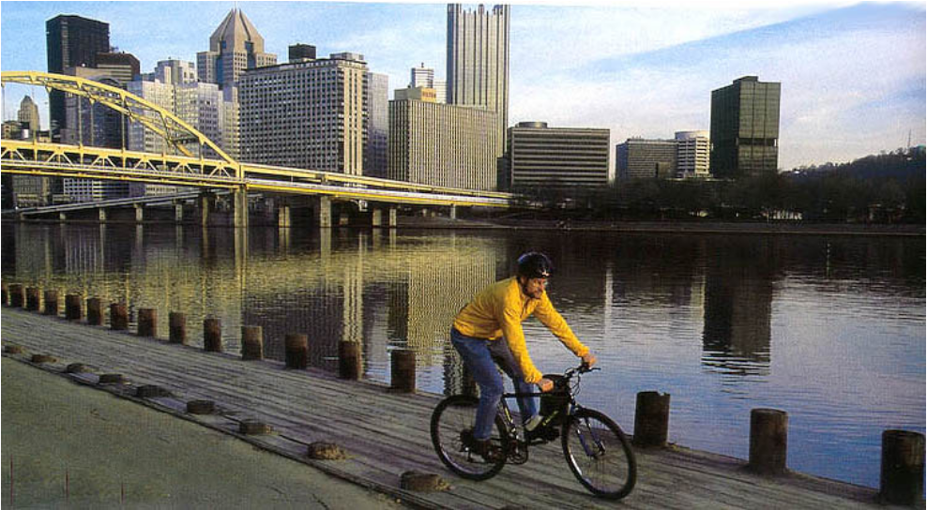
Riverfront Parks and Trails
Notes:
28
28

Slide 29
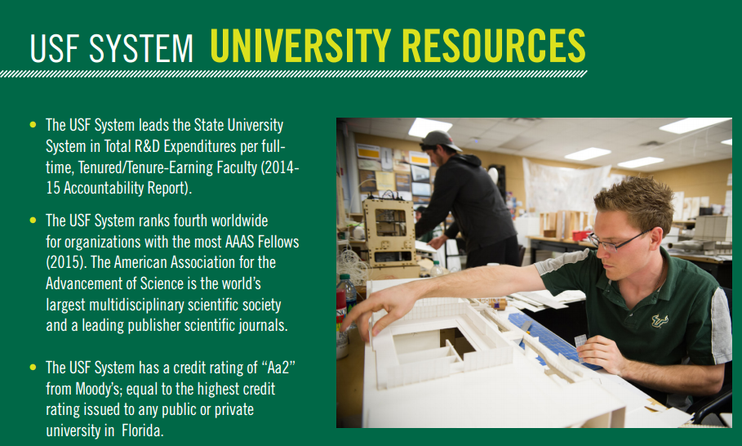
Growing Talent:
University of South Florida Total Research Expenditures: $494 M
Source: http://www.usf.edu/ods/documents/system-facts/usf-system-facts-2016-17.pdf

Slide 30

Venture Capital Investment
In 2016, Tampa Bay saw venture capital deals amounting to $47.7 million

Slide 31


Slide 32
A Glossary of Financing Tools

Slide 33


Tools
Layering of financing
Use every tool available

Slide 34

The pieces of the puzzle

Slide 35


Think Strategically
1-2 December 2009
Highline Park, New York City
Notes:
35

Slide 36

Dynamic Leadership
University Commons, Knoxville, TN

Slide 37


Strong Partnerships
OUR MISSION
3CDC is a non-profit, real estate development and finance organization focused on strategically revitalizing Cincinnati’s downtown urban core in partnership with the City of Cincinnati and the Cincinnati corporate community. Our work is specifically focused on the Central Business District and in Over-The-Rhine.
3CDC manages The Cincinnati Equity Fund (CEF) and the Cincinnati New Markets Fund (CNMF). These investment funds play an important role by providing financial aid in downtown development activities.
Notes:
37

Slide 38








Talent

Slide 39

Placemaking and Design
Schenley Plaza--Then

Slide 40



Placemaking and Design
Schenley Plaza--Now

Slide 41

Where Will the New Roads Lead…

