Slide 1
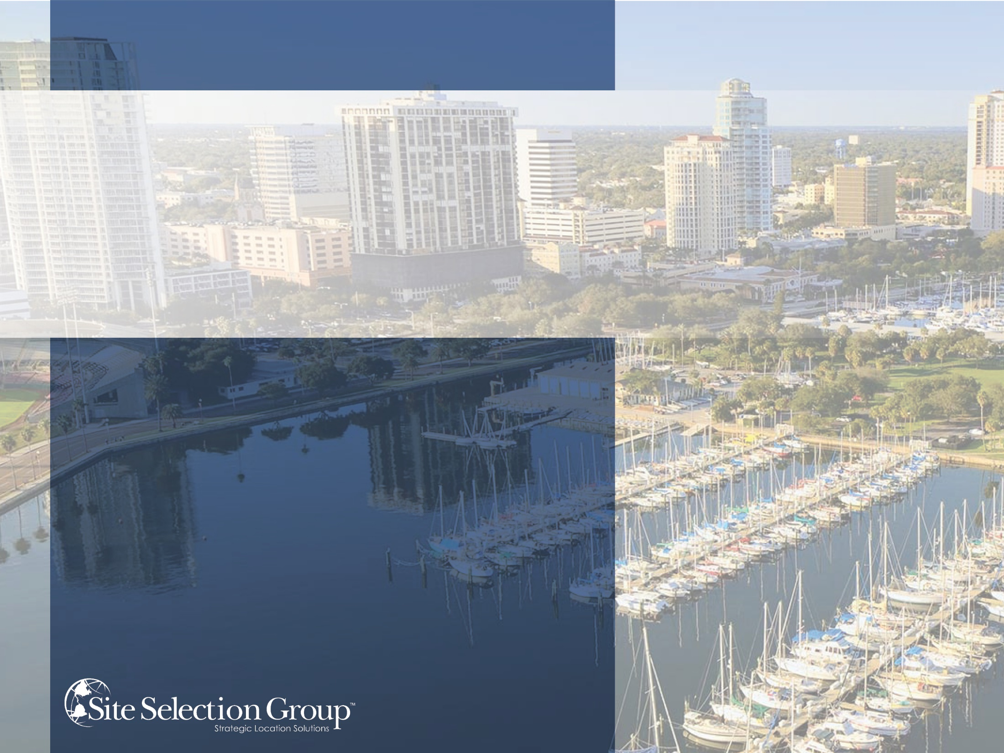
COMPETE NOW
PINELLAS COUNTY ECONOMIC DEVELOPMENT
COMMUNITY PRESENTATION
APRIL 20, 2017

Slide 2

AGENDA
Overview of Site Selection Group
Objectives & the Site Selection Process
Summary of Results
  Mock Project Profiles
  Preliminary Community Filtering
  In-Depth Site Selection Analysis
  Real Estate & Incentives Summary
Final SSG Impressions & Comments
Questions & Answers

Slide 3
ABOUT SITE SELECTION GROUP

Slide 4




SITE SELECTION GROUP
LEADING CORPORATE LOCATION ADVISORY AND ECONOMIC DEVELOPMENT CONSULTING FIRM
Full-service location advisory and economic development consulting firm based in Dallas with 29 global affiliate offices
One of the largest independent site selection firms in the United States with 29 full-time employees
Provides economic development consulting services through the corporate lens
500+ completed corporate projects
50+ completed economic development projects
$2.0B+ in economic incentives negotiated
$2.0B+ in real estate transactions negotiated
SCOPE OF SERVICES
LOCATION ADVISORY
ECONOMIC
INCENTIVES
CORPORATE
REAL ESTATE
ECONOMIC
DEVELOPMENT
CONSULTING

Slide 5

















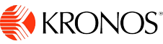






















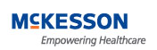






DIVERSIFIED EXPERIENCE
CUSTOMIZED SOLUTIONS ACROSS ALL INDUSTRY SECTORS

Slide 6



















ECONOMIC DEVELOPMENT CONSULTING EXPERIENCE
PROVIDING SOLUTIONS FOR STATE, REGIONAL, LOCAL & UTILITY ECONOMIC DEVELOPMENT
LOCATION
OPTIMIZATION
NEGOTIATION
LEVERAGE

Slide 7
OBJECTIVES & SITE SELECTION PROCESS

Slide 8

OVERALL PROJECT OBJECTIVES
  Evaluate the community’s competitive positioning for attracting corporate investment with a focus on high-impact projects.
  Benchmark the Pinellas County against key competitor communities.
  Identify critical strengths and weaknesses for attracting and sustaining corporate investment.

Slide 9



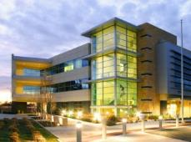


SITE SELECTION PROCESS
SSG’S ENGAGEMENT WITH PCED IS MEANT TO MIRROR THE STEPS OF AN ACTUAL SITE SELECTION PROJECT
1
2
3
4
5
6
PHASE
Needs
Assessment
Community
Filtering
Site Selection
Analysis
Tours and
Due Diligence
Negotiations
Incentive Compliance
Strategy formation
Business drivers
Project timeline
Criteria weighting
Employee profile
Job creation
Infrastructure needs
Capital investment
Geographic preference
Facility specifications
Labor force size
Labor turnover
Security analysis
Competitor concentration
Wage rates
Unemployment rate
Time zone
Accessibility
Union conditions
Utility rates
Real estate availability
Economic incentive climate
Demographics
Labor force analysis
Economic incentives
Real estate research
Infrastructure
Wage and benefits
Business climate
Geo-political risks
Accessibility
Operating cost analysis
Decision matrix
Economic development agencies
Community leaders
Education and workforce training institutions
Employer interviews
Recruitment agencies
Real estate options
Infrastructure providers
Economic Incentives
Tax reductions
Training grants
Tax credits
Cash grants
Real estate grants
Infrastructure grants
Real Estate
Acquisitions
Dispositions
Build-to-Suits
Lease Renewals
Annual reporting
Training reimbursements
Job creation filings
Applications
Contract amendments
Site audits
EDC coordination
KEY STEPS
Project Questionnaire
Project Profile Summary
GeoCision Analysis
Site Selection Report
Tour Agenda
Building/Site Ranking Matrix
Request for Proposals
Proposal Comparison
Financial Analysis
Letter of Intent
Documentation
Compliance Documents
Reimbursement Management
Contract Amendments
IncenTrak Updates
DELIVERABLE
Understand Client’s
Needs & Objectives
Identify
Candidate Communities
Comprehensive Evaluation
of Candidate Communities
Identification of
Finalist Locations
Secure
Economic Incentives
& Real Estate
Compliance of Economic Incentives
RESULTS

Slide 10
PROJECT STEPS
  MOCK PROJECTS: Select aspirational mock site selection projects and identify key parameters to test the community’s overall competitiveness.
  COMMUNITY FILTERING: Provide better understanding of where Pinellas County and the greater Tampa Bay region fall in terms of overall national competitiveness for projects.
  SITE SELECTION ANALYSIS: Analyze how the region compares to selected competitor communities in terms of estimated operational cost and locational competitiveness for those same project types.
  KEY STRENGTHS AND WEAKNESSES: Develop deeper of key community strengths and weaknesses related to both broad economic development efforts and specific project requirements.
5
4
3
Full Report and Community Presentation
2
Site Selection Analysis
1
Community Visit
Filtering
Mock Project Profiles
JANUARY - APRIL

Slide 11
MOCK PROJECT PROFILES

Slide 12
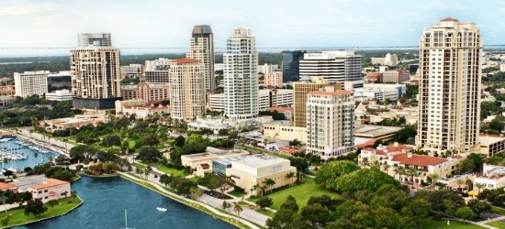


PROJECT PROFILES
  CORPORATE HEADQUARTERS
  Specifications
  Drivers
  300 jobs
  $95k average wage
  Typical corp. HQ occupations
  100k SF or 10 acre build-to suit
  Workforce availability and costs
  Tax climate
  Large, fast growing metro
  Real estate
  Incentives
  FINANCIAL SERVICES
  Specifications
  Drivers
  250 jobs
  $75k average wage
  Focus on finance, accounting, and IT
  75k SF
  Workforce availability and costs
  Educational programming
  Real estate
  Large, fast-growing metro that’s not fully saturated
  “Millennial” demographic
  ADVANCED MANUFACTURING
  Drivers
  Specifications
  250 jobs
  $50k average wage
  Focus on production, engineering and logistics occupations
  200k SF on 30 acres
  Workforce availability and costs
  Real Estate – shovel-ready
  Geographic positioning (SE U.S.)
  Training and education
  Utilities

Slide 13
Enjoy Your Lunch

Slide 14
COMMUNITY FILTERING

Slide 15
COMMUNITY FILTERING APPROACH
For both this project and for the vast majority of its corporate projects, SSG applies some form of the community filtering model approach below.
EVERY U.S. MSA
MARKET
SIZE
GEOGRAPHY
KEY SCORING METRICS
SSG & CLIENT EXPERIENCE
COMMUNITIES FOR IN-DEPTH ANALYSIS
All 917 MSAs
Depending on the project, SSG often filters out markets that are either too large or too small.
Typically, SSG will filter out locations that do not provide the best geographic positioning, either for personal accessibility or logistics.
SSG will then filter based on the model scoring, using the most important variables first to eliminate lower scoring communities.
In the end, SSG and its clients typically applies their judgement to eliminate communities that will likely not work for the requirement.
In the end, SSG and its clients typically isolate 5-15 communities that warrant an in-depth analysis.
917
MSAs
~150-200
MSAs
~100
MSAs
~20-40
MSAs
< 20
MSAs
~5-15
MSAs

Slide 16
TYPICAL VARIABLES
GEOCISION® ANALYSIS
Although the variables used are contingent on the specific project, the below shows a sample of the types of data SSG uses in its initial filtering analysis.
LABOR AVAILABILITY
LABOR SCALABILITY
2016 Population
Labor Force
Labor Force Participation Rate
% Population Growth
% Millennial Population Growth
Unemployment Rate
OCCUPATION DEMAND
Financial Sales Occupation Cluster Demand
Business and IT Occupation Cluster Demand
Support Occupation Cluster Demand
Financial Sales Occupation Demand Per Cluster Total
Business and IT Occupation Demand Per Cluster Total
Support Occupation Demand Per Cluster Total⁴
OCCUPATION PRESENCE
Financial Sales Occupation Cluster
Financial Sales Occupation Cluster (% of LF)
Financial Sales Occupation Cluster Growth 2016-2021
Business and IT Occupation Cluster
Business and IT Operations Cluster (% of LF)
Business and IT Operations Cluster Growth 2016-2021
Support Occupation Cluster
Support Occupation Cluster (% of LF)
Support Occupation Cluster Growth 2016-2021
INDUSTRY PRESENCE
Financial Services Businesses Total
Financial Services Business as Percent of All Businesses
TARGET EDUCATIONAL ATTAINMENT
% High School Graduates (or GED)
% Some College, No Degree
% Associates Degree
% Bachelor's Degree
% More Than a Bachelor's Degree
TARGET AGE GROUP
% Ages 18-24
% Ages 25-34
% Ages 35-44
% Ages 45-54
% Ages 55-64
TARGET HOUSEHOLD INCOME DISTRIBUTION
% $25,000 to $34,999
% $35,000 to $49,999
% $50,000 to $74,999
% $75,000 to $99,999
% $100,000 or more
EDUCATION OUTPUT
Bachelors and Masters Business Completions
Bachelor and Master Completions in All Areas
Bachelors and Masters Business Completions as %
Bachelor and Master Completions in All Areas
OPERATING COSTS & CONDITIONS
TAXES & UNION CLIMATE
Top State Corporate Income Tax Rate
State and Average Local Sales Tax Rate
Private Union Coverage Rates
SUTA Rate
SUTA Wage Base
Individual Income Tax Ranking
Effective Corporate Tax Rate - New Facility
Property Tax Ranking
REAL ESTATE
Average Class A Office Space Lease Rate (2016Q4)
TRANSPORTATION & LOGISTICS
ACCESSIBILITY
Total Current Population Within 11-Hour Drive
5-Year Growth Population Within 11-Hour Drive
5-Year Average Annual Airline Passengers
QUALITY OF LIFE
ECONOMIC FACTORS
Median Household Income
Per Capita Income
CULTURE & ENTERTAINMENT
Arts, Entertainment and Recreation Establishments Count
Accommodation and Food Establishments Count
Retail Establishments Count
Arts, Entertainment and Recreation Establishments per capita
Accommodation and Food Establishments per capita
Retail Establishments per 1,000 Capita
SAFETY AND STRESS
Total Crime Index
Commuter Stress Index
Weather Risk Index

Slide 17
COMMUNITY FILTERING RESULTS
GEOCISION® ANALYSIS
Results for the Tampa-St. Petersburg MSA are shown below. At this stage, SSG typically compares only like-sized MSAs to one another. As a result, the scoring reflects the Tampa/St-Petersburg MSA as compared to other large U.S. markets.
 | Weight | 25% | 25% | 25% | 15% | 10%
HEADQUARTERS | TOTAL INDEX | LABOR AVAILABILITY | LABOR COST | OPERATING COSTS & CONDITIONS | ACCESSIBILITY | QUALITY OF LIFE
Tampa-St. Petersburg-Clearwater | 118% | 123% | 103% | 119% | 146% | 102%
 | Weight | 35% | 25% | 20% | 10% | 10%
FINANCIAL SERVICES | TOTAL INDEX | LABOR AVAILABILITY | LABOR COST | OPERATING COSTS & CONDITIONS | ACCESSIBILITY | QUALITY OF LIFE
Tampa-St. Petersburg-Clearwater | 115% | 116% | 106% | 114% | 144% | 105%
 | Weight | 30% | 30% | 30% | 10%
ADVANCED MANUFACTURING | TOTAL INDEX | LABOR AVAILABILITY | LABOR COST | OPERATING COSTS & CONDITIONS | ACCESSIBILITY
Tampa-St. Petersburg-Clearwater | 106% | 89% | 112% | 113% | 117%

Slide 18
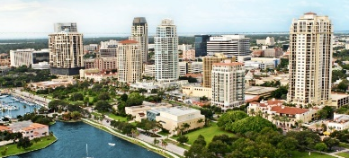


COMMUNITY FILTERING RESULTS
Specific Takeaways
Overall Results
Comparison Communities Selected
CORPORATE HEADQUARTERS
Market scores well across all key variables (demographics, labor costs, operating costs, accessibility). Scores slightly lower than markets with hub airport access
For many HQ projects, overall Tampa Bay market could make the first cut.
Dallas, TX Orlando, FL Atlanta, GA Charlotte, NC Houston, TX Indianapolis, IN Nashville, TN
FINANCIAL SERVICES
Market scores well across all key variables (demographics, labor costs, operating costs, accessibility). Very fast-growing cities with younger populations may have better demographic profiles Scores slightly lower than markets with hub airport access
For many Financial Services projects, Tampa Bay market could make the first cut.
Dallas, TX Orlando, FL Atlanta, GA Charlotte, NC Phoenix, AZ Denver, CO Miami/Ft. Lauderdale, FL
ADVANCED MANUFACTURING
Scores relatively well overall compared to other large metro areas. Geographic positioning may not be optimal for production (market and port access) Scores lower compared to major production metros (e.g. Upstate SC, GA, TN)
Unless a production project has a strong reason to be in Florida, markets further north may better satisfy.
Atlanta, GA Greensboro/Winston-Salem, NC Greenville/Spartanburg, SC Huntsville, AL Knoxville, TN Augusta, GA Lexington, KY Jacksonville, FL

Slide 19
IN-DEPTH SITE SELECTION ANALYSIS

Slide 20


EVALUATING COMMUNITIES: IN-DEPTH
COST VS. QUALITIVE FACTORS
After the preliminary filtering process, SSG then conducts a more in-depth analysis of the remaining communities.
Qualitative Analysis
Examines qualitative factors such as demographic trends, workforce availability, hiring pressures, complementary and competing industries, organized labor, and other factors that are difficult to assign a specific cost.
Operating Cost Analysis
Estimates the 10-year and average annual operating cost of the operation in each location including wage and benefits, turnover and training, utilities, logistics, state and local taxes, real estate, and capital expense.
KEY CONSIDERATIONS
Balance between cost and quality
Point and Drive Time vs. MSA
  Estimating the actual labor shed/commute zone

Slide 21
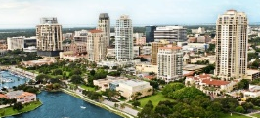
HEADQUARTERS
RESULTS
  10-YEAR OPERATING COST ESTIMATE
 | Nashville, TN | Indianapolis, IN | Tampa, FL | Pinellas County | Orlando, FL | Atlanta, GA | Charlotte, NC | Houston, TX | Dallas, TX
ESTIMATED DIFFERENCE FROM LOWEST MARKET (%) | 0.00% | 3.48% | 5.90% | 6.47% | 8.21% | 9.74% | 9.91% | 12.68% | 13.38%
Less Expensive
More Expensive
  QUALITATIVE ANALYSIS
 | WEIGHT | 30.0% | 30.0% | 15.0% | 25.0%
 | TOTAL | Workforce Demographics | Occupation & Industry Presence | Air Accessibility & Traffic | Tax Climate
Dallas (Plano) | 106.4 | 132.9 | 100.0 | 120.6 | 73.8
Charlotte (Southpark) | 100.7 | 117.2 | 66.6 | 115.7 | 113.1
Atlanta (Sandy Springs) | 100.1 | 131.2 | 89.6 | 120.2 | 63.4
Nashville (Brentwood) | 98.9 | 107.5 | 109.4 | 92.0 | 80.1
Houston (The Woodlands) | 97.7 | 115.9 | 102.0 | 92.6 | 73.8
Orlando (Maitland) | 96.6 | 104.1 | 73.2 | 98.6 | 114.3
Indianapolis (Carmel) | 90.4 | 80.1 | 77.5 | 80.4 | 124.2
Tampa (Hidden River) | 89.0 | 83.8 | 74.5 | 86.3 | 114.3
PINELLAS (CARILLON) | 88.6 | 81.6 | 67.8 | 100.9 | 114.3
PINELLAS (DOWNTOWN) | 86.1 | 74.8 | 68.6 | 96.4 | 114.3
PINELLAS (NORTH COUNTY) | 84.9 | 70.9 | 68.5 | 96.4 | 114.3

Slide 22

FINANCIAL SERVICES
RESULTS
  10-YEAR OPERATING COST ESTIMATE
 | Pinellas County | Orlando, FL | Tampa, FL | Phoenix, AZ | Atlanta, GA | Charlotte, NC | Dallas, TX | Miami, FL | Denver, CO
ESTIMATED DIFFERENCE FROM LOWEST MARKET (%) | 0.00% | 0.22% | 0.77% | 2.25% | 5.61% | 6.16% | 8.10% | 8.74% | 9.83%
Less Expensive
More Expensive
 | WEIGHT | 40.0% | 40.0% | 10.0% | 10.0%
 | TOTAL | Workforce Demographics | Occupation & Industry Presence | Air Accessibility & Traffic | Tax Climate
Phoenix (Tempe) | 119.2 | 123.1 | 130.0 | 95.3 | 84.4
Dallas (Plano) | 113.5 | 126.2 | 117.6 | 82.4 | 77.9
Denver (Downtown) | 108.5 | 124.6 | 110.2 | 65.0 | 81.2
Atlanta (Sandy Springs) | 98.5 | 123.5 | 89.8 | 76.6 | 55.5
Charlotte (Uptown) | 90.5 | 109.6 | 67.3 | 90.6 | 106.3
Miami (Fort Lauderdale) | 89.1 | 97.3 | 71.4 | 100.8 | 115.8
Orlando (Downtown) | 88.9 | 106.0 | 69.0 | 72.7 | 115.8
Tampa (Downtown) | 81.0 | 82.1 | 69.0 | 90.4 | 115.8
PINELLAS (CARILLON) | 79.4 | 75.8 | 73.1 | 82.9 | 115.8
PINELLAS (DOWNTOWN) | 76.5 | 67.8 | 75.6 | 75.8 | 115.8
PINELLAS (NORTH COUNTY) | 75.1 | 64.1 | 75.4 | 76.8 | 115.8
  QUALITATIVE ANALYSIS

Slide 23

ADVANCED MANUFACTURING
RESULTS
  10-YEAR OPERATING COST ESTIMATE
 | Lexington, KY | Knoxville, TN | Huntsville, AL | Greensboro, NC | Augusta, GA | Tampa, FL | Atlanta, GA | Jacksonville, FL | Greenville, SC | Pinellas County
ESTIMATED DIFFERENCE FROM LOWEST MARKET (%) | 0.00% | 0.63% | 1.99% | 2.27% | 2.71% | 4.27% | 4.37% | 4.96% | 4.98% | 6.59%
Less Expensive
More Expensive
  QUALITATIVE ANALYSIS
 | WEIGHT | 20.0% | 30.0% | 30.0% | 10.0% | 10.0%
 | TOTAL | Workforce Demographics | Occupation & Industry Presence | Accessibility | Union Climate | Tax Climate
Atlanta (Acworth) | 121.1 | 130.1 | 140.3 | 109.4 | 103.4 | 98.5
Greenville (Matrix) | 112.9 | 94.4 | 126.9 | 115.9 | 150.5 | 61.8
Greensboro (Premier) | 110.1 | 92.6 | 94.9 | 123.8 | 146.6 | 113.0
Knoxville (Hardin) | 99.4 | 86.3 | 80.2 | 133.9 | 84.6 | 94.7
Tampa (60 and I-75) | 98.5 | 124.6 | 99.2 | 71.0 | 117.3 | 108.5
Lexington (Alexandria) | 98.3 | 82.3 | 84.0 | 135.9 | 68.0 | 90.6
Jacksonville (JAXUSA) | 95.5 | 104.7 | 102.9 | 80.4 | 87.2 | 108.5
PINELLAS (CARILLON) | 95.4 | 116.3 | 96.6 | 68.7 | 117.3 | 108.5
PINELLAS (SOUTH COUNTY) | 95.0 | 109.4 | 100.6 | 68.1 | 117.3 | 108.5
Huntsville (Jetplex) | 93.4 | 90.7 | 91.2 | 117.1 | 27.6 | 100.5
PINELLAS (NORTH COUNTY) | 92.5 | 103.3 | 96.3 | 68.1 | 117.3 | 108.5
Augusta (Corporate Park) | 91.7 | 85.7 | 87.0 | 107.8 | 63.0 | 98.5

Slide 24
REAL ESTATE & INCENTIVES SUMMARY

Slide 25
REAL ESTATE COMPARISON SUMMARY
 | CORPORATE HEADQUARTERS | FINANCIAL SERVICES
STRENGTHS | Baseline options available Effectively priced compared to other comparison markets Planned future market activity (e.g. proposed developments)
AREAS OF CONCERN | Attractive options mostly limited to Carillon area Sheer number of options
COMMENTS | The office real estate market in Pinellas County is adequate, especially when compared to production availability. There is diversity among options and real estate is competitively priced, although mostly limited to the Carillon area. In addition, there are proposed projects that could provide long-term space options if they are fully realized.
ADVANCED MANUFACTURING
None. The Airco site could become a competitive option in the future, but would require significant investment.
Lack of existing buildings Lack of competitive land development options
Industrial real estate is an area of significant concern for Pinellas County’s ability to attract new and expand its current advanced manufacturing operations.

Slide 26
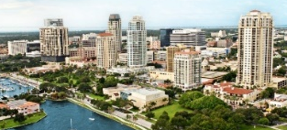


SAMPLE PROPOSED INCENTIVES
PINELLAS COUNTY PROPOSAL
While their importance in identifying and securing the optimal location for an operation may be overstated from time to time, incentives remain a critical part of the site selection process. As part of this process, PCED provided hypothetical local incentive offerings for each type of project and from partner organizations, like the State of Florida and Duke Energy.
INCENTIVE | CORPORATE HEADQUARTERS | FINANCIAL SERVICES | ADVANCED MANUFACTURING
QTI | $2.1 Million | $1.5 Million | $1.25 Million
Ad Valorem Tax Exemption | TBD (based on ownership or lease) | N/A | $5.7 Million
Capital Investment Tax Credit | Eligible: Depending on Corporate Income Tax Liability | N/A | Eligible: Depending on Corporate Income Tax Liability
High Impact Performance Credit | Eligible: Negotiated | N/A | Eligible: Negotiated
Expeditated Permit Initiatives | Eligible: Based on Permit Costs | Eligible: Based on Permit Costs | Eligible: Based on Permit Costs
Training: FloridaFlex | $270,000 | $225,000 | $225,000
Training: Incumbent Worker Training | $35,000 | $35,000 | $35,000
Training: On-the-Job | Eligible | Eligible | Eligible
Sales Tax Exemption on M&E | N/A | N/A | $3.0 Million
Sales Tax Exemption on Electricity | N/A | N/A | Eligible: Dependent on Consumption
Electricity: Duke Energy ED Rider | $169,865 | $92,540 | $517,774

Slide 27
MOCK PROJECTS: LOCAL INCENTIVES
HYPOTHETICAL INCENTIVES PROPOSAL
Average Local Incentive Package | Pinellas County Mock Offer | Comparison Community Summary
Property Tax Abatement | ✓ Competitive offer | Commonly used local incentive.
Expedited Permits | ✓ Offered to all three projects types. | Commonly used local incentive.
Permit Waivers/Cost Reimbursement | ✓- Not initially offered for mock projects, but individual municipalities may offer. | Commonly used local incentive to go above and beyond simply expediting the process.
Local Workforce Development Support | ✓- Initially offered to all three projects types, but limiting OTJ training assistance to only currently unemployment workers may limit effectiveness. | Local workforce incentives can take a variety of forms including local grant money for training, physical space for training, or other in-kind services.
Competitive Local Incentive Package
Free Land / Discounted Rent / Building Upfit / Public Space Improvements | ✗ Not initially offered for mock projects. | Can vary widely among communities, but very competitive ones may offer free/discounted land especially for industrial.
Highly Competitive Local Incentive Package
Cash Grants, Forgivable Loans, Etc. | ✗ Not initially offered for mock projects. | Can vary widely among communities, but very competitive ones may offer some upfront cash assistance for high impact projects.

Slide 28
MOCK PROJECTS: PARTNER INCENTIVES
HYPOTHETICAL INCENTIVES PROPOSAL
Average State Incentive Package | Pinellas County Mock Offer | Comparison Community Summary
State Tax Credits | ✓ Capital Investment Tax Credit offered for Headquarters and Manufacturing projects. | Depends on state tax structure.
Training Incentives | ✓ Offered to all three project types. | Critical to provide both start up screening, hiring, and training assistance, along with ongoing and incumbent support. Southeastern states are leaders in this type of customized training and support.
Statutory Tax Exemptions | ✓ Exempt Sales Tax on M&E and Electricity. | Many competitive states already exempt key inputs and purchases from sales tax.
Utility Discounts/ED Riders | ✓ Offered to all three project types. | Both for competitive electric rates and economic development support, Duke is one of the nation’s top utilities for economic development.
Competitive State Incentive Package
Refundable Tax Credit/ Withholding-Based Grant | ✓- Offered to all three project types via QTI. However, wage thresholds could limit effectiveness for manufacturing. | Commonly used discretionary incentive in competitive states. Wage thresholds (especially in more populated areas can be a challenge)
Highly Competitive State Incentive Package
Cash Grants/Closing Fund | ✓ Potentially offered to Headquarters and Manufacturing projects. | As with other incentives, closing funds and similar cash grants can help tip the balance towards one competitive community over another.

Slide 29
FINAL SSG IMPRESSIONS

Slide 30
TYPICAL PROJECT FLOW
CRITICAL TO ENGAGE REGIONAL AND STATE PARTNERS
The graphic below shows a high-level view of how most projects move from either a consultant or company to economic development support at the community level.
CONSULTANT (~50%)
Site Selection Consultants
Tax/Advisory Firms
Real Estate Brokers
Law Firms
Engineering Firms
COMPANY (~50%)
Operations
Financial
Real Estate
Supply Chain/Logistics
Corporate Development
Executive Level
State & Regional
EDC Partners
Enterprise Florida, regional economic development, Duke
Community EDC
Pinellas County

Slide 31





FINAL SSG IMPRESSIONS
KEY CONSIDERATIONS
REAL ESTATE
Very limited industrial real estate options
Baseline office availability
Critical for the community and developers to make strategic investments in key sites.
ACCESSIBILITY
“Peninsula on a peninsula”
True commuting patterns and challenges
Focus recruitment efforts and tell the labor availability story throughout the county.
ECONOMIC DEVELOPMENT
Regional and state partnerships
Funds for economic development
Ensure regional and state marketing, project flow and funds for long-term development.
QUALITY OF LIFE
Community presents well; employer advocates
But demographic and perception challenges
Attractive place to live and do business, but important to overcome outside perceptions.

Slide 32

QUESTIONS?
www.siteselectiongroup.com | 1.866.938.SITE (7483)

