Slide 1
Citizen-Centered Gainesville
Bob Woods, Communications & Marketing Manager
City of Gainesville
Economic Leadership Symposium
April 20, 2017

Slide 2
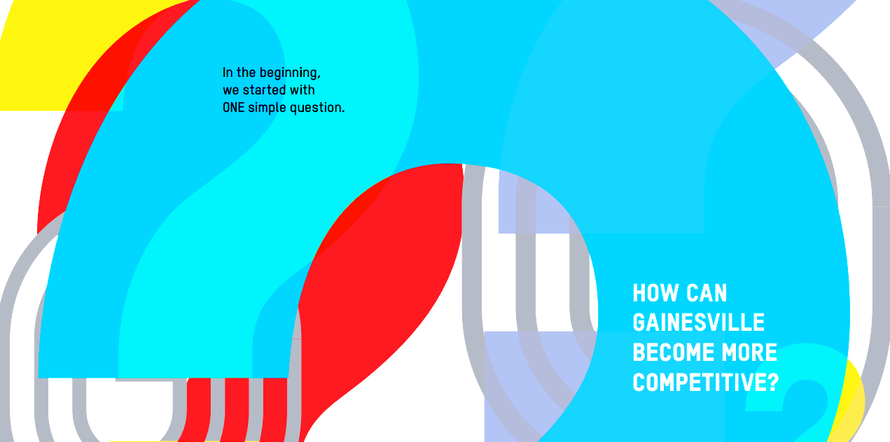
We started with one simple question...

Slide 3
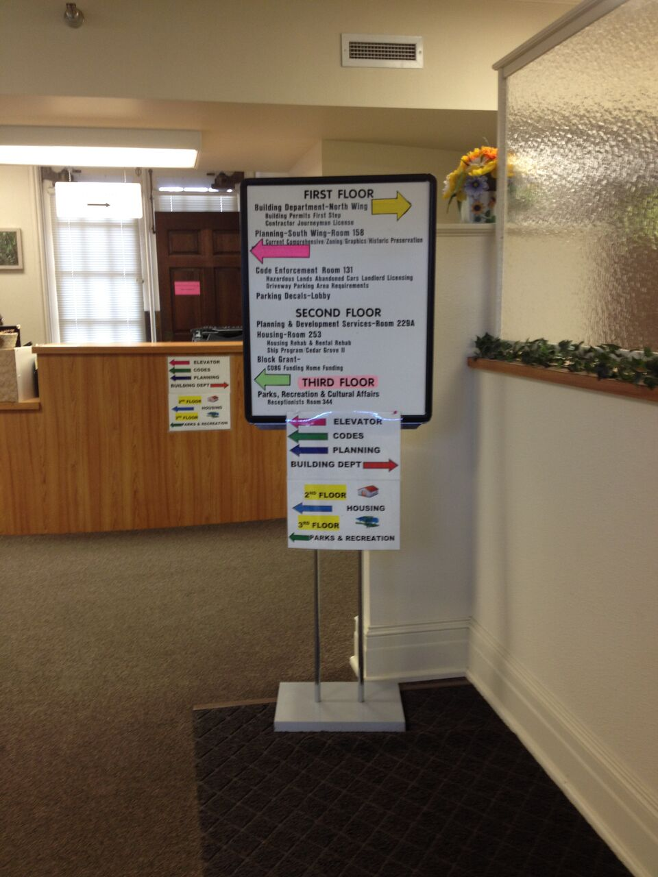
Which would you rather visit?

Slide 4
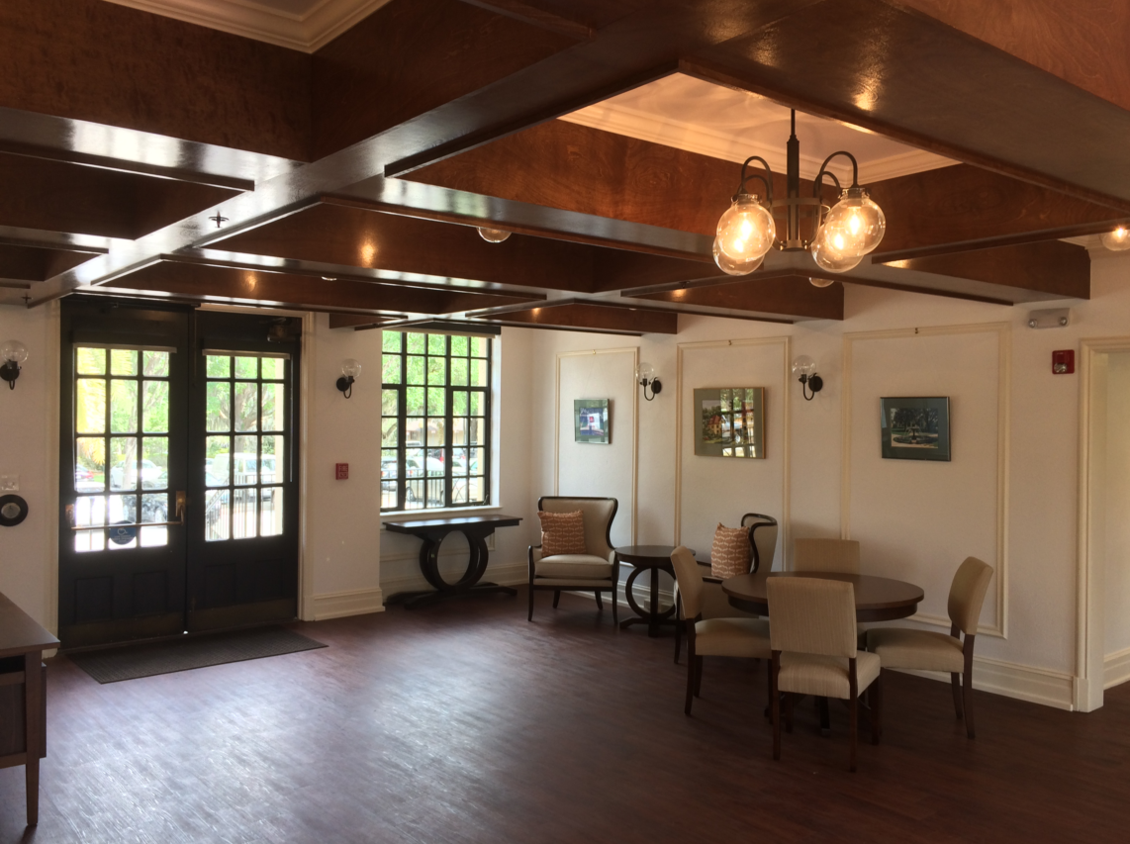
or…

Slide 5

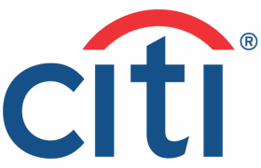



























Private Sector Using Human Centered Design
Notes:
5

Slide 6
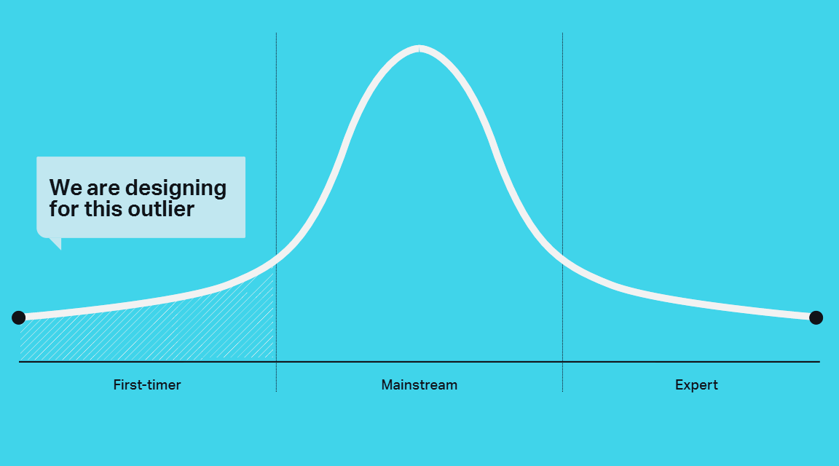

Slide 7
WE CALL IT
Citizen-Centered
Gainesville

Slide 8
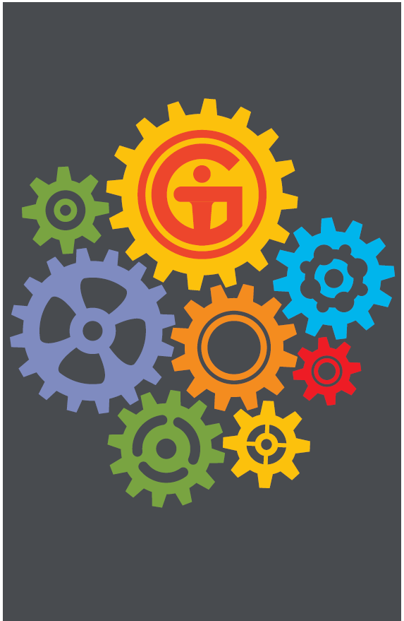
Nine Changes outlined in the Blue Ribbon Report
Change 1: Our Commitment
Change 2: One Band, One Brand
Change 3: Our “Get It Done” Plan
Change 4: The Talent to Win
Change 5: Our Front Doors
Change 6: Policy Making That Works
Change 7: The Citizen at the Center
Change 8: The Department of Doing
Change 9: The Department of Measuring

Slide 9
Change 3:
Our “Get It Done” Plan

Slide 10
Has our strategic plan affected the positive change desired by the community?
Notes:
- We have consistently heard common desires to create breakthrough change around big issues like disparity, income equality, public safety, and quality of life
- Has our traditional strategic planning process been good at affecting change, changing the path per the changing needs of the Commission and the organization, is it getting us to where Gainesville wants to be?

Slide 11
4
10+
20
24
40
450+
2,400+

Slide 12
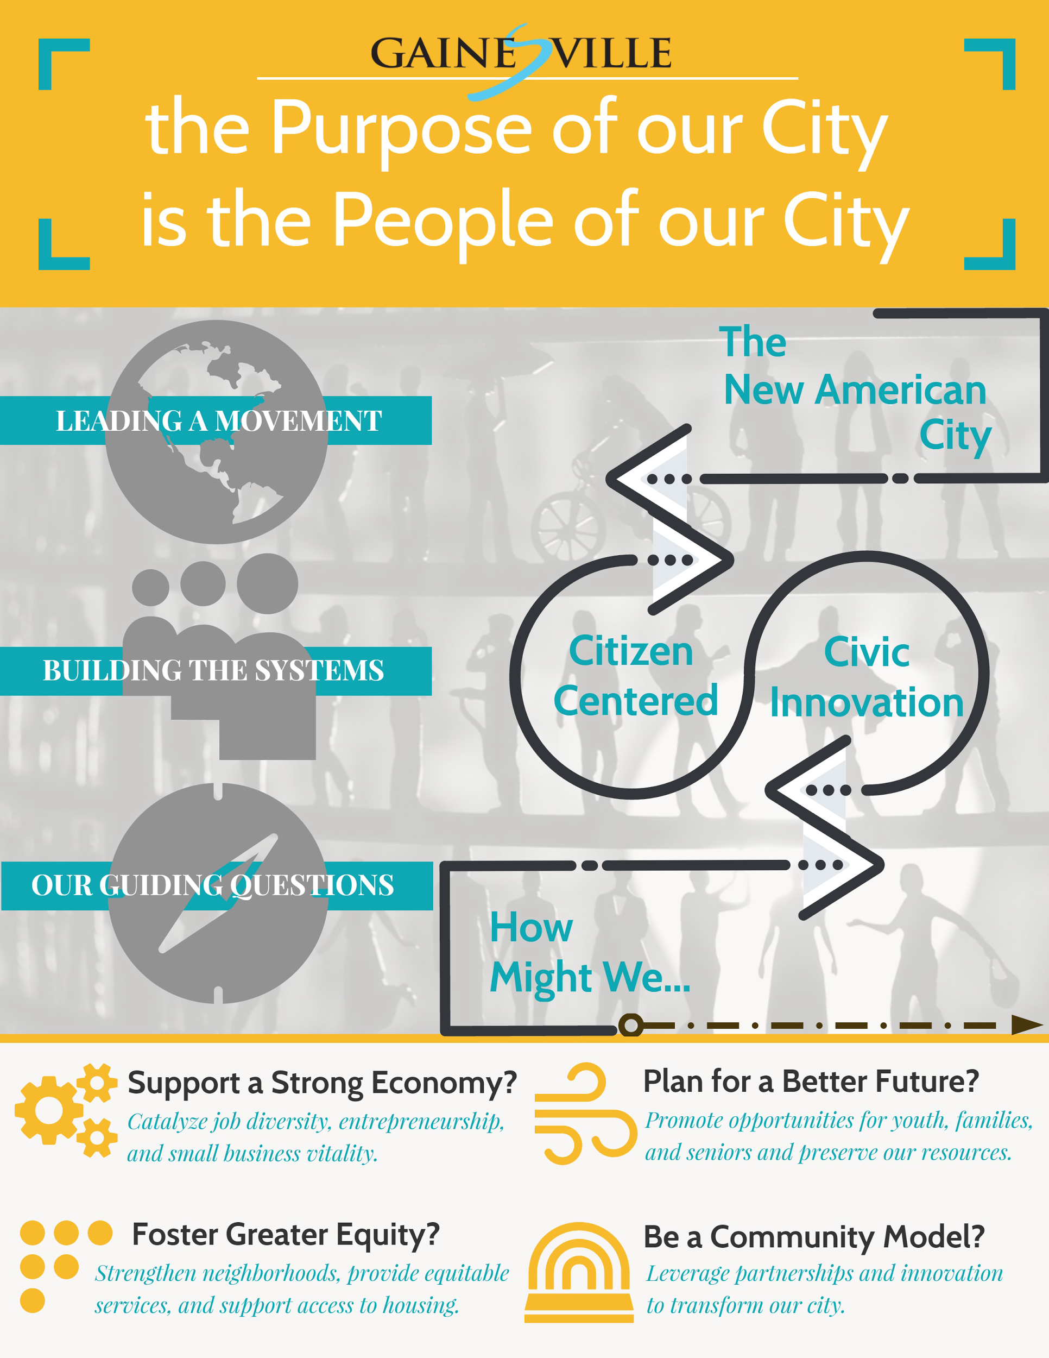
Notes:
Discuss 4 main areas of focus, including building a strong economy; equity in services, future planning and becoming a model community

Slide 13
How can we solve old problems with a new approach?
Notes:
Instead, how can we approach big challenges differently, so positive change is evident in the lives of our citizens?
As an organization, we are learning how to re-create what we do around our citizens’ experiences, to incorporate the human element into developing and changing government programs and services.
We are learning to observe and experiment with new ideas, and to fail and quickly try again.

Slide 14
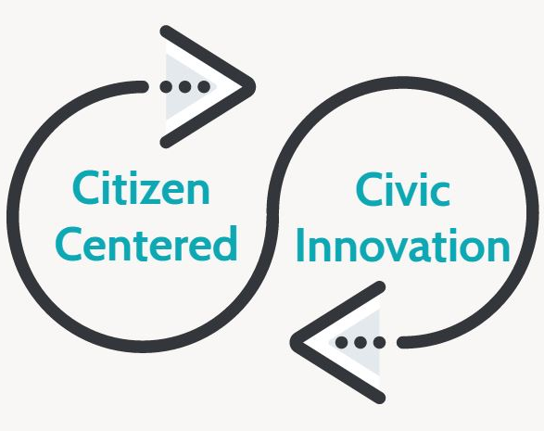
Building the Systems
We will help, guide, and celebrate our citizens.
We will leverage partnerships to design solutions for our greatest challenges.
Notes:
As stated by our partner, the University of Florida, who is concurrently developing big ideas to guide their strategic redevelopment
Preeminence...

Slide 15
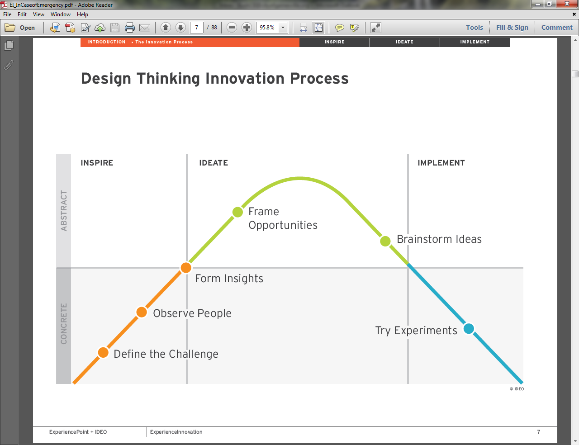
Citizen-Centered Approach
We will help, guide and celebrate our citizens
Our Front Doors
  Website Usability Study
  Mobile City Hall
  Thomas Center Redesign
The Talent to Win
  Strategic Initiatives Department
  Department of Doing

Slide 16
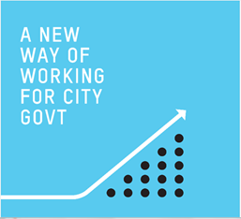
Civic
Innovation
Collaborative Planning
  Giving structure to collaboration
Volunteer Corps
  People helping people
Fellowship Programs
  Information leading action
Smart Cities Lab
  A living laboratory
Notes:
Collaborative Planning: UF: $250,000 to fund local research: Potential issues include, Access to Housing, Cooperative Business Ownership, Neighborhood Vitality Index, Urban Growth and Business Development
Volunteer Corps: Opportunities to leverage student, faculty and staff engagement; Joining the Cities of Service Coalition provides access to AmeriCorps VISTAs, plans to develop a volunteerism Website
Fellowships: Research, Internships, etc.
Example: Graham Center Fellowship; Opportunity to replicate across 16 Colleges
Smart Cities Lab: City, University of Florida & Florida Department of Transportation have a joint initiative to test autonomous vehicles and connected infrastructure
Advanced Computing & Information Systems (ACIS) Lab, Smart University Town Conference
Anthony Lyons appointed to a Global Smart Cities Connect Advisory Board

Slide 17

Department
of Doing

Slide 18
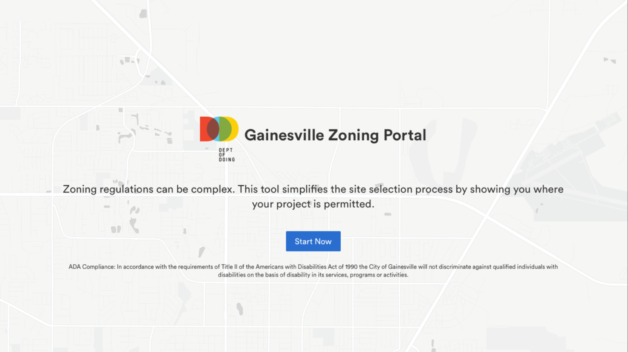
Teams
Technology
TC-B
Open Counter

Slide 19
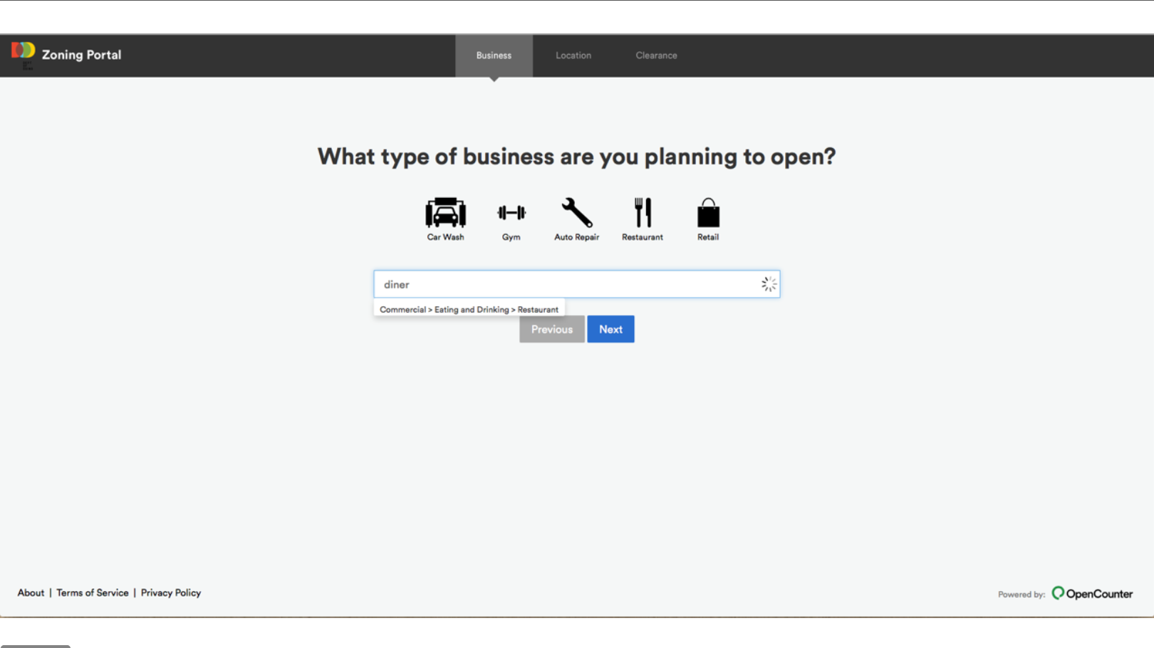

Slide 20
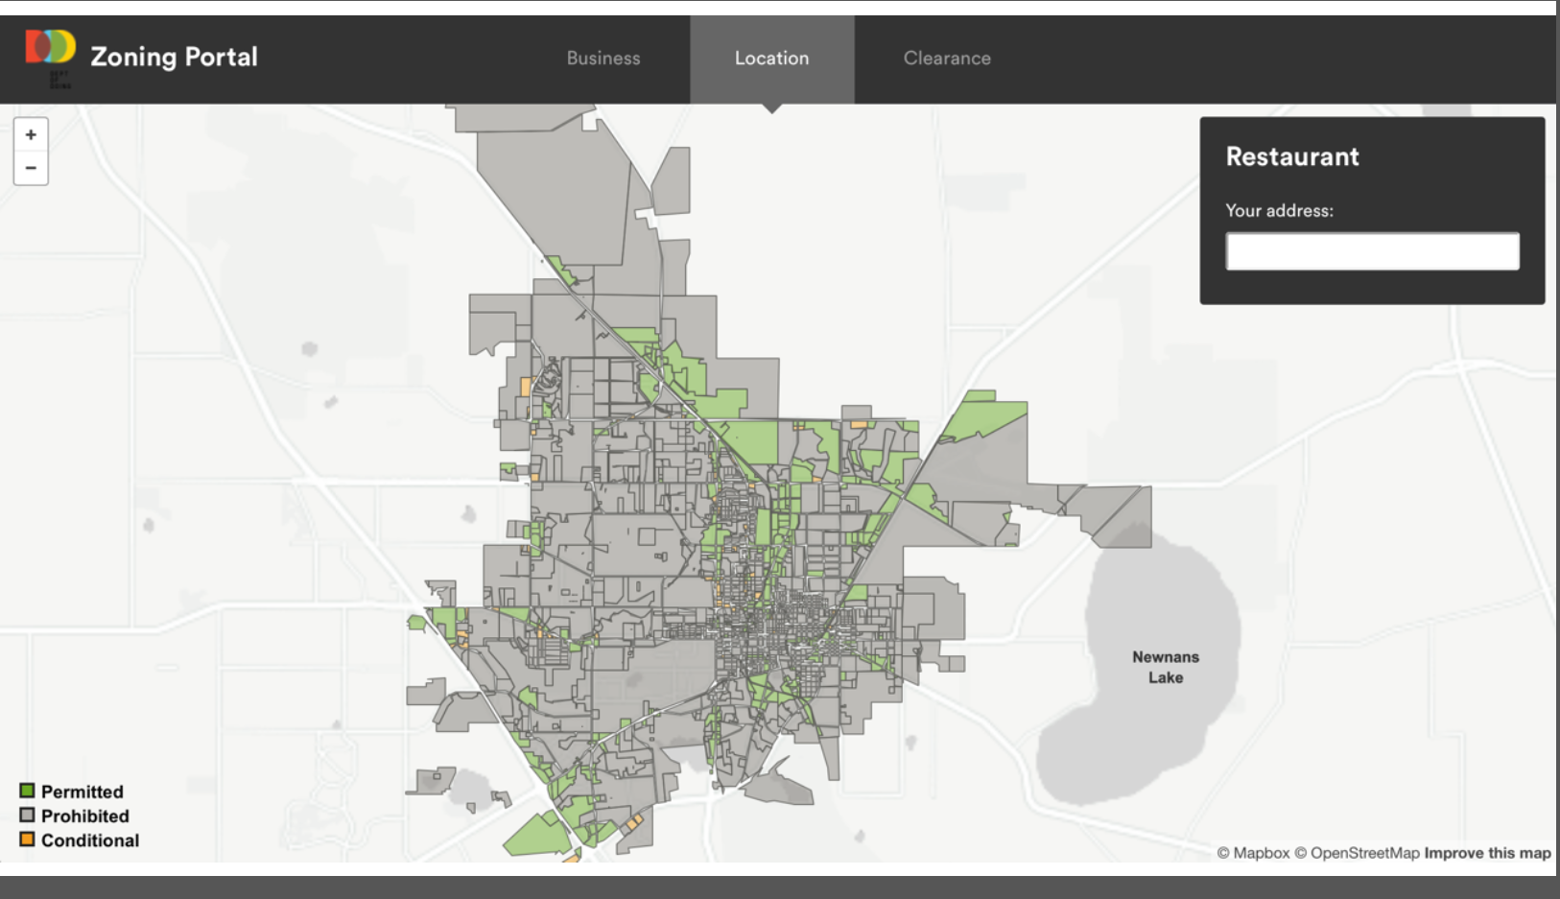

Slide 21
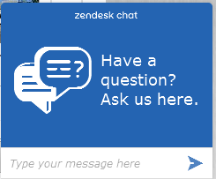
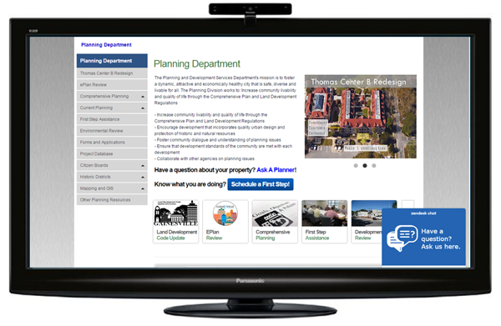
Chat with
a Planner

Slide 22

Project Dox

Slide 23
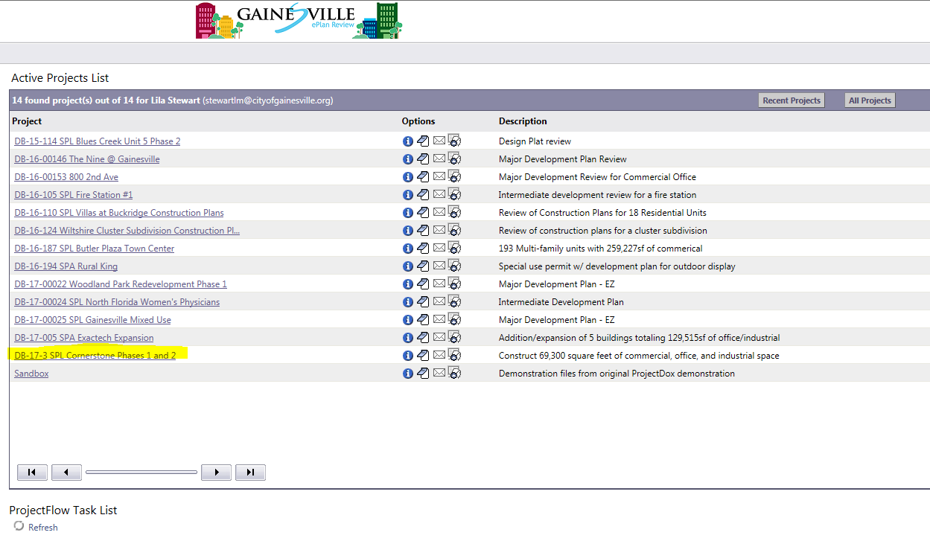

Slide 24
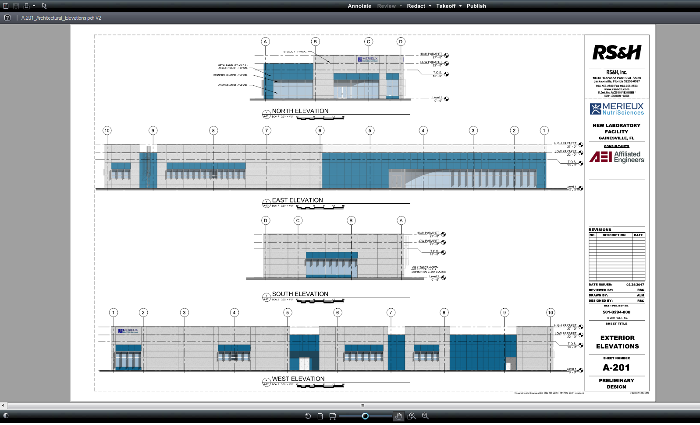

Slide 25
HOW DO WE DO THIS?
With Community Partners
Notes:
Insert logs for UF, Santa Fe, Chamber of Commerce, School Board, Alachua County, UF Health, Career Source, Nonprofit and Civic Orgs
We cannot do this work alone: We all play a crucial role
Partnership slide
Career source
Santa Fe
Chamber of Commerce
Govt partners

Slide 26
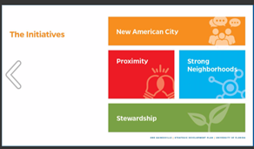
UF Strategic Development Initiatives

Slide 27
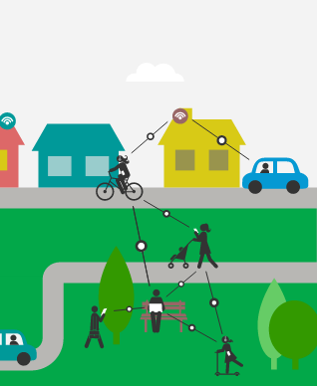
Civic
Innovation
Collaborative Planning
  University of Florida Partnership
  $250,000 Grant Funding
  Research Opportunities
    Access to Housing
    Cooperative Business Ownership
    Neighborhood Vitality Index
    Urban Growth and Business Development

Slide 28
Civic
Innovation
Volunteer Corps
  Cities of Service Coalition
  AmeriCorps VISTAs
  Volunteerism Website
  Blueprints & Service Plans
    Stormwater Mitagation
    Mentorship
    Disaster Awareness
Notes:
Storm Busters - engages volunteers to help mitigate damage from stormwater runoff and improve the health of the city's surrounding waterways by planting trees
Path Finders - engages local employers to provide volunteers to help middle school students develop career goals that will inspire them to achieve
Prepared is Protected - mobilizes knowledgeable volunteers to bolster disaster awareness and preparedness in their communities

Slide 29
Civic
Innovation
Fellowship Programs
  Graham Center Fellowship
  Strategic Initiatives Rotation
    Digital Services
    Research & Prototyping
    Communications & Engagement
    Visual Design

Slide 30
Civic
Innovation
Smart Cities Lab
  UF & Florida Department of Transportation
    Joint Initiative Announcement
    Autonomous Vehicles Testing
  Advanced Computing & Information Systems (ACIS) Lab
    National Science Foundation Grant
    Urban Informatics
    Smart University Town Conference
  Smart Cities Advisory Board
    City Manager Appointed

Slide 31
What inspires you?
How can you contribute?
Notes:
Talk about the scope of city services: full service local government - Fire, Policed, medical emergencies, CRA’s work in quality life in adjacent neighborhoods, Code Enforcement, Parks & Rec - Depot Park and Wild Spaces funding, Master Plan for PRCA, GRU, electric, gas and stormwater utilities
What are some of your favorite aspects of Gainesvilled? Concerts dat Bo Didyed Plaza?
Partnerships with Architecturedd/ URP/Fine Arts/IFAS
Play up the possibilities and connections

Slide 32


Thank you!

