Slide 1
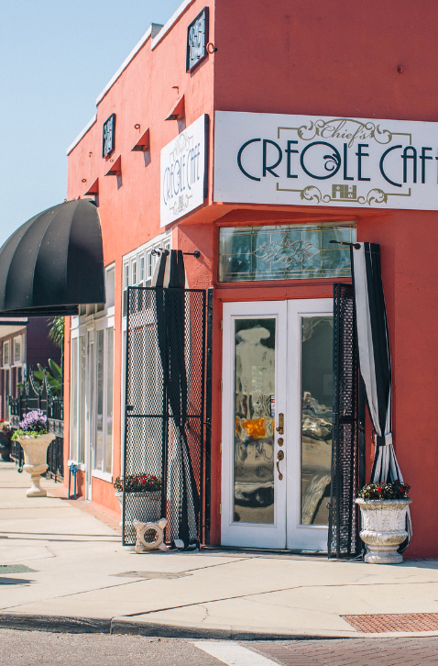
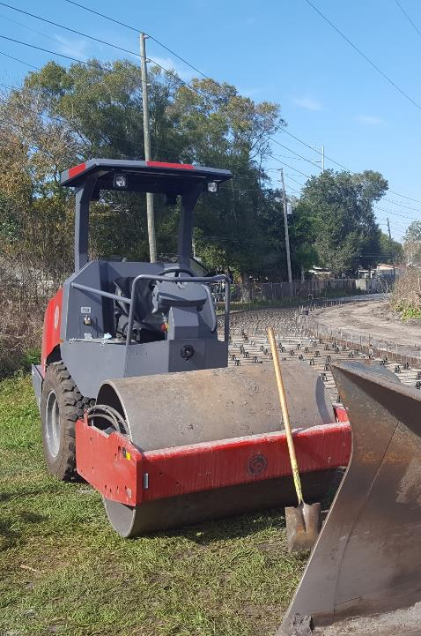
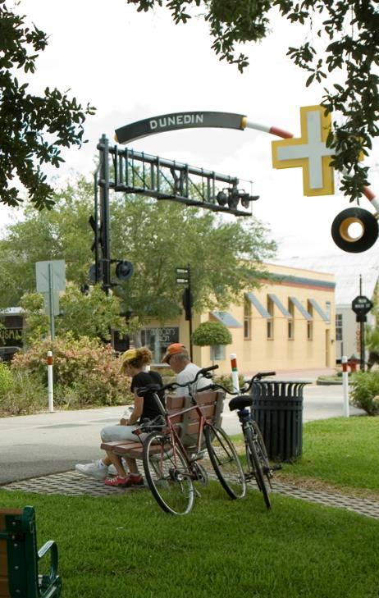
Adapt – Build – Connect
A Shared Approach for a Better Pinellas County
Whit Blanton, FAICP
Forward Pinellas

Slide 2
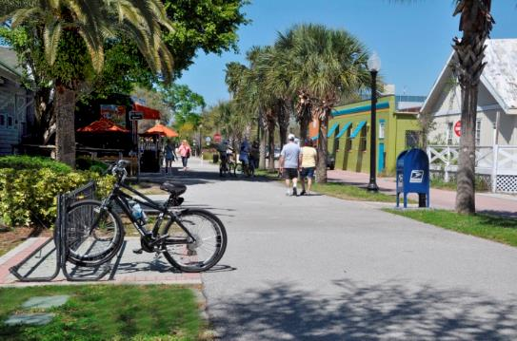
Planning Builds Public Wealth
Planning should:
  Better our neighborhoods
  Better our communities
  Better our region
Accessibility improves opportunity; planning positions us for successful outcomes
Sen. Jeff Brandes: make communities “Economical by Design”

Slide 3
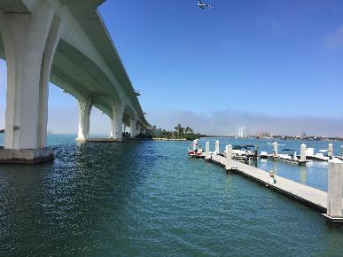
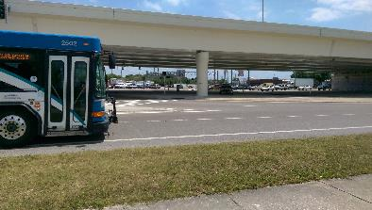
What Are We Working On?
Strategic Emphasis Areas
Gateway/Mid-County Area Master Plan
  Pursuing funding from FDOT & local gov’t partners
  Establishing Community Working Group (with FDOT)
Enhancing Beach Community Access
  Waterborne Transportation grant program
  S.R. 60 Corridor Study
  Gulf Blvd safety/Vision Zero initiative
  West Bay Drive Complete Street transformation
A Vision for U.S. 19
  Studying U.S. 19 premium transit options
  Conducting economic/market analysis and land use studies

Slide 4
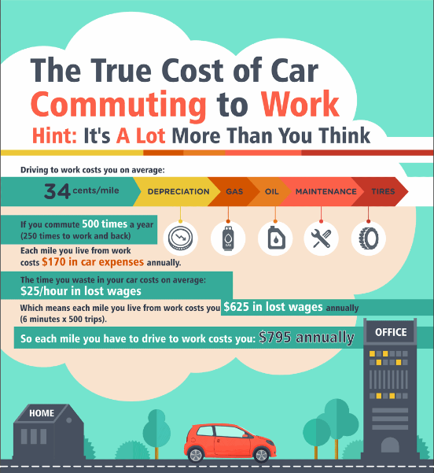
How are We Doing?
Households in Tampa Bay spend 60% of income on housing + transportation
  Pinellas County home prices jumped 14.3% in March, year-over-year
  Rents jumped 15.4%
  Minorities are hit hardest
Investing in housing + transportation gives people money to spend in other ways
Source: Investmentzen.com
Notes:
Picture is hyperlinked to the full scrollable graphic
http://www.tampabay.com/news/business/realestate/tampa-bay-home-prices-surge-again-as-demand-continues-to-dominate-supply/2273969
http://www.tampabay.com/news/business/realestate/tampa-bay-rents-are-soaring-and-hitting-minorities-the-hardest/2318748

Slide 5
Where Do We Go From Here?
Working with our partners, we identified key steps to fully tap into Pinellas County’s potential as a great community
What are we trying to do as an agency?
How does that fit into a larger multi-jurisdictional framework?
Adapt – Build – Connect

Slide 6
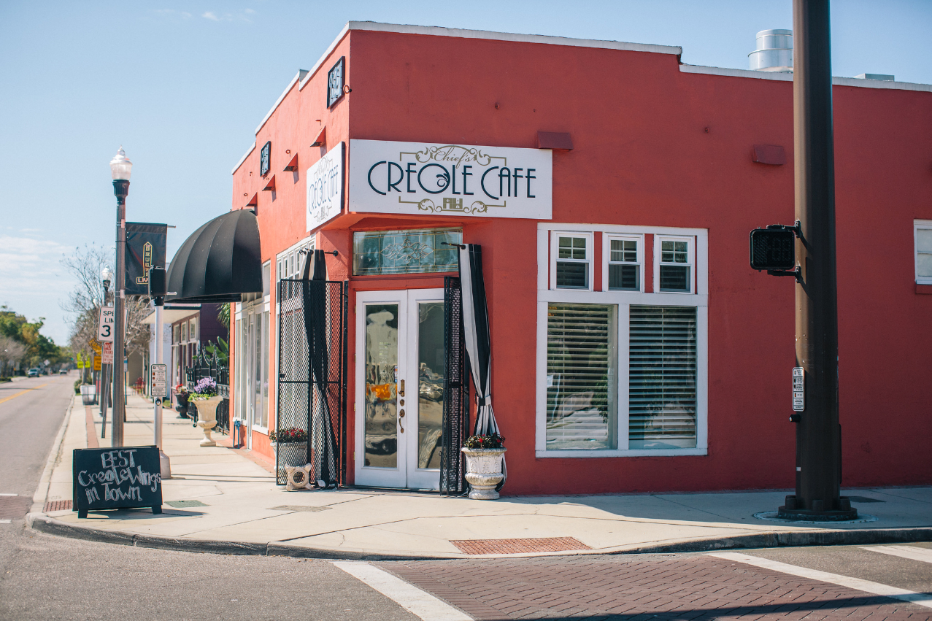
ADAPT

Slide 7
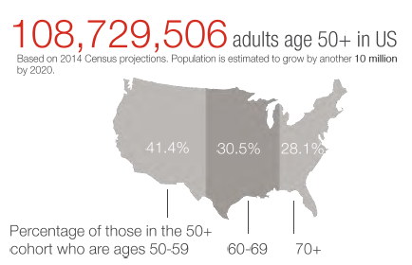
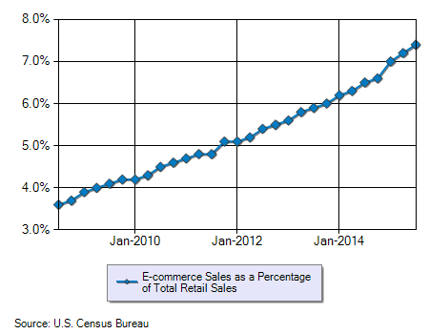
Adapt Means …
Responding to a shifting economic market
Planning for changing demographics
Recognizing vulnerability to environmental factors
Embracing technology
Understanding a changing policy environment
Source: AARP

Slide 8
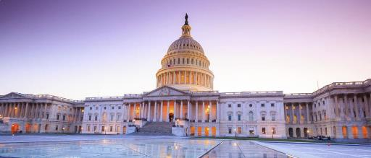
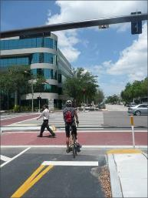
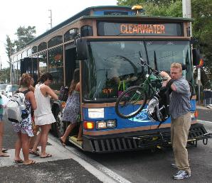
The Big Picture
We’re experiencing biggest change in the policy environment in decades
Expect a different role from the federal government
  Shift more decision-making to states
  Increased private sector investment
State and regional response
  Reinforce Florida’s support of Complete Streets policy
  Create a regional vision and funding strategy

Slide 9
Adapting Our Process
  Link land use and transportation as the avenue for innovation and strategic decisions
Forum for effective regional leadership
  Set a clear, compelling vision
  Align policies and strategies to get there
  Reinforce with a clear, predictable funding program
Performance based, outcome-driven
  Planning – identify measures, set targets and define strategies to achieve outcomes
  Design – provide standards, flexibility and incentives
  Funding – collaborate and provide clear return on investment

Slide 10
Tracking Our Progress
VISION & GOALS
OBJECTIVES
PERFORMANCE MEASURES
Set performance measures & targets
  Builds transparency
  Shows public we’re taking action
  Allows us to track our progress
First, have to ask, “what does success look like?”
PLANNING
IMPLEMENTATION
& EVALUATION
PROGRAMMING
MONITORING OUTPUTS
MONITORING OUTCOMES
ADJUSTING PROCESSES
CAPITAL PROJECTS
STRATEGIES
FUNDING MECHANISMS

Slide 11
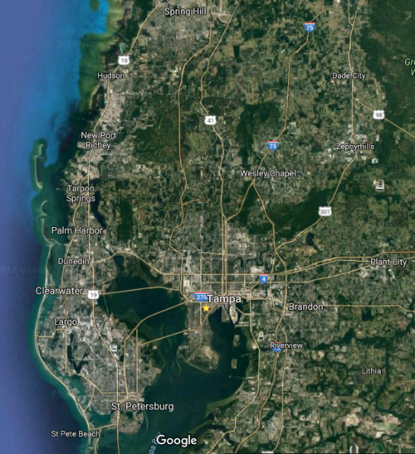
Align Decision-making
Our economic success is tied to the region
Three-tiered planning framework
  State/Region
  County
  Local
Improve resilience & travel choices linking our neighborhoods and economic centers

Slide 12
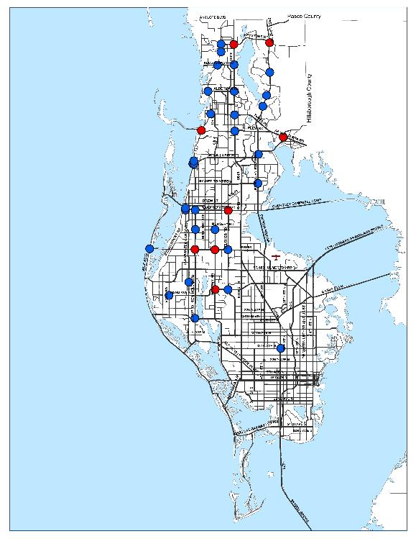
How We Must Adapt Locally
Highly developed transportation network
30+ “saturated” intersections failing mobility standards
  $5-10 million in cost for each (or more)
  Physically and financially constrained
Zero-sum set of modal outcomes
Set a target for a more balanced and connected transportation network to support growth and existing communities

Slide 13
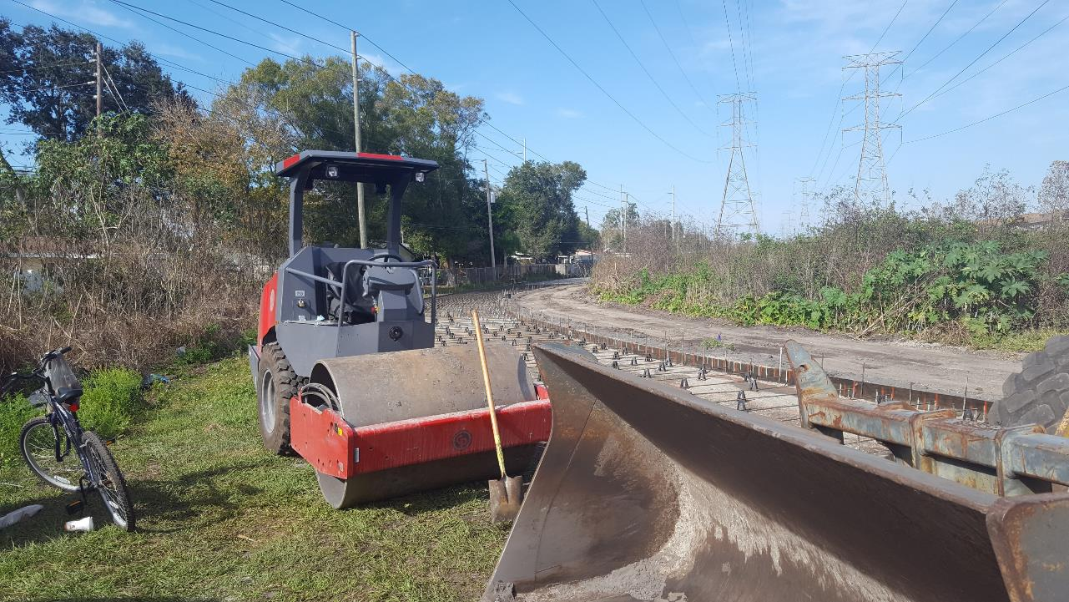
BUILD

Slide 14
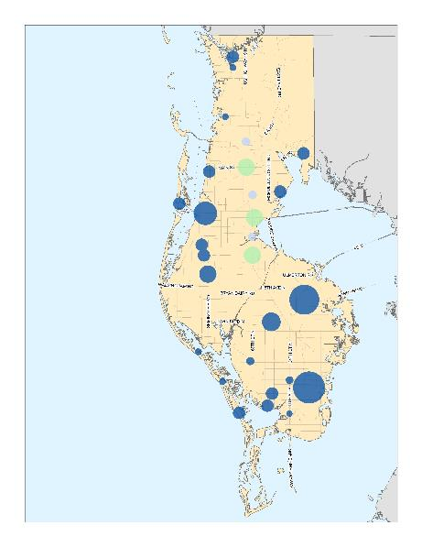
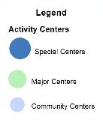
Build Means …
Guiding planned growth to right locations
  Efficient development
  Context appropriate
  Complementary needs, services and public facilities
Building community and building capacity
  Increasing engagement and understanding for wise decisions
  Holistic assessment of needs
  Providing technical assistance to broaden understanding
Building trust in the process through greater transparency
Building connected networks
Building public wealth

Slide 15
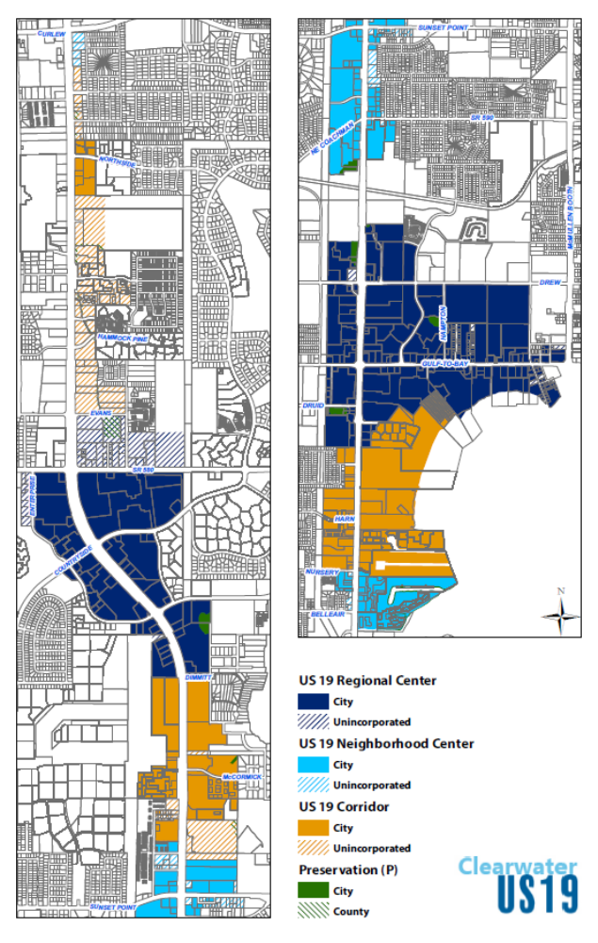
Clearwater U.S. 19 Development Standards
The City of Clearwater created its U.S. 19 Zoning District Development Standards in accordance with the Countywide Plan
Directs growth to specific areas and creates standards for development
Partners in Action Award Winner

Slide 16
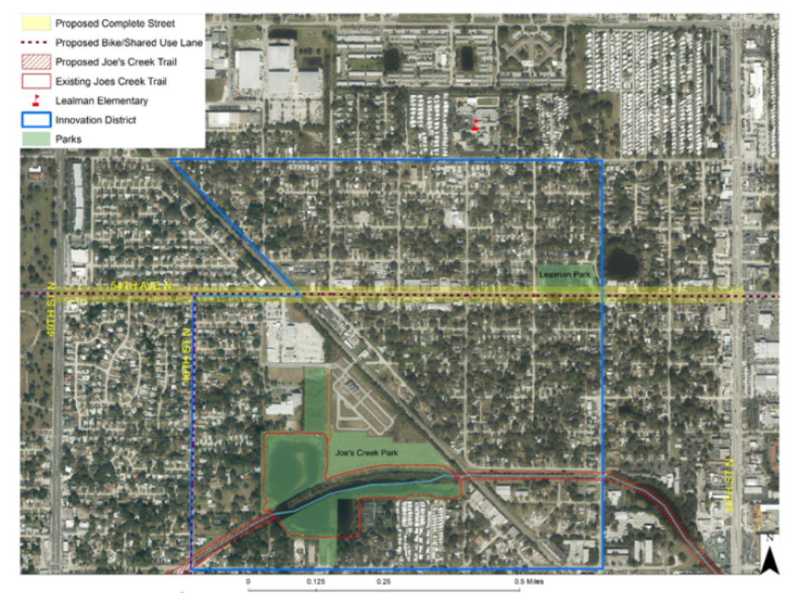
Lealman Complete Streets Concept Plan
Plan explores complete streets concepts to enhance safety and access for all modes along 54th Ave N
Provided $50K in matching funds

Slide 17
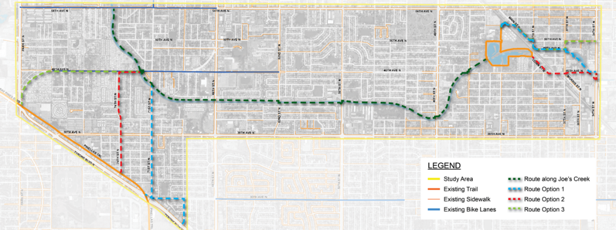
Joe’s Creek Corridor
Joe’s Creek Trail Alignment Study would establish a multimodal option in an underserved area
Link housing, services, recreation and jobs
Department of Health grant

Slide 18
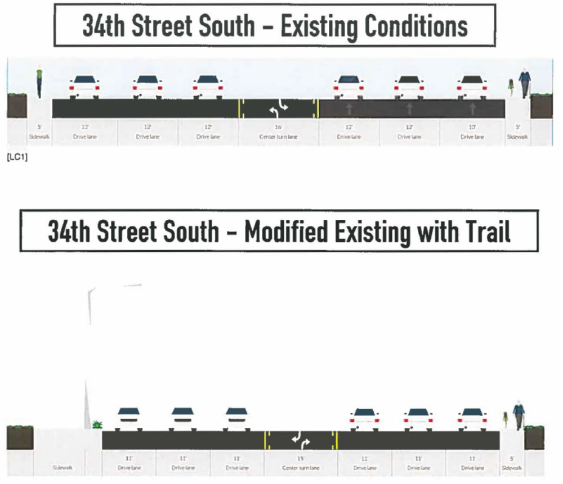
Skyway Marina District Sidewalks
Plan to construct a 10-foot sidewalk from 30th Ave S to 54th Ave S
Aligns with FDOT resurfacing Plan
Funded up to $1M
Conduct lane elimination study to assess feasibility of repurposing travel lanes on 34th St. S

Slide 19
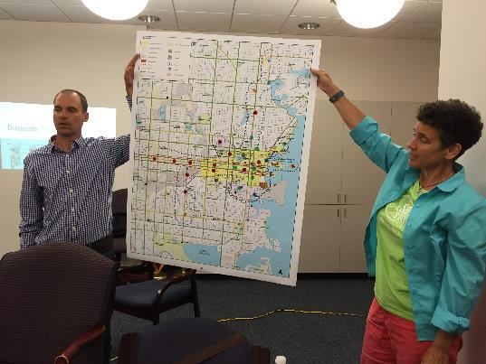
Building Trust and Buy-in
Engage in open community conversations
Coordinate with agency partners on “whole community” approach to identify needs and priorities
Present a clear and unified message
Share data, ideas, plans and resources
Meet with each local governments every year
Notes:
Blue are special centers, green are major centers, purple are community centers

Slide 20
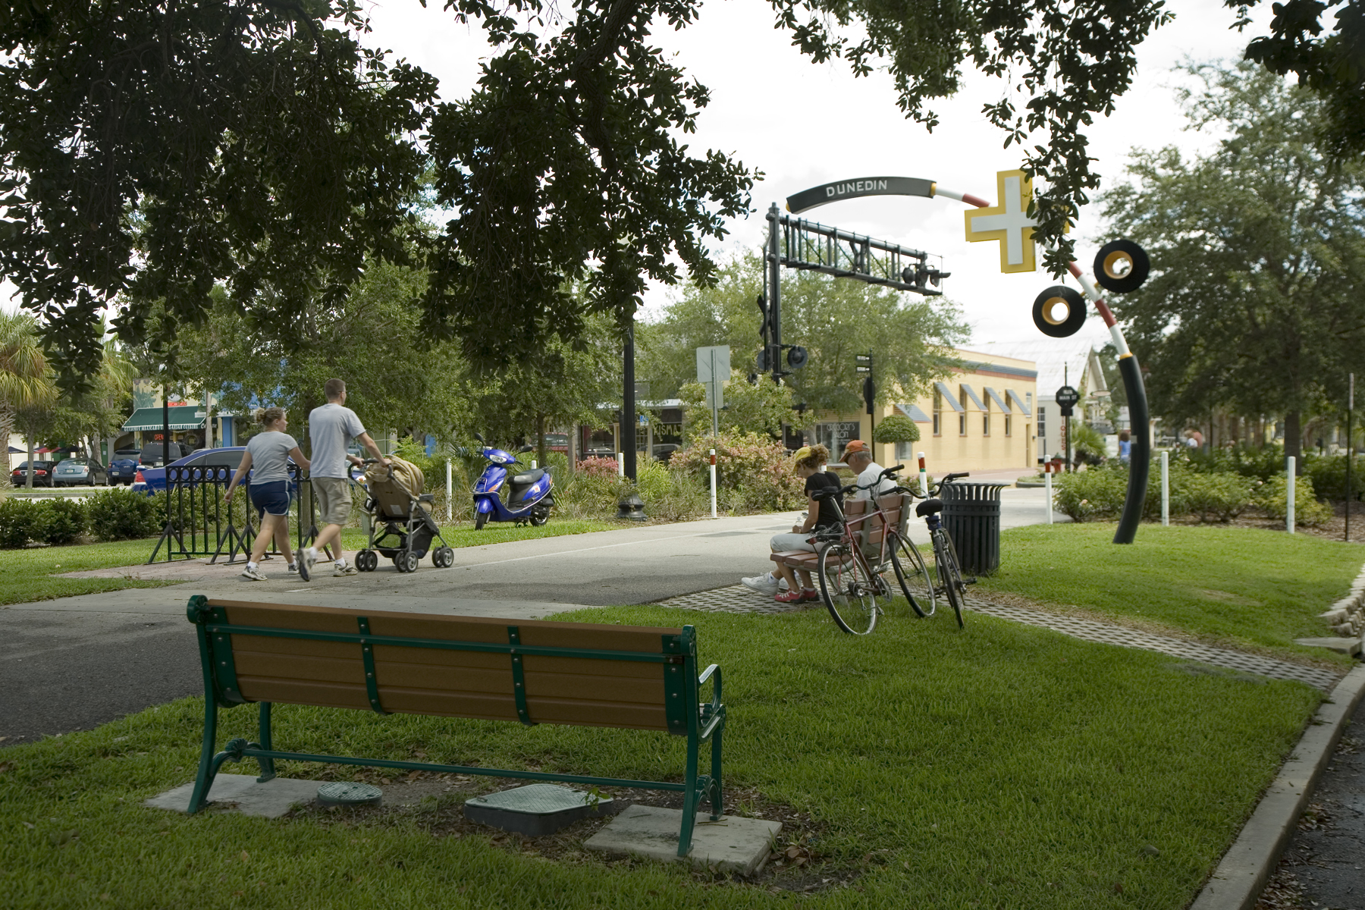
CONNECT

Slide 21
Connect Means …
Strengthen our transportation networks for all modes
  Move people and goods effectively
  Expand travel choices with viable alternatives
  Enable seamless interchange between travel modes
Work as one region to unite our communities and districts through transportation
Establish a sense of identity and enhance attachment to place
Provide avenues for productive and meaningful dialogue

Slide 22
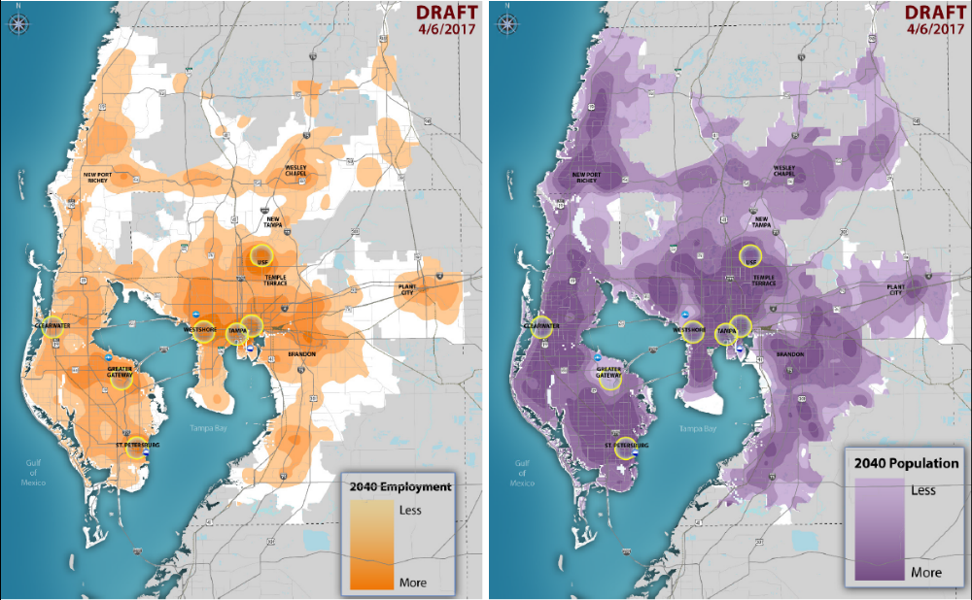
A Need for Connection
Source: Regional Transit Feasibility Plan (Jacobs Consulting)
Notes:
Maps from Regional Transit feasibility plan – Regional Activity Centers

Slide 23
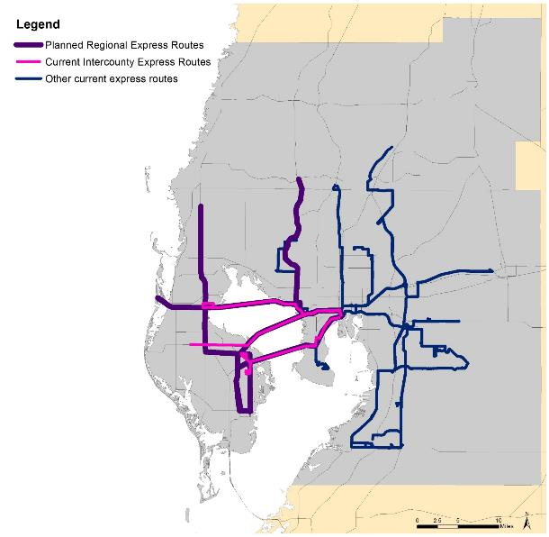
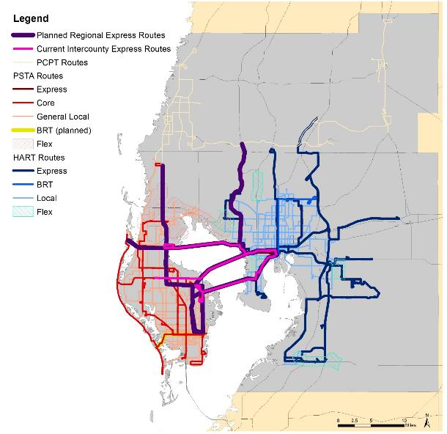
Developing Complementary Regional Transit Services
Core and Local Route Network
Current & Planned Express Routes
Notes:
Planned express route network includes modifications to existing routes to connect downtowns, Gateway, Westshore and beaches
Includes additional link to Pasco County
Additional express, or limited express, routes in Hillsborough County

Slide 24
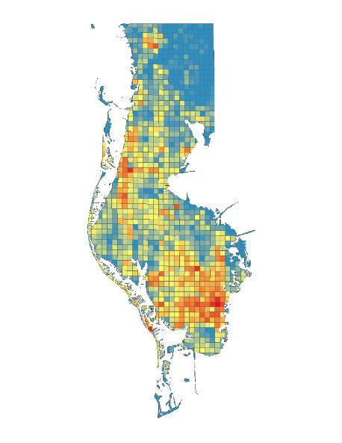
Transit Suitability Analysis
The red “hot spots” are areas in the county that are more supportive of transit
  More walkable, dense
  Close to employment
  Diverse land use
  Favorable for redevelopment
We can plan for connecting the county via transit

Slide 25
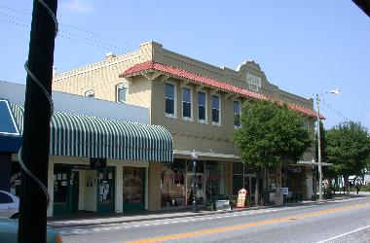
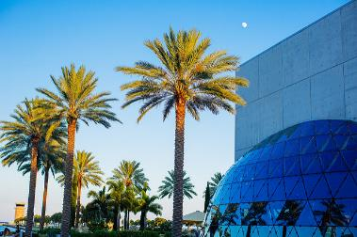
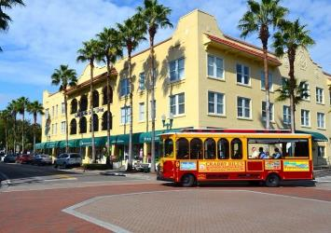
Connecting Distinctive Places

Slide 26
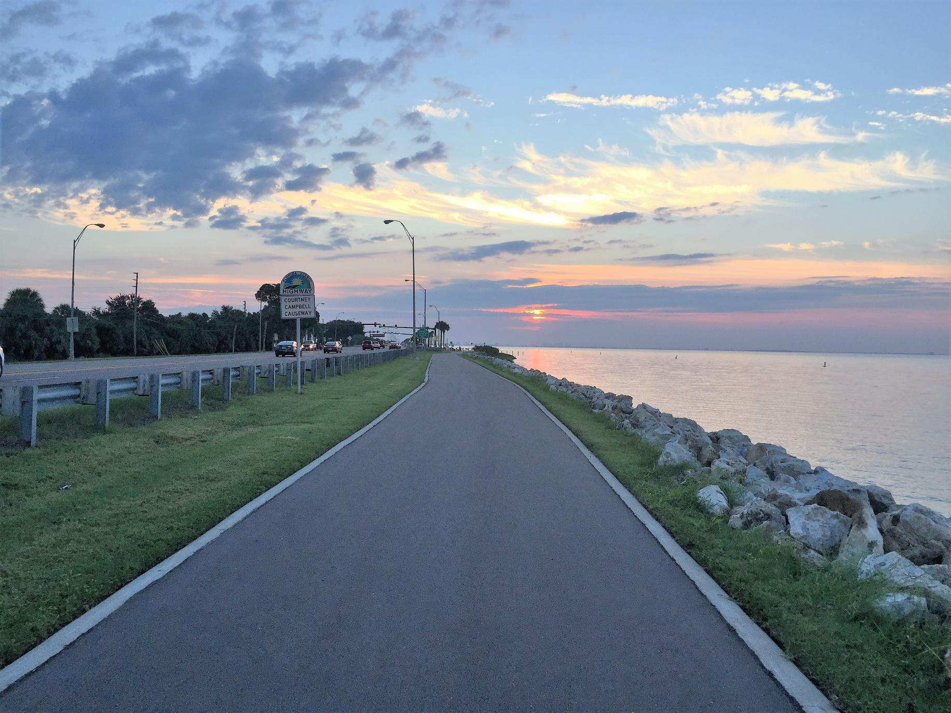
THE FUTURE

Slide 27
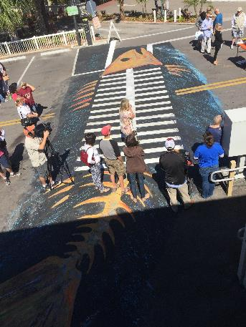
Future Direction
What makes Pinellas County unique and distinctive?
  Reflect in plans and programs
  Embody in the Long Range Transportation Plan
Reallocate space, resources and priorities to achieve the goal of a connected community
Develop strong partnerships to
  Celebrate places
  Create better travel experiences
  Increase competitiveness of modes

Slide 28
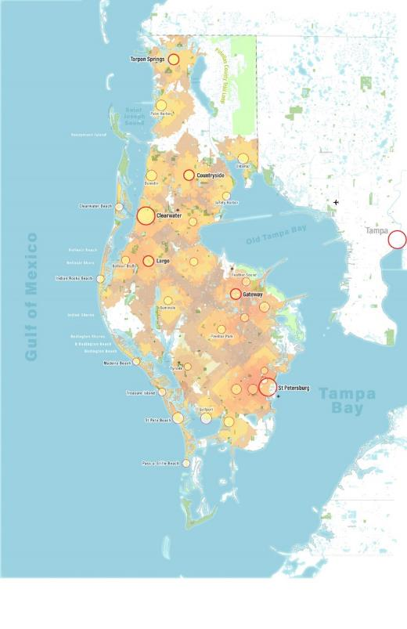
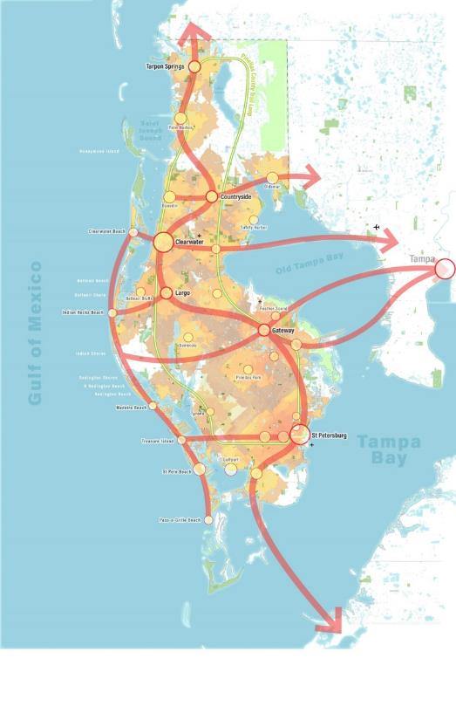
Working Vision Map
20-minute neighborhoods
Focus on accessible communities and connected networks – overcome barriers to local and regional destinations
Strategic investments supported by complementary lower-cost strategies
Retain Pinellas County’s and its communities’ unique character and culture
Notes:
Vision map routes come in on click

Slide 29
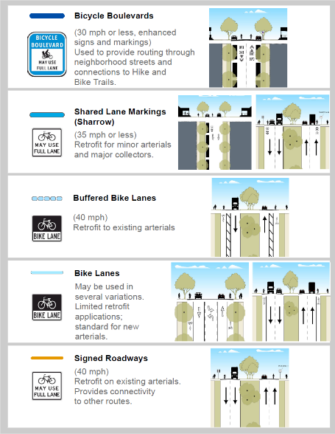
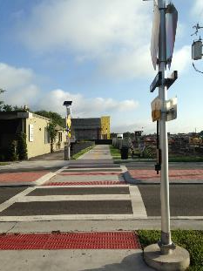
Creating a “Well Defined Network”
Access to destinations
Continuity & flow
Available capacity
Acceptable speed differential
Smooth surface
Signage and pavement markings

Slide 30
Keys to Success
Start with a vision – what’s our desired outcome?
Create a compelling, inclusive plan reflecting broad-based input
Clarify vision, missions, roles & responsibilities
Demonstrate accountability and transparency
Report progress, results and response to challenges

Slide 31
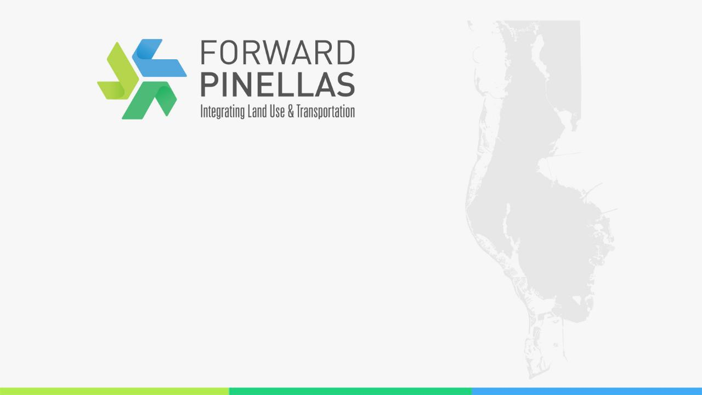
Questions / Discussion
Whit Blanton, FAICP
(727) 464-8250
forwardpinellas.org

